Slide 1

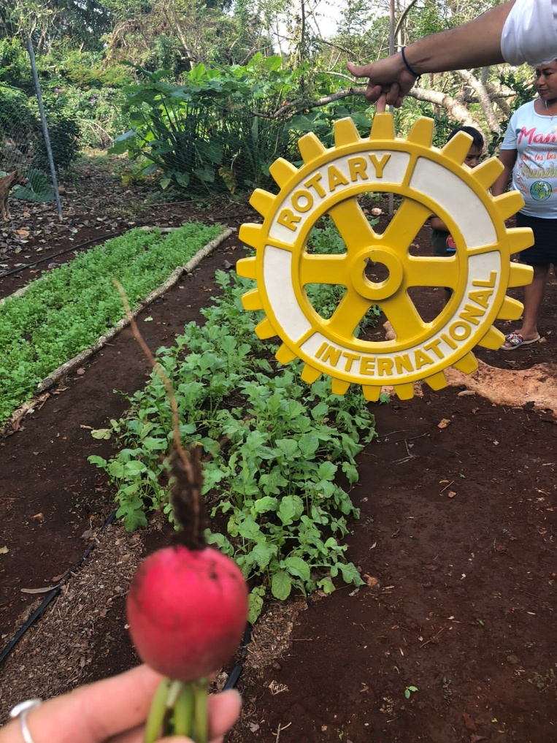

PROJECT FAIR
2025-2026
DISTRITO MÁGICO 4195
Empowered Women through Organic Gardens

Slide 2
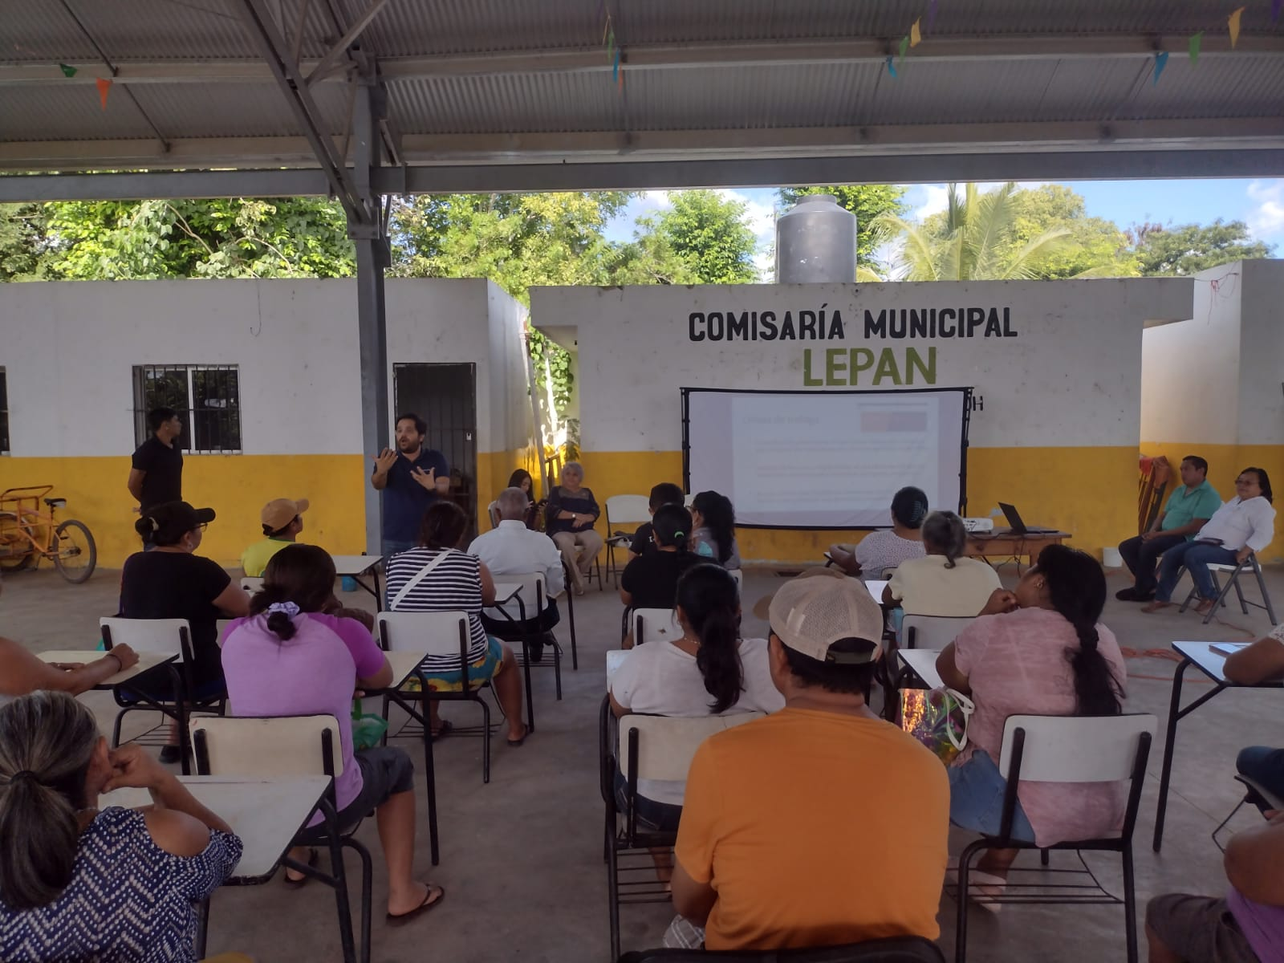
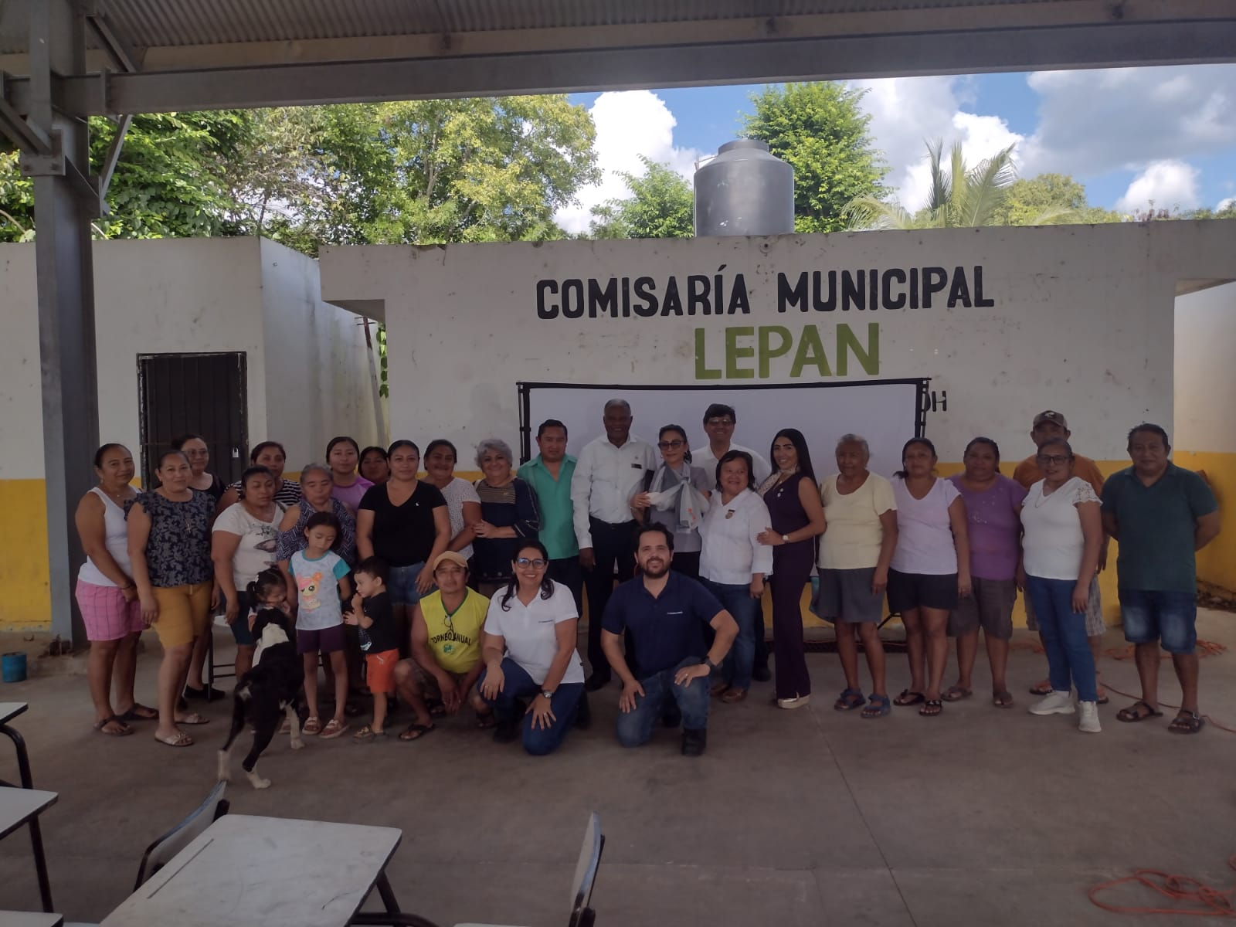
Empowered Women through Organic Gardens
PROJECT MEMBERS
Club Rotarios de Meridanas
ID: 222085
Principal Contacts:
Anavelia Estrella Carrillo: anavelia@estrellaacevedo.com
Leticia Ruiz Ocejo: leticia.ruiz.ocejo@gmail.com
Natalia Lara: : nathalia.lara@hotmail.com
PROBLEMATIC
Community Economic Development

Slide 3


Empowered Women through Organic Gardens
PROJECT PROPOSAL
Empower rural women in Lepán, Tecoh, Yucatán through training and support in the design and implementation of productive and marketing processes from the social economy approach and thereby increase the income of families in the communities.

Slide 4
Empowered Women through Organic Gardens
PROJECT BUDGET
# | Categoría* | Descripción | Proveedor | Costo en moneda local | Costo en USD
1 | Supplies | Inputs and construction for the establishment of the 5 orchards in Yucatan. | Alternativas para el Planeta | $ 487,500 | $ 25,000
2 | Trips | 30 Trips to Tecoh | GT Consultores | $ 40,950.00 | $ 2,100
3 | Equipment | Basic equipment for gardening | Alternativas para el planeta | $ 48,750.00 | $ 2,500
 | Equipment | Basic equipment for the production of value-added products | Proveedores Varios | $ 78,000.00 | $ 4,000
4 | Training | Support and training in empowerment and self-sustainability processes of social enterprises, technical assistance and marketing. In Yucatan | GT Consultores | $ 97,500.00 | $ 5,000
Presupuesto total: |  |  |  | $ 752,700.00 | $ 38,600.00

Slide 5
Empowered Women through Organic Gardens
MEASUREMENT OF OBJECTIVES
Strengthen the rights approach with gender and intercultural perspectives from the principles of social economy in community management in women's groups.
Increase and strengthen technical-productive skills for the management of backyard gardens in women.
Implement 5 backyard gardens with agroecological processes.
Develop value-added products that meet the standards for commercialization in the formal market.
Quarterly progress reports will be presented.
The indicators will be quantified based on the results and direct observations will be established.

Slide 6
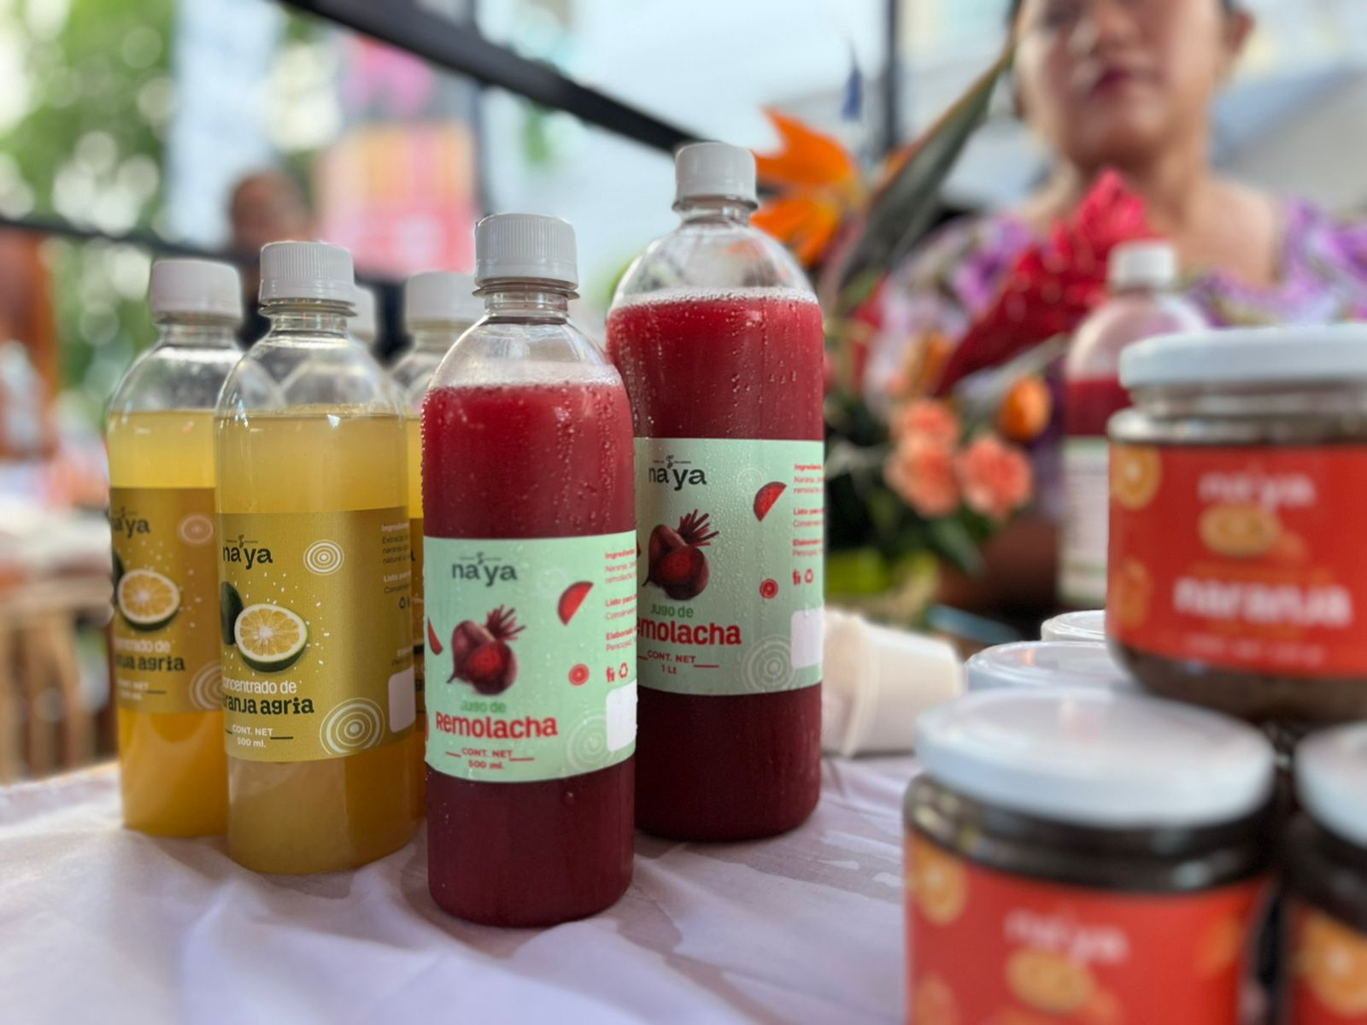
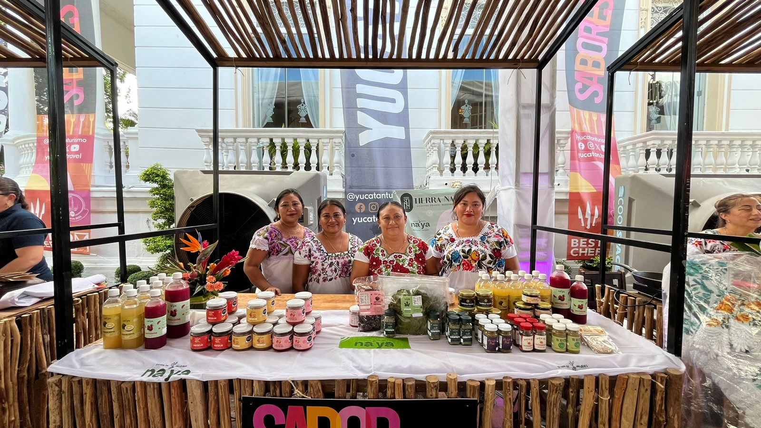
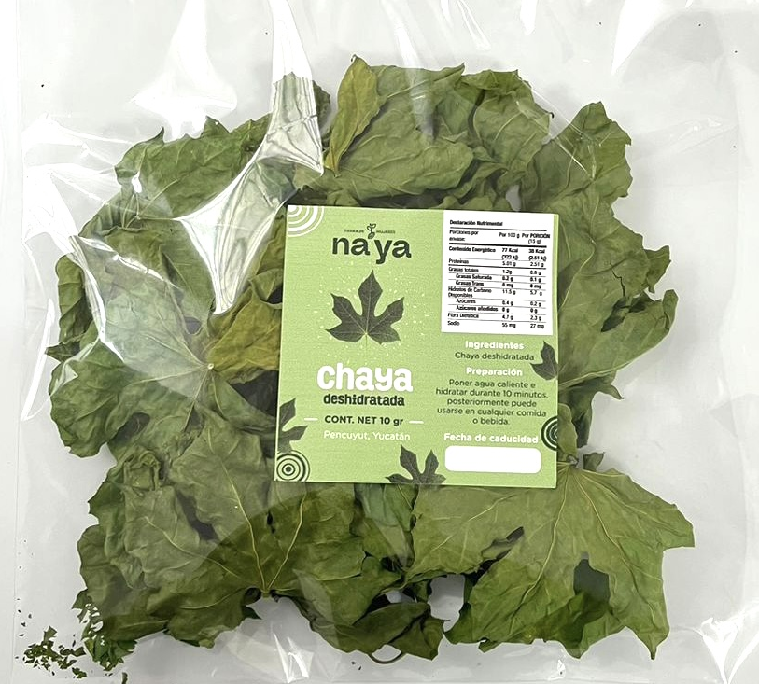
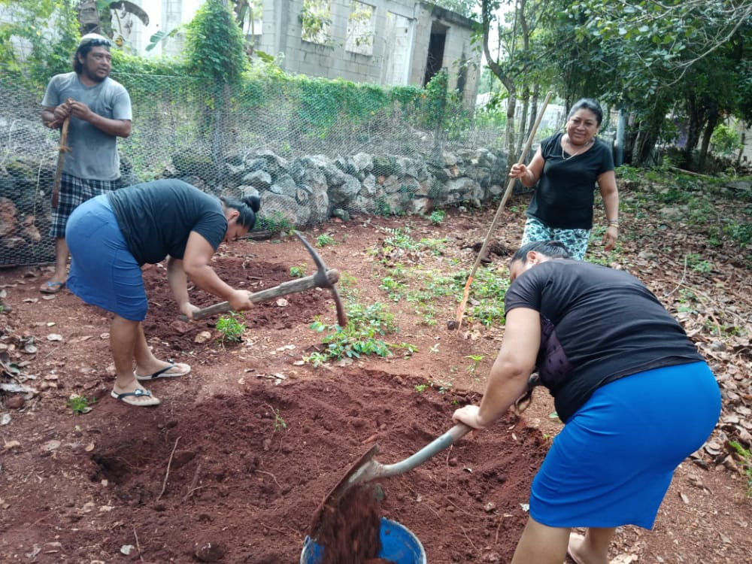
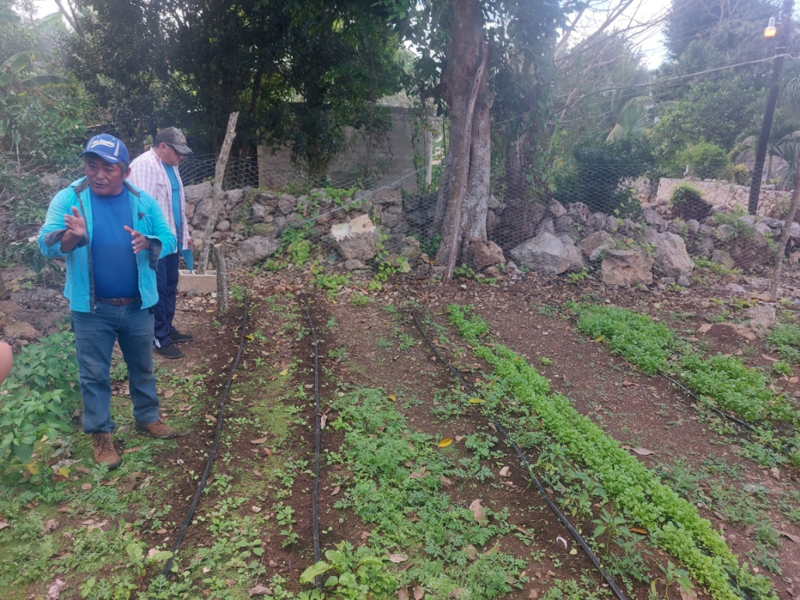
Empowered Women through Organic Gardens
OBJECTIVES

Slide 7
Empowered Women through Organic Gardens
PROJECT SUSTAINABILITY
What actions will be carried out to make it a sustainable project?
Once the 2 social companies have been created and their value-added products have been developed, the commercialization of these will give them a source of income that helps maintain and increase the results of the project in the long term.
Through the commercialization of value-added products that will be developed as part of the project.

Slide 8
PROJECT SUMMARY
Club’s Name Proyect’s Name | De Meridanas Empowered Women through Organic Garden
Place | Lepan, Tecoh, Yucatán, México
Objetiv | Empower rural women in Lepán, Tecoh, Yucatán through training and support in the design and implementation of agroecological gardens, production and marketing processes from the social economy approach and thereby increase the income of families in the communities.
Impact on Rotary Focus Areas (7 total) | Economic and Comprehensive Community Development.
Number of Beneficiaries | 50 -99
GLOBAL Grant Amount

