Slide 1


Opening of a Primary Healthcare Center and Equipping an Ambulance for Intensive Care Transfers
Zamora Industrial Club

Slide 2
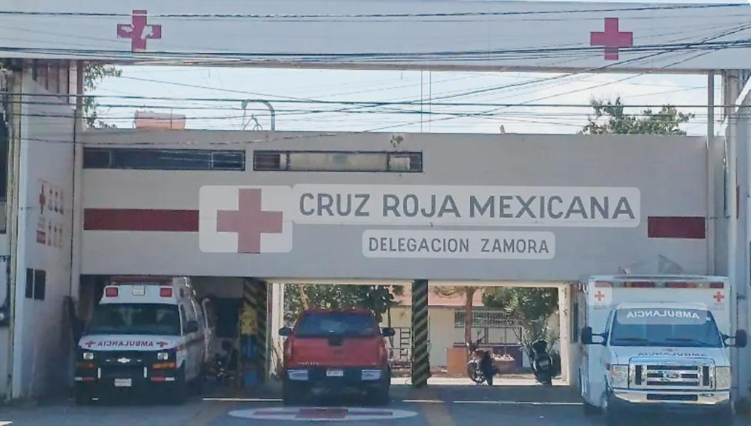
Historia / History
Red Cross of Mexico was founded in 1910 and integrated into the International Red Cross and Red Crescent Moon movement. Distinguished by its humanitarian commitment and its focus on healthcare and the well-being of people in emergency situations.
Since its inception, the Red Cross has played a fundamental role in responding to emergencies and natural disasters, providing medical assistance, rescue operations, and medications to affected populations across the country.
The Red Cross has been operating in Michoacán since the mid-20th century, providing essential healthcare services and humanitarian assistance, with a focus on the region’s most vulnerable communities.
The Red Cross branch in Zamora was formally established in the 1960s, providing pre-hospital care and community health services, becoming a benchmark for medical care in the region.

Slide 3
Identificación del Problema / Problem Identification
The municipality of Zamora de Hidalgo has approximately 204,860 inhabitants.
Only 65.2% of the population (≈ 133,000 people) are reported to have access to formal health services. Leaving 35% of the population to seek private healthcare attention at high cost or not seeking medical attention at all.
In 2024 the Secretaría de Salud de Michoacán (SSM) recorded 18,479 ambulance/prehospital service requests originating in Zamora – among the highest in the state.
Within the SSM’s jurisdiction, Zamora accounted for 3,716 coordinated emergency transports in recent years under advanced ambulances.
There are only 4 public health clinics, 2 Social Security Hospitals, 1 Hospital for state government employees, and 5 private Hospitals to attend to the entire population.

Slide 4
Objetivos del Proyecto / Project Objectives
Strengthen access to timely and quality primary healthcare and emergency medical services in Zamora de Hidalgo by establishing a fully equipped Primary Healthcare Center and an Intensive Care Transfer Ambulance, serving underserved populations without formal health coverage.
This project seeks to: Increase healthcare access for more than 70,000 residents currently without formal medical services.
Reduce emergency response and transfer times for critical patients requiring intensive care, by providing an advanced life-support ambulance.
Enhance community resilience through preventive health programs, early diagnosis, and improved emergency preparedness.
Promote partnerships between Rotary, the local health authorities, and the Cruz Roja Mexicana to ensure sustainable, long-term operation and maintenance of both the facility and ambulance unit.

Slide 5
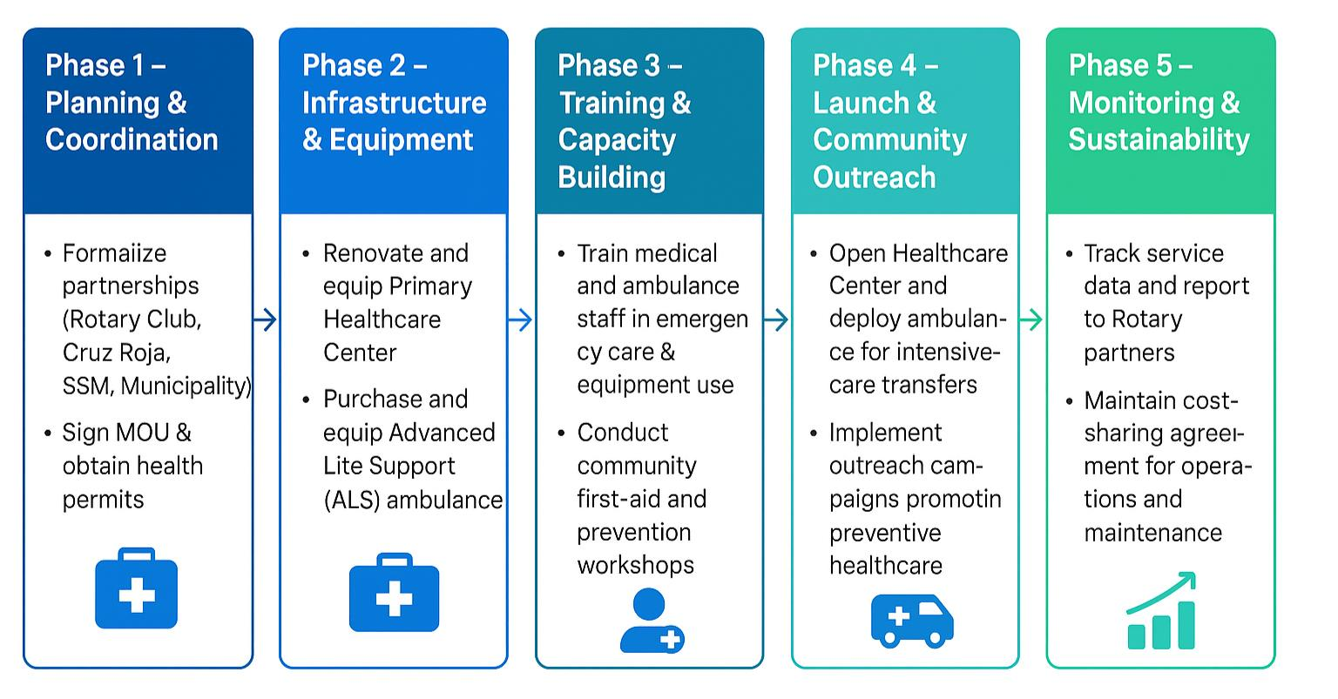
Actividades y Estrategia de Implementación / Activities and Implementation Strategy
Phase 1 – Planning & Coordination
Phase 2 - Infrastructure & Equipment
Phase 3 – Training & Capacity Building
Phase 5 – Monitoring & Sustainability
Phase 4 – Launch & Community Outreach
Formalize partnerships (Rotary Club, Red Cross & Municipality)
Renovate and equip Primary Healthcare Center
Purchase and equip Advanced Life Support (ALS) ambulance
Train medical and ambulance staff in emergency care & equipment use
Conduct community first-aid and prevention workshops
Open Healthcare Center and deploy ambulance for Intensive Care transfers.
Implement outreach campaigns promoting preventive healthcare
Track Service data and report to Rotary partners
Maintain cost sharing agreement for operations and maintenance

Slide 6
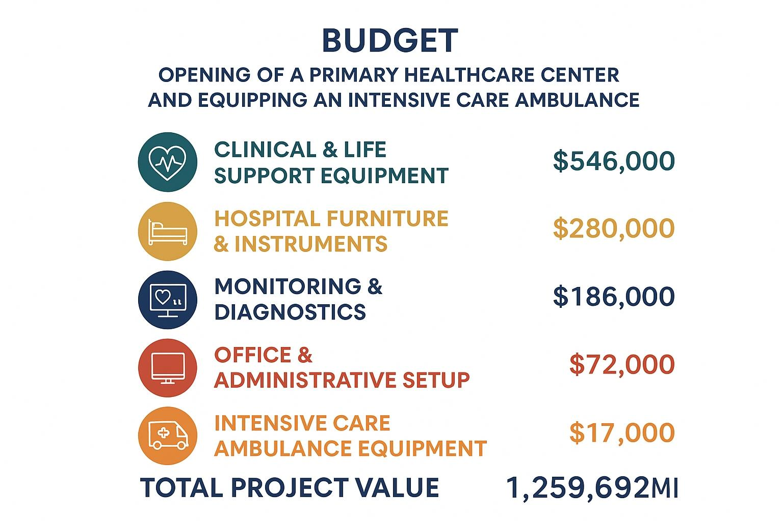
Presupuesto y Financiamiento / Budget and Funding
Suggested Budget Summary for Rotary Presentation:
Total Project Value: $1,259,692 MXN (~US$70,000)
Funding Sources:
Rotary Club of Zamora Industrial: $2,000 USD
Heart to Heart / International Partner Club: $68,000 USD

Slide 7
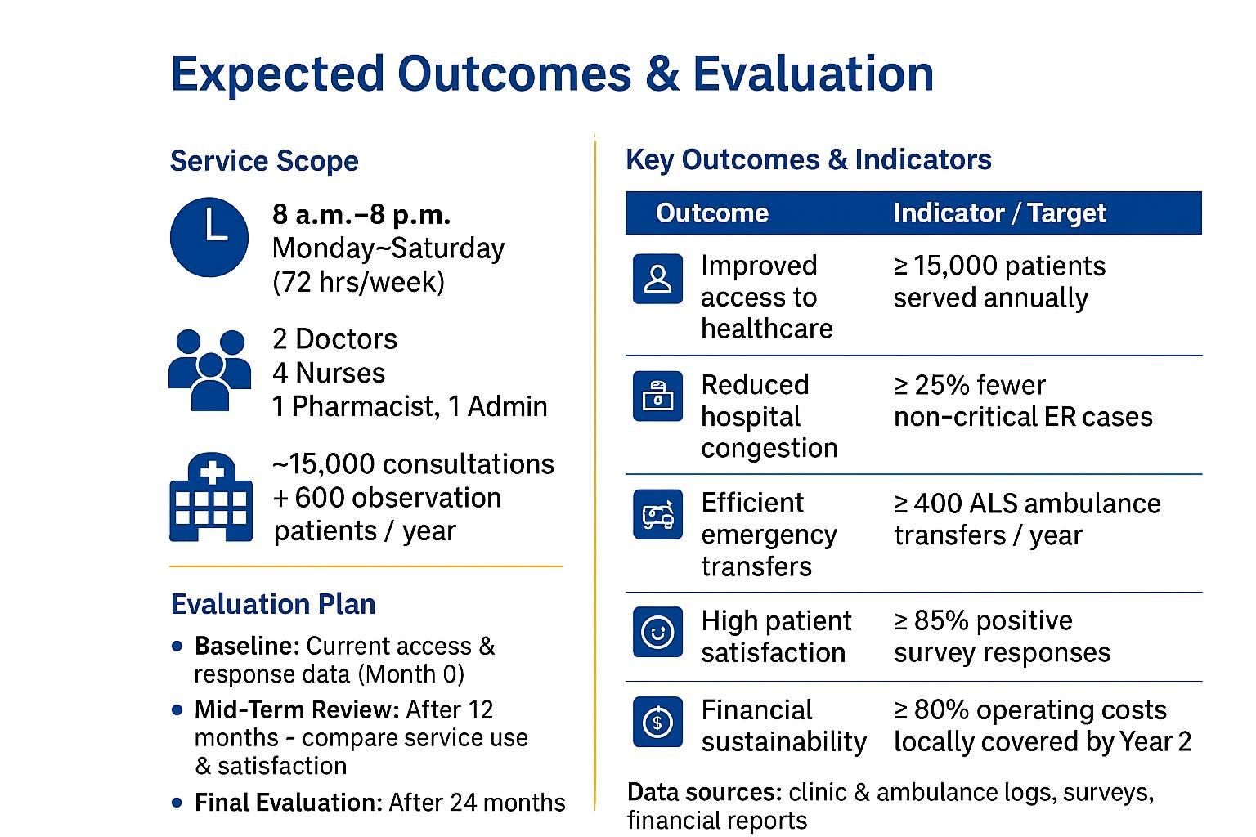
Resultados Esperados y Evaluación / Expected Outcomes and Evaluation
8:00 p.m.
Monday – Saturday
(72 hrs/wk)
2 Doctors
4 Nurses
1 Pharmacist, 1 Admin
11,000 consultations
+300 observation patients/year
Baseline (Month 0–3):
Collect data on current access gaps, hospital admissions, and ambulance response times in Zamora.
Define performance indicators with the Cruz Roja Mexicana.
Mid-Term Evaluation (Month 6):
Measure number of patients served, response times, and user satisfaction.
Assess community outreach impact and partnership efficiency.
Final Evaluation (Month 12):
Comprehensive impact analysis comparing baseline vs. current service levels.
Financial sustainability review.
Presentation of findings to Rotary International and Heart to Heart partners.
Outcome | Indicator / Target
Improved access to healthcare | > 11,000 patients served annually
Reduced hospital congestion | >5% fewer non-critical ER cases
Efficient emergency transfers | >250 ALS ambulance transfer / year
High patient satisfaction | >85% positive survey responses
Financial sustainability | >80% operating cost locally covered by end of year 1
Data Sources: clinic & ambulance logs, surveys, financial reports.
Baseline: Current access and response data.
Mid-Term Evaluation: After 6 months compare service use and satisfaction.
Final Evaluation: After 12 month see total results

Slide 8
Sostenibilidad y Cierre / Sustainability and Closing
The Red Cross - Zamora Delegation will manage day-to-day operations with Rotary oversight during the first 24 months.
Nominal service fees on consultations and ambulance transfers will support maintenance, consumables, and staff training.
The Red Cross also receives donations from other sources such as COPARMEX, large companies in Zamora and street fundraising from its members.
Annual refresher training for doctors, nurses, and EMTs ensures quality and readiness.
Rotary volunteers and partner clubs will continue preventive-health campaigns and community education.
A maintenance fund (5% of annual operating budget) will be established for equipment repair and replacement.
The Center becomes a regional reference point for primary care and emergency transfers.
Strengthened partnerships between Rotary, Cruz Roja, and SSM will expand outreach to neighboring communities and vulnerable
The new center will facilitate equitable access to healthcare services, especially for vulnerable populations such as low-income individuals, ensuring that everyone has the opportunity to receive medical care regardless of their economic situation.
With this project, we strive to achieve our Rotary’s mission: “United to Do Good – Unidos para Hacer el Bien.”

