Slide 1


Slide 2



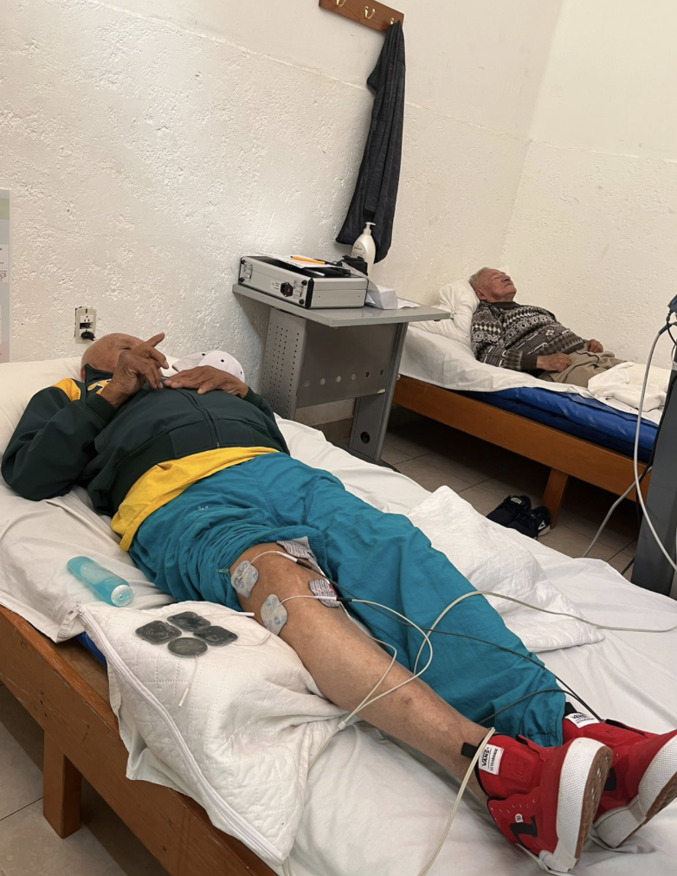
Name: Transforming Lives Through Physical Rehabilitation — Caritas Puebla
Topic: Disease Prevention and Treatment

Slide 3

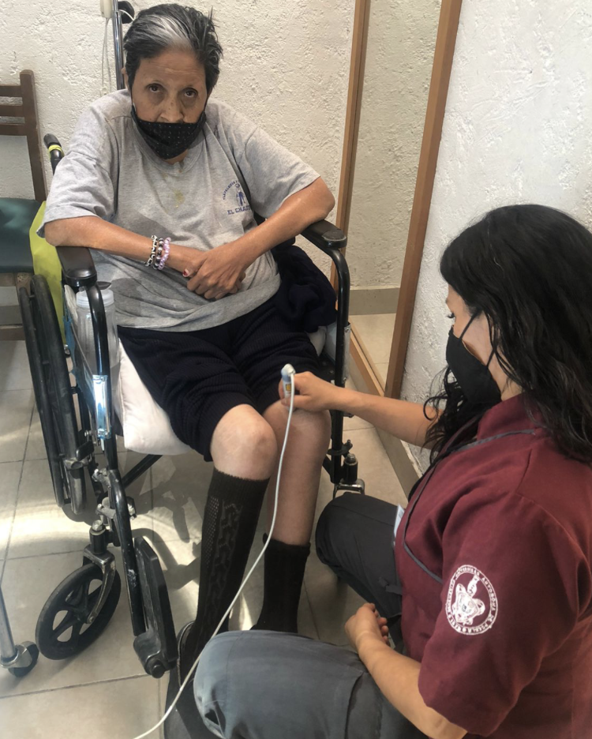
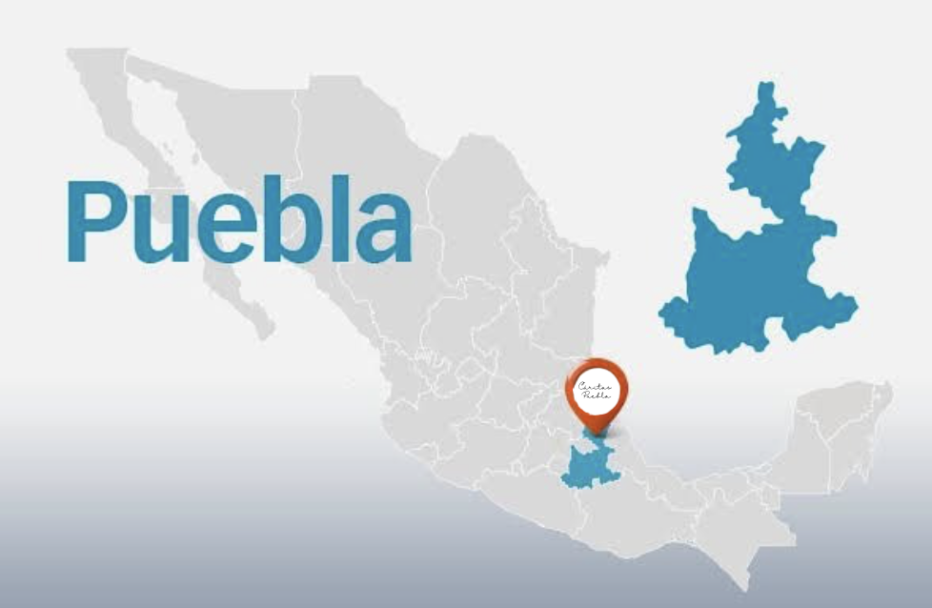
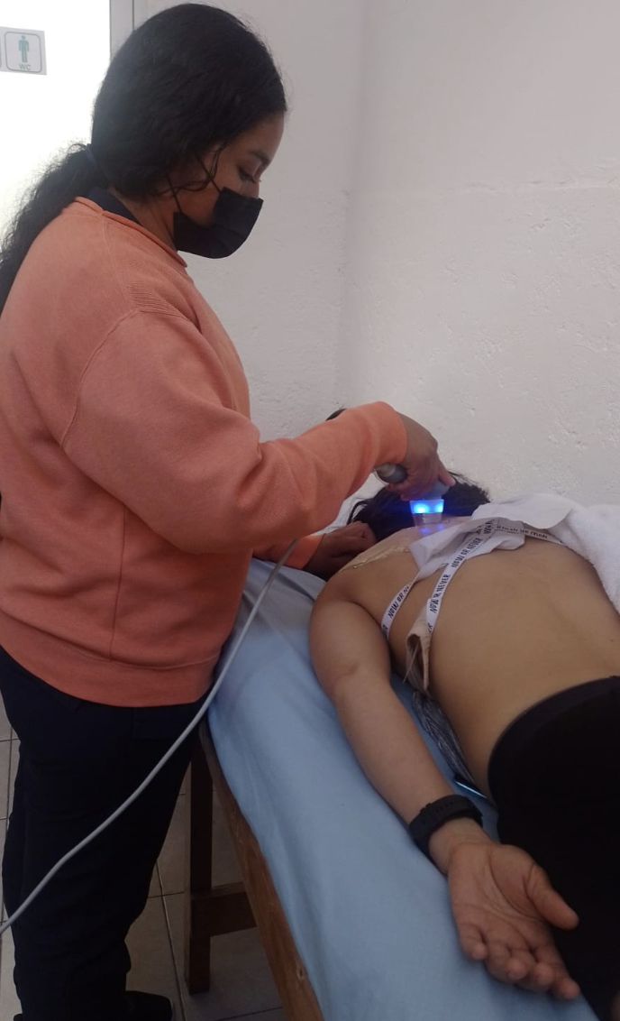
GENERAL INFORMATION
15.4% of the population lives with some form of disability.
46.4% require physical therapy or rehabilitation services (470,000 people).

Slide 4

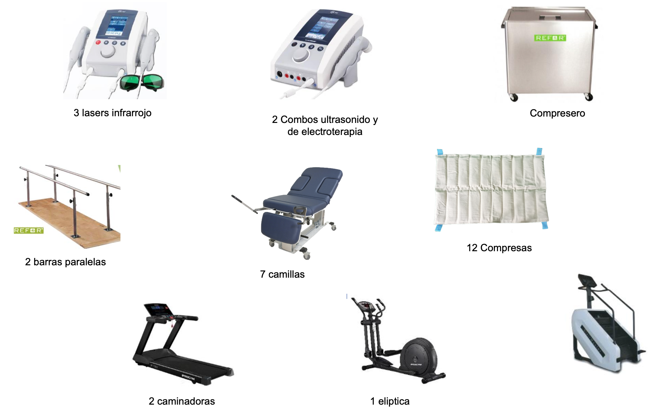
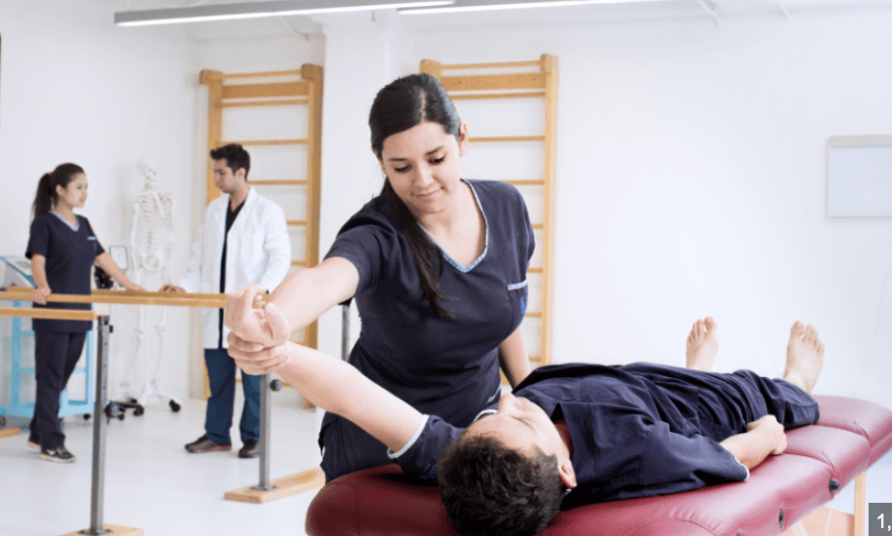

SUSTAINABILITY
Long-Term
Train three professionals
Maintenance and
Operation
19 specialized
therapeutic devices
Minimal cost-recovery fees ensure long-term sustainability.
Short-Term

Slide 5

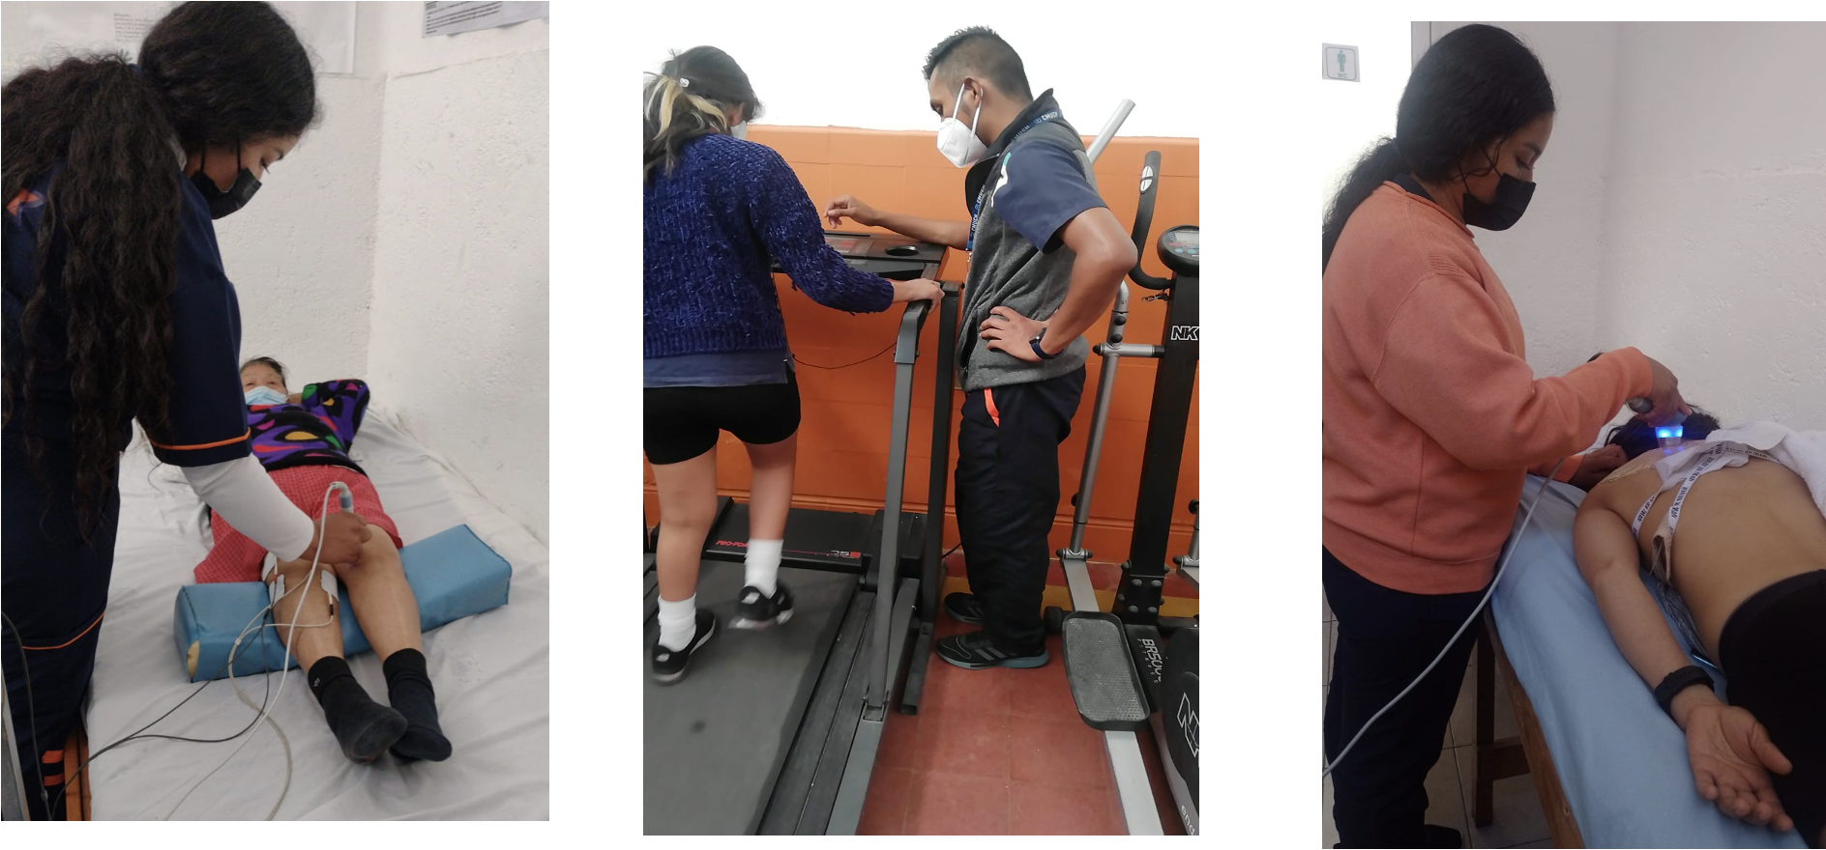
IMPACT AND BENEFICIARIES
Currently:
3,500 therapy sessions
With the project:
7,804 therapy sessions
100%
3,500 t

Slide 6

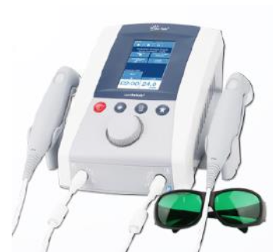
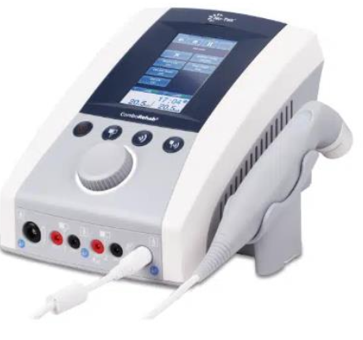
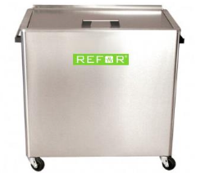
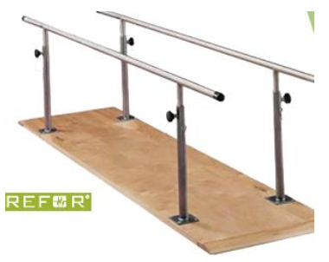
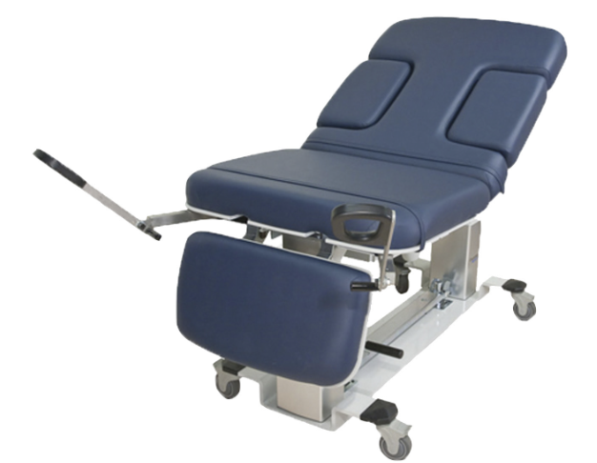
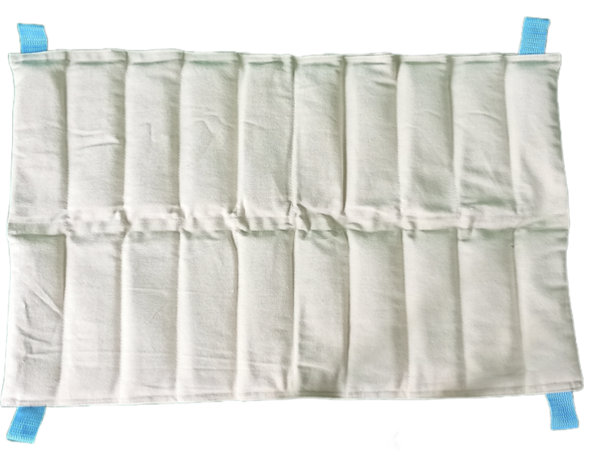
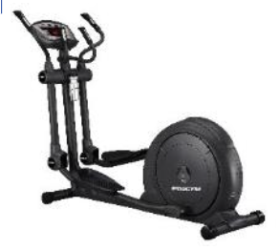
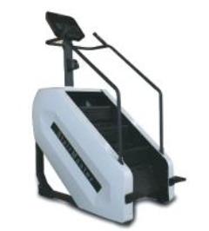
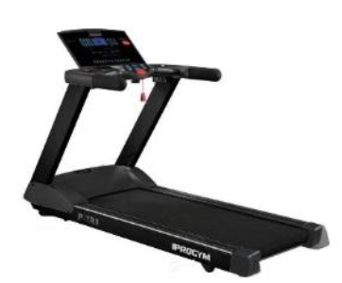
3 lasers infrarrojo
2 Combos ultrasonido y de electroterapia
Compresero
COST OF PROJECT:
$54,055.35 USD
12 Compresas
2 barras paralelas
7 camillas
2 caminadoras
1 eliptica
1 escaladora

Slide 7

FUNDS
DONANTE | Aporte Club (Cash) | Aporte Distrital (FDD) | Match (80% FDD) + 5% Cash Fee | Total Aportado
Club Rotario Puebla Campestre Real (Cash) | $5,400.00 |  |  | $5,400.00
Club Rotario de San Nicolás de los Garza Nuevo León (Cash) | $3,000.00 |  |  | $3,000.00
Distrito Internacional MEXICO--(4130) |  | $5,000.00 | $4,000.00 | $9,000.00
Club Rotario Juárez Ejecutivo (Cash) | $2,000.00 |  |  | $2,000.00
Distrito Internacional MEXICO- (4110) |  | $2,000.00 | $1.600.00 | $3,600.00
Totales Generales | $10,400.00 | $7,000.00 | $5,600.00 | $23,000.00

Slide 8

CONTACT INFORMATION
Contacto 1: Beatriz Gómez
Correo electrónico: betygomezv33@gmail.com
Télefono / Whatsapp: +52 221 165 1715
Contacto 2: Adriana Medina McQuade
Correo electrónico: adrianamquade@yahoo.com
Télefono / Whatsapp: +52 222 260 0800
Contacto 3: Guadalupe Jiménez Castillo
Correo electrónico: lupyjim2812@hotmail.com
Télefono / Whatsapp: +52 222 430 1656
Cargo: Presidenta electa 2026-2027

