Slide 1

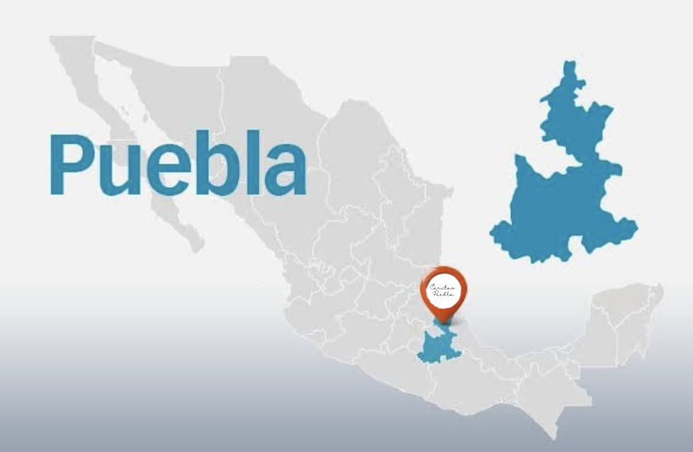
ROTARY CLUB PUEBLA CAMPESTRE REAL
“Provision of Equipment for the Cáritas Puebla Physical Rehabilitation Center”
LOCATION OF CÁRITAS PUEBLA
Calle 13 Sur 1701, Barrio de Santiago, Puebla, México, Código Postal 72410.

Slide 2
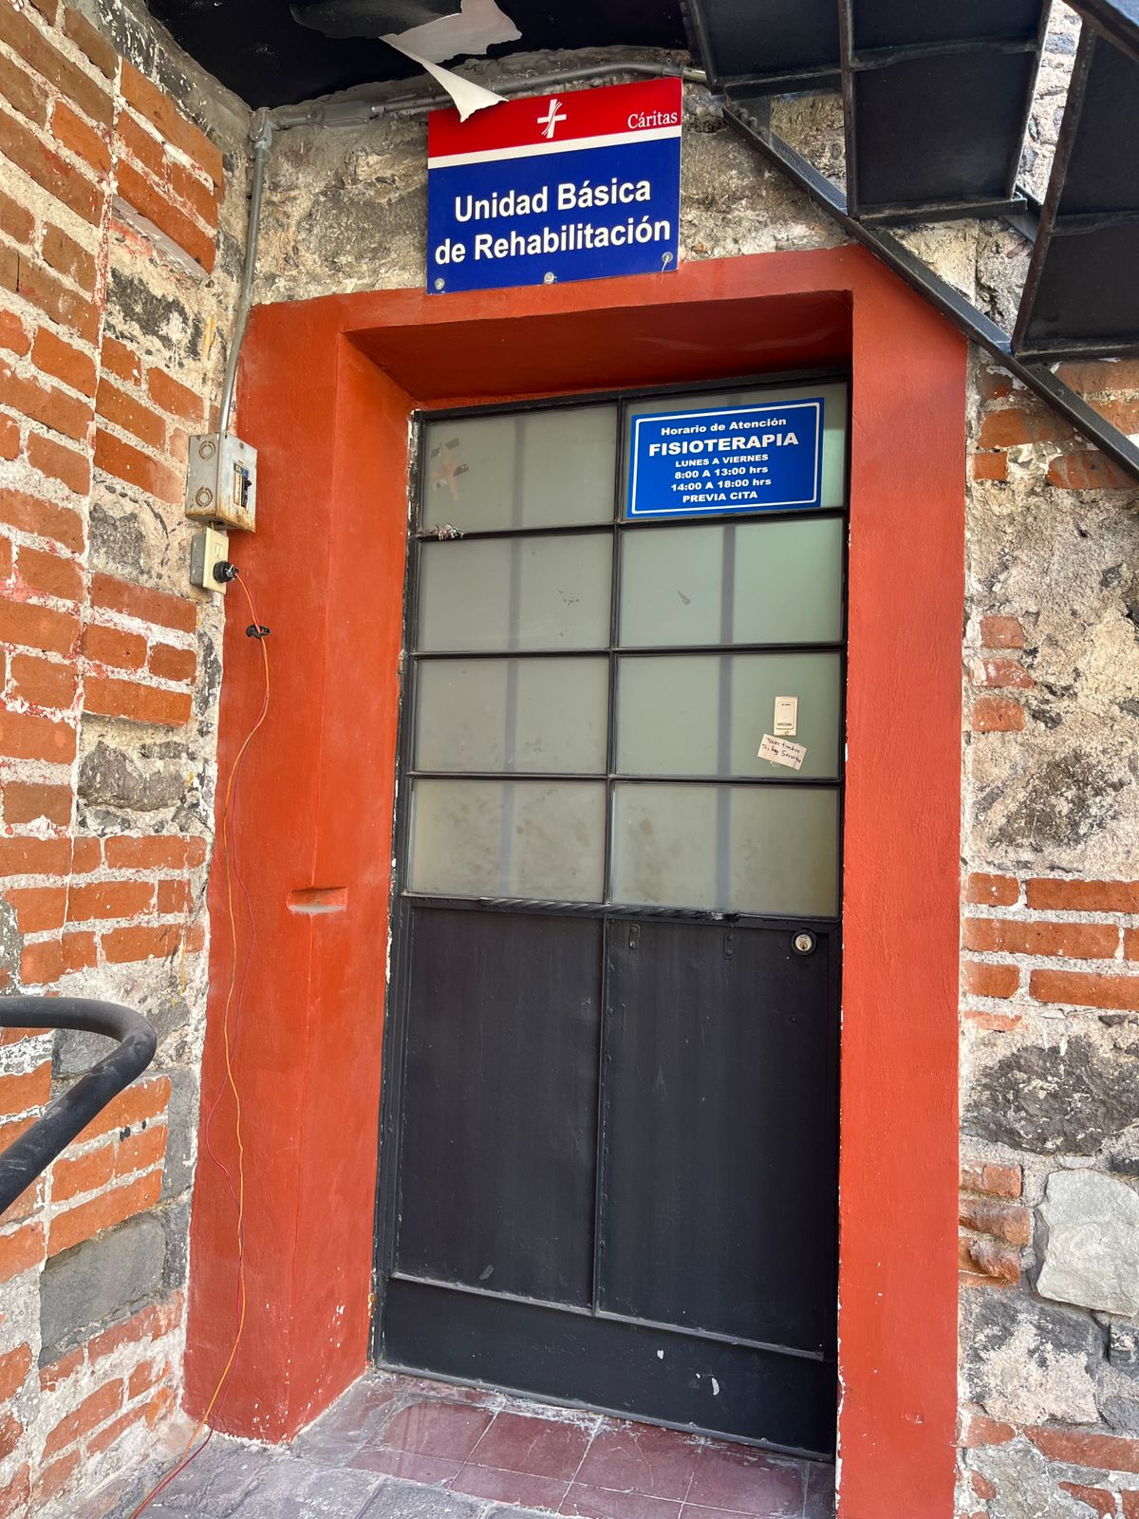
ROTARY CLUB PUEBLA CAMPESTRE REAL
“Provision of Equipment for the Cáritas Puebla Physical Rehabilitation Center”

Slide 3
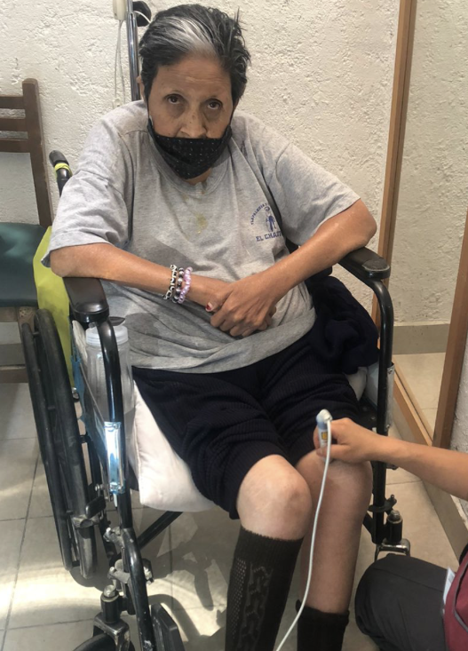
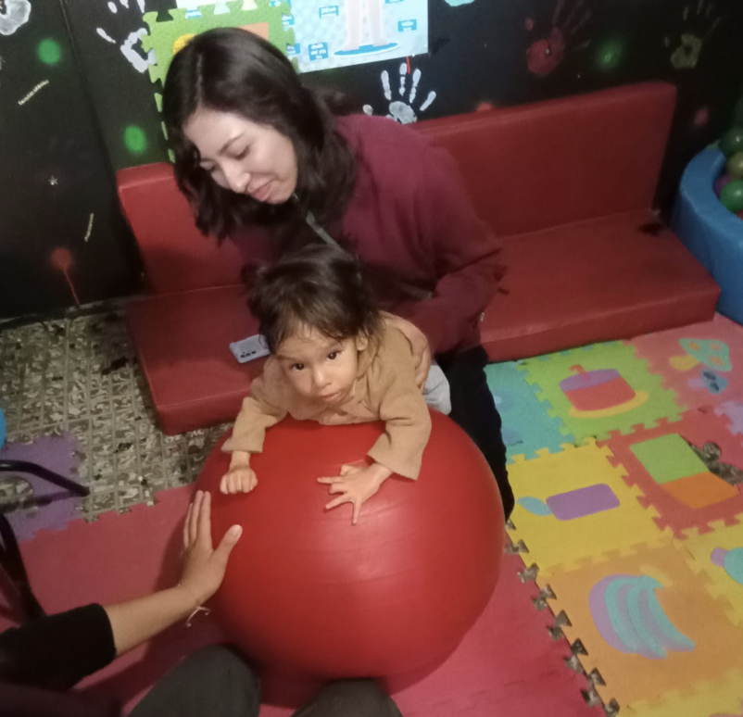
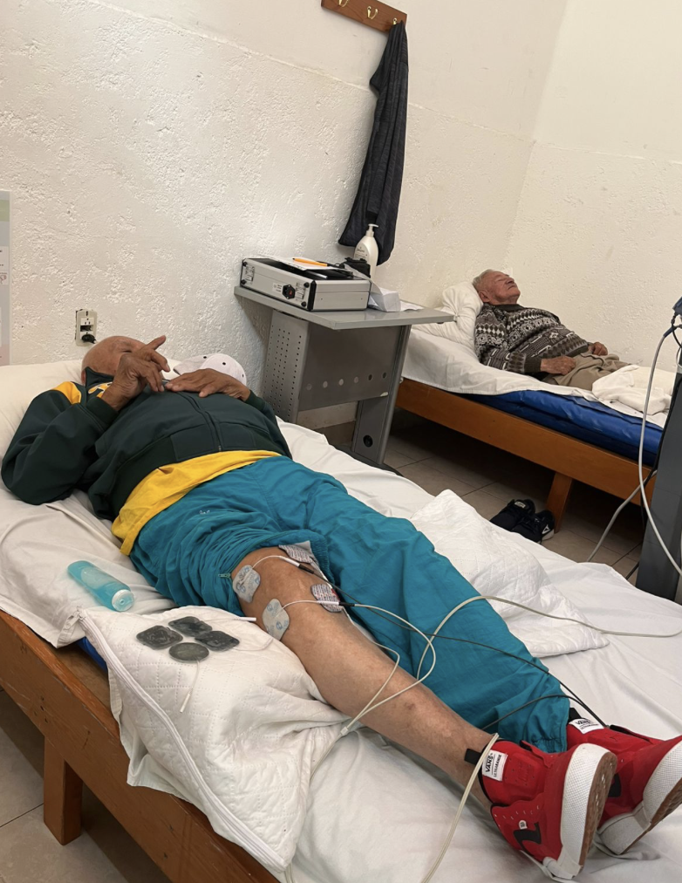

PHOTOS

Slide 4
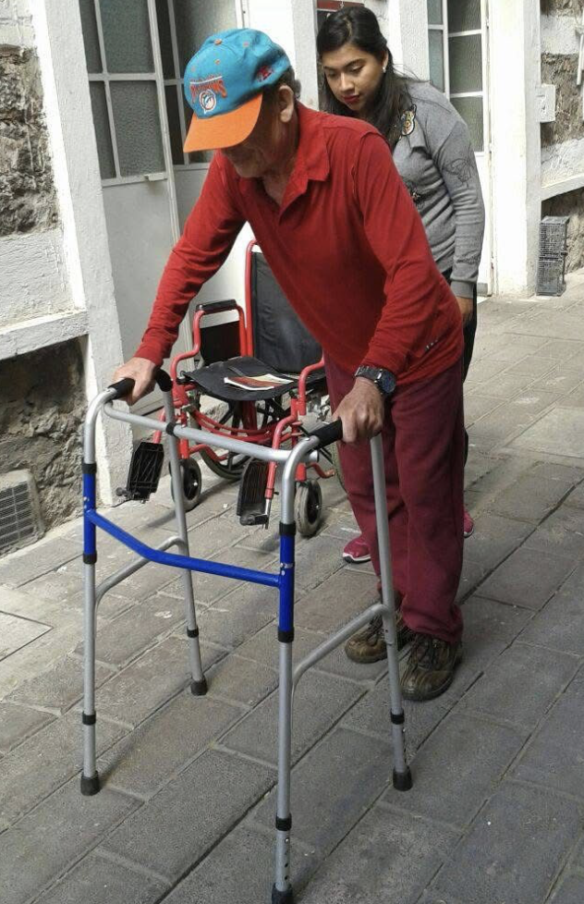
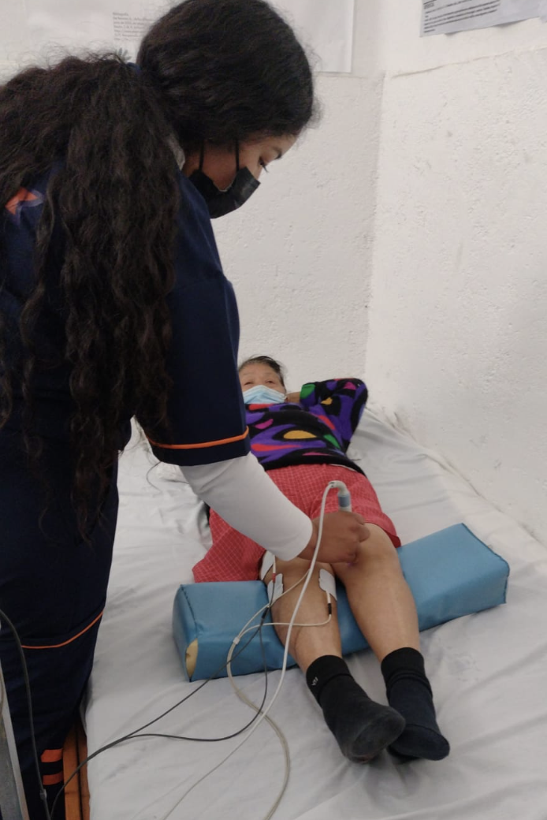
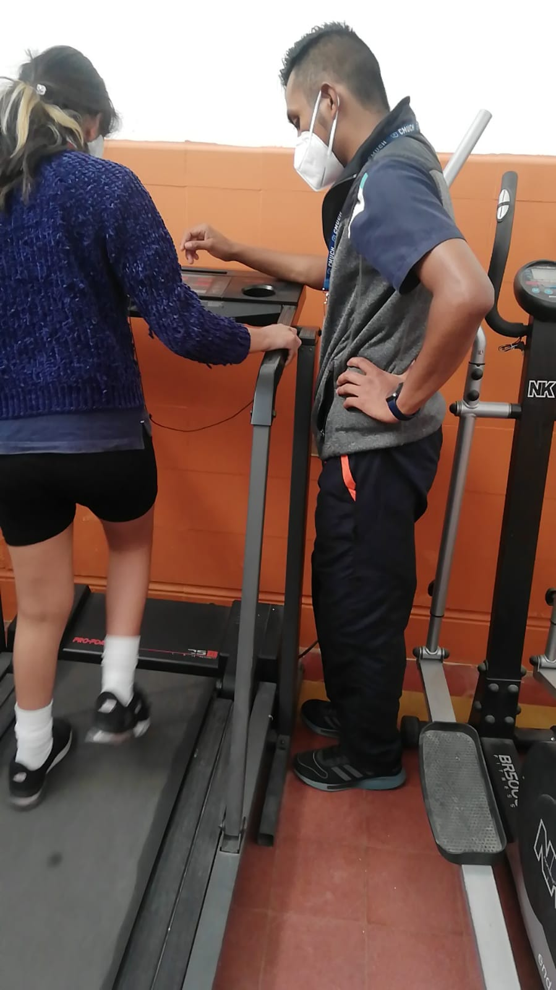
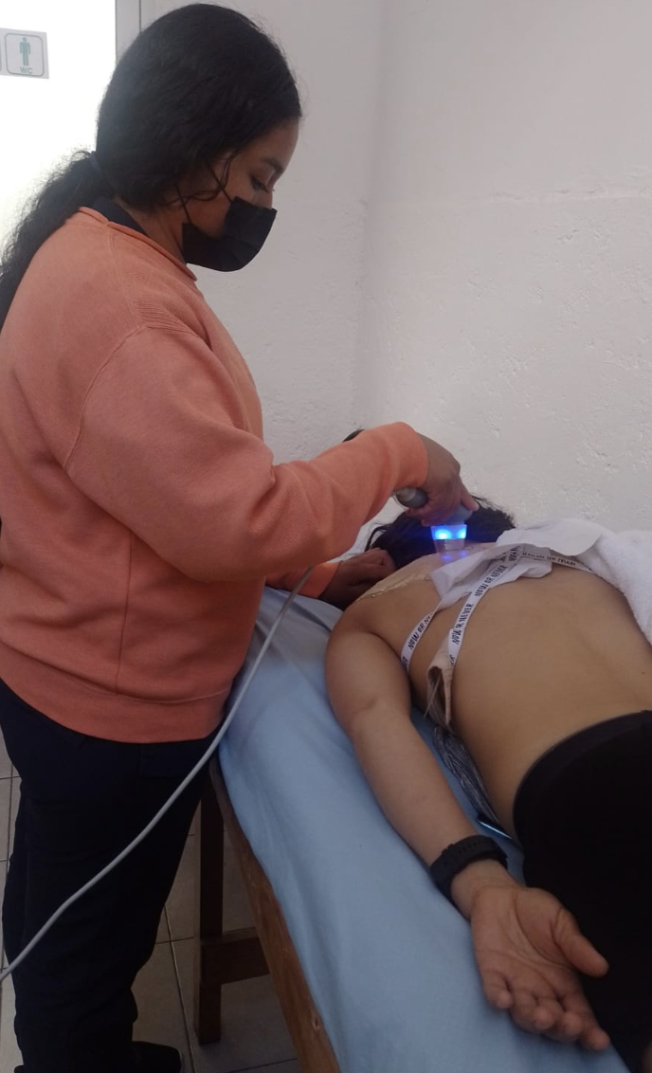
PHOTOS

