Slide 1



Building Bridges of Peace
Title Page Option

Slide 2

Identificación del Problema / Problem Identification: Community-Driven Need in High-Violence Neighborhoods
In Jalisco, violence has stolen more than safety — it has stolen childhood. Through education, we can give it back. By reclaiming schoolyards as places to play, connect, and coexist, we teach peace not as a theory, but as a daily experience.
The project responds to needs identified by school leadership, teachers, and families through participatory diagnosis and prior collaboration.
(REDiM, 2024)

Slide 3
Descripción del Proyecto/ Project Description
Integrated intervention that transforms schoolyards into safe community spaces while building a culture of peace through education and daily practice.
Improve school infrastructure to create dignified, safe, and inclusive spaces for play, interaction, and community use.
Provide peacebuilding and coexistence training to teachers, students, and families, integrating these practices into school life.
Strengthen schools as community hubs that promote safety, peaceful coexistence, and child protection.

Slide 4
Actividades y Estrategia de Implementación / Activities and Implementation Strategy
Comprehensive program aimed at promoting peace and positive coexistence in schools located in vulnerable areas.
Through two main actions:
Training programs given to all school community to foster a culture of peace — focusing on coexistence, assertive communication, and conflict resolution.
Infrastructure and furniture improvements in schoolyards, transforming them into learning spaces for peace and community building.
Expected outcomes include improved perception of safety, reduced conflict incidents, and increased use of schoolyards as safe spaces.

Slide 5
Presupuesto/Budget DDF: $4,000 Zapopan: $500
Activity |  |  | Unit/Duration | Cost (MXN) | Cost (USD) |  | Direct Beneficiaries | Indirect Beneficiaries
Education and Training
School climate assessment | Application of diagnostic tools with teachers, students, and families to identify coexistence challenges and intervention priorities. Includes analysis and an initial action roadmap. | 2-3 weeks | 2-3 weeks | $80.000 | $4.624 | $4.624 | 14 teachers; 13 groups= 584 students | 1680 Family members
Students’ Workshops | Series of specialized workshops to strengthen socioemotional skills, communication, conflict resolution, and peace-oriented educational practices. | 6-8 workshops per school | 6-8 workshops per school | $143.000 | $8.266 | $8.266 | 13 groups= 584 students
Teachers workshops |  | 6-8 workshops per school | 6-8 workshops per school | $106.000 | $6.127 | $6.127 | 14 teachers
Design and Implementation of Institutional Strategies | Technical support to establish or strengthen the School Coexistence Committee and design/implement the Institutional Coexistence Plan with a Peace Culture approach. | Annual program per school | Annual program per school | $116.000 | $6.705 | $6.705 | 14 teachers; 13 groups= 584 students; 420 families
Evaluation and Systematization of the Experience | Outcome and impact evaluation, participatory systematization, training of internal school teams for ongoing follow-up, and recognition of the school’s progress. | 3–4 months per school | 3–4 months per school | $87.000 | $5.029 | $5.029 | 14 teachers; 13 groups= 584 students; 420 families
 |  | Total with taxes | Total with taxes | $532.000 | $30.751 | $30.751 | 14 teachers; 13 groups= 584 students; 420 families
Equipment
Shade structure and shade cloth installation | Supply of materials and labor for the installation of a steel structure and shade cloth covering the playground or multi-purpose court. Includes excavation and construction of concrete footings for structural posts, installation of steel columns, beams, and bracing, as well as the installation of shade cloth in the selected color. The work includes priming and painting of the metal structure. | 19 m x 32 m area over the school #1 AND 14mX24m over the school #2 | 19 m x 32 m area over the school #1 AND 14mX24m over the school #2 | $ 810.966,00 | $ 45.053,67 | $ 45.053,67 | 26 teachers; 25 groups= 1160 students; 840 families (infrastructure for schools benefits two shitfs in school #1) | 3360 Family members
 |  | Total with taxes | Total with taxes | $ 940.720,56 | $ 52.262,25 | $ 52.262,25
 |  | TOTAL | TOTAL | $ 1.472.720,56 | $ 83.013,70 | $ 83.013,70

Slide 6
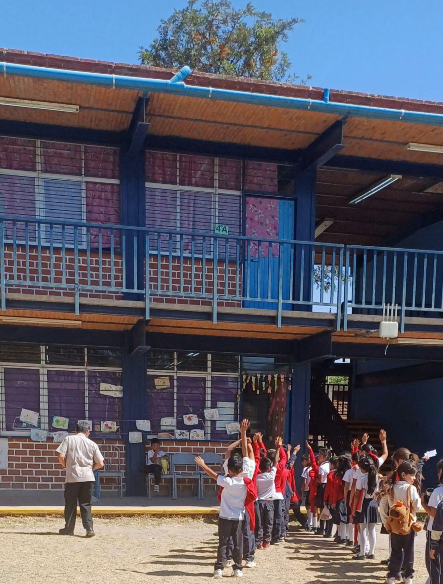

School #1
Name: Urbana 1098
Nivel: Elementary
Teachers: 12
Students: 478
Located in: San Pedro Tlaquepaque

Slide 7
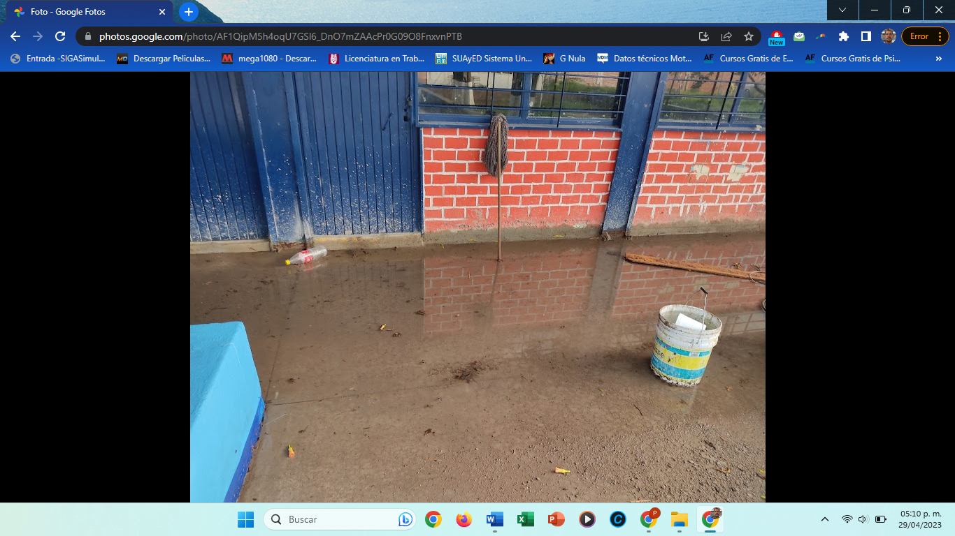
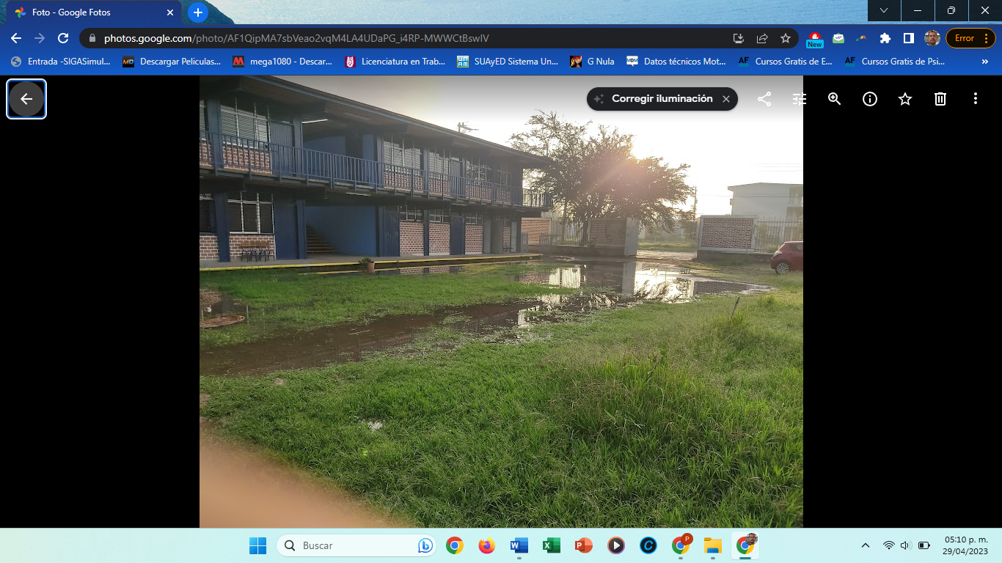
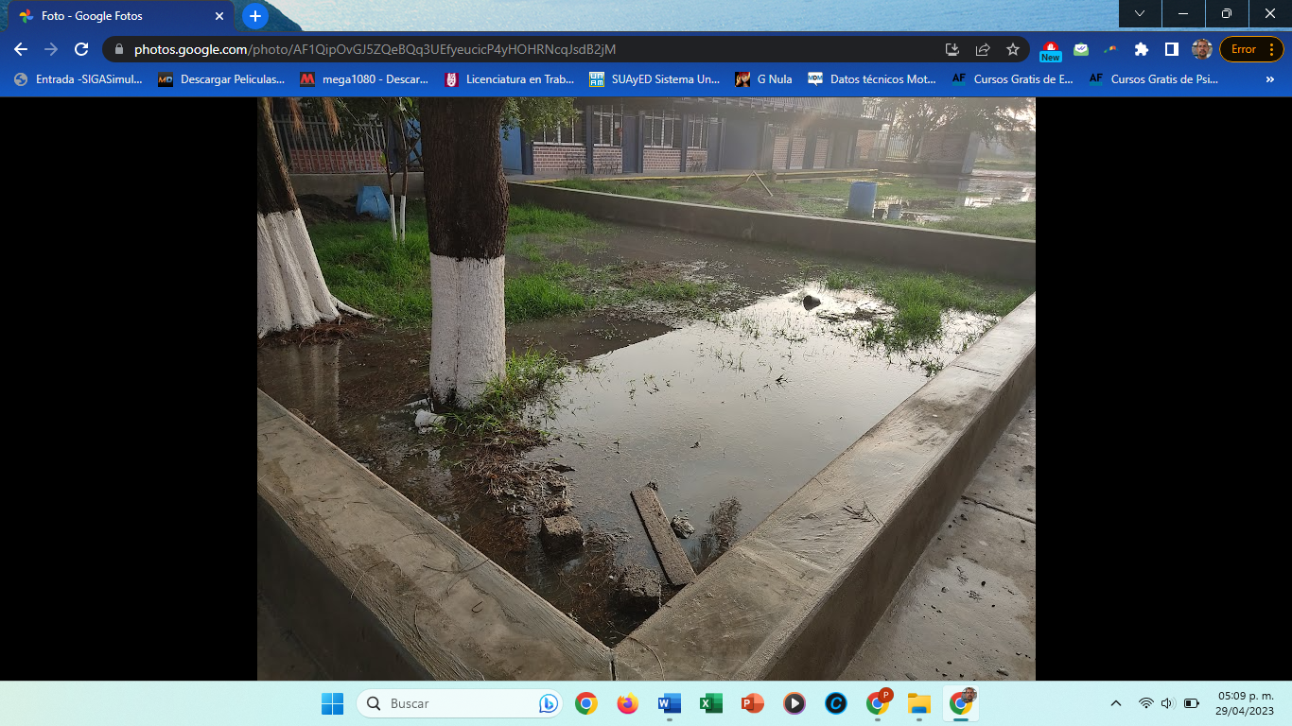
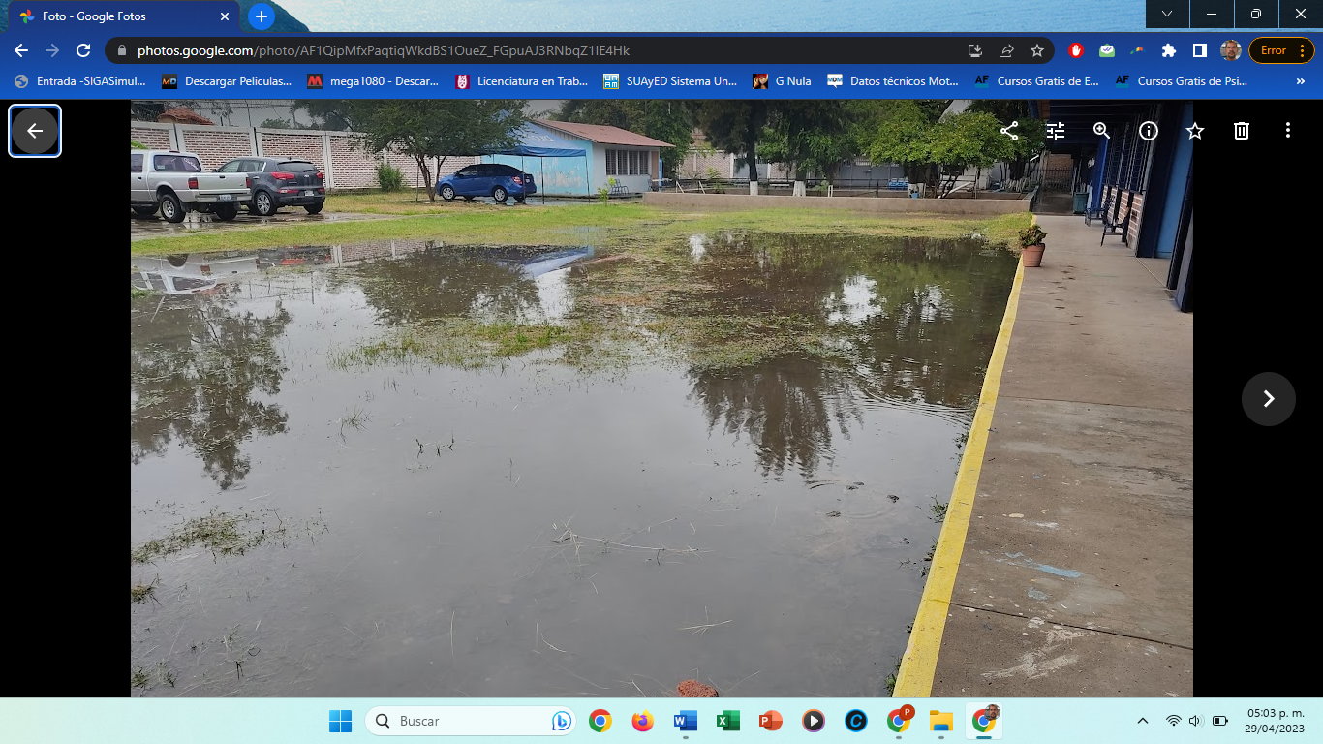
School #1
In a neighborhood with high levels of violence and no parks or safe public spaces, this flooded and unusable schoolyard represents an urgent opportunity. Transforming it into a dignified space for play, connection, and learning-while providing peace and coexistence training to the entire school-can restore childhood, strengthen community bonds, and turn the school into a true hub for peace in daily life.

Slide 8
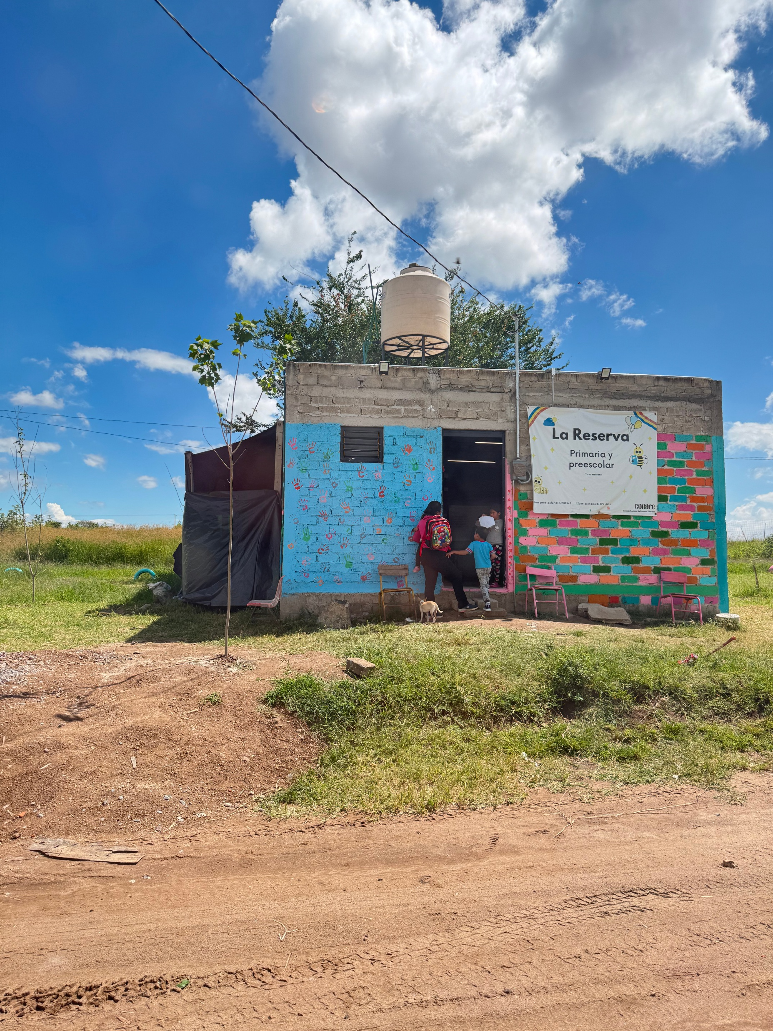
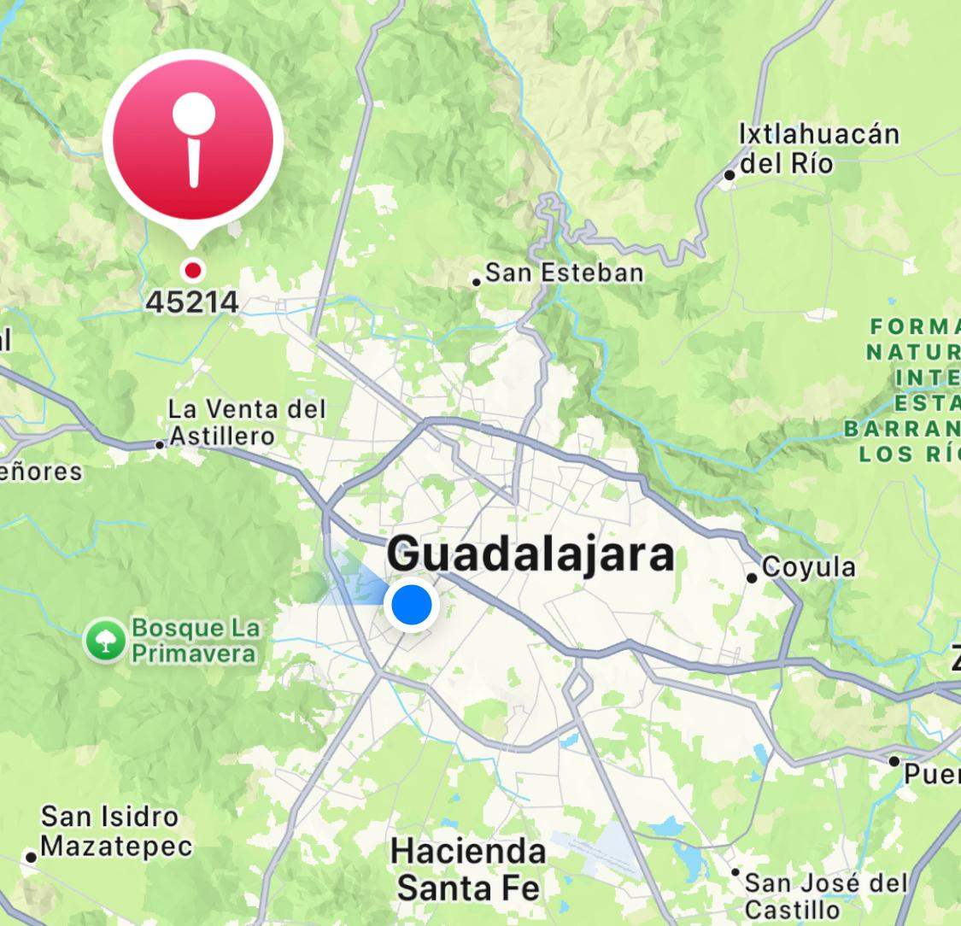
School #2
Name: La Reserva
Nivel: Preschool and Elementary
Teachers: 2
Students: 8
Located in: Zapopan

Slide 9
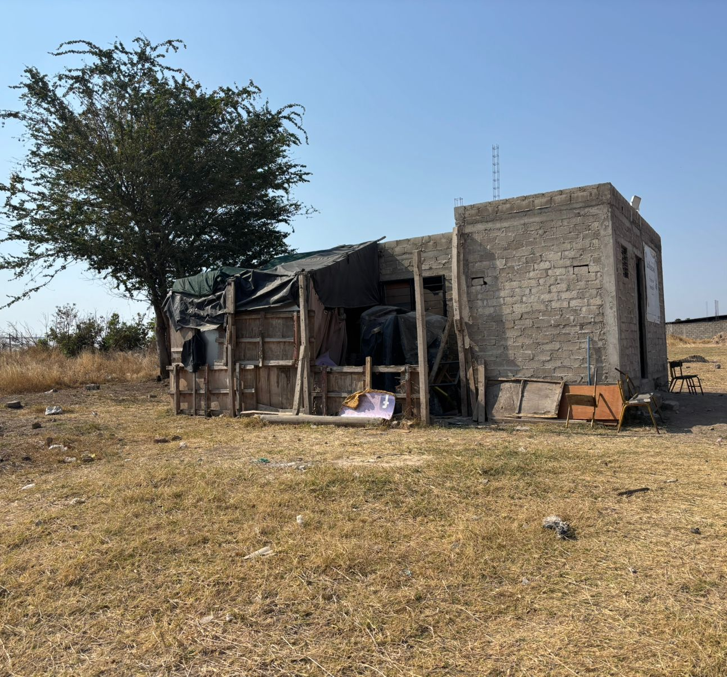
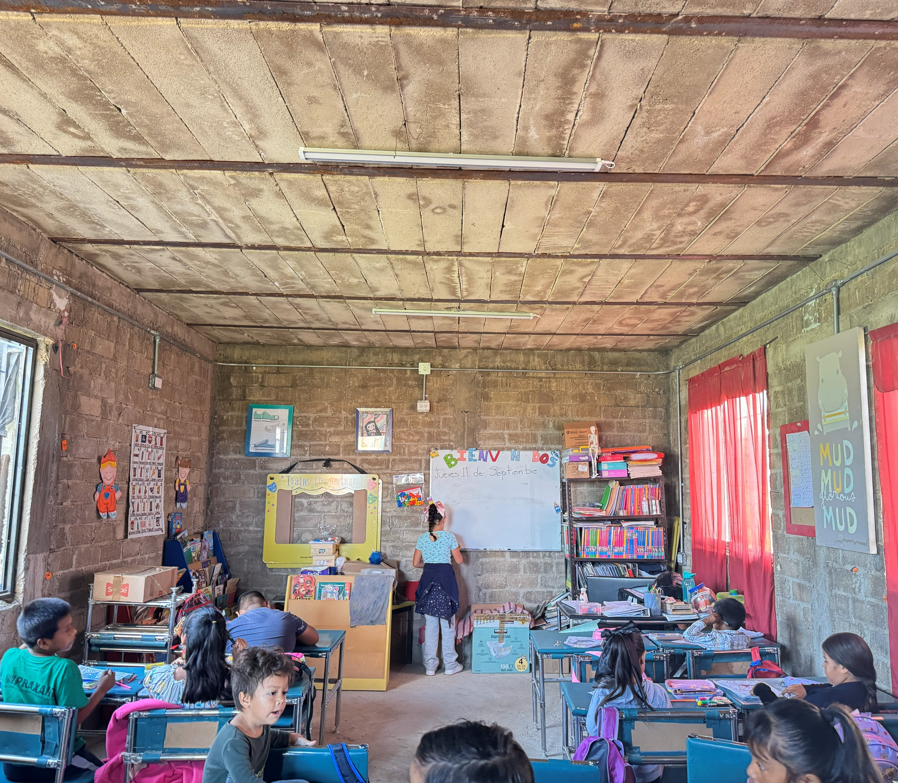
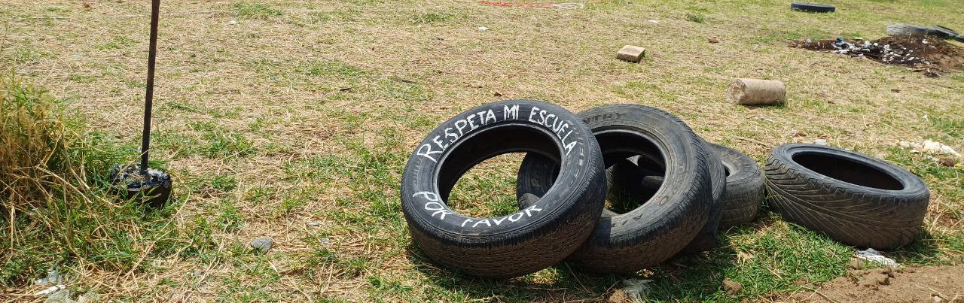
School #2
In the outskirts of the municipality, where there are no parks or safe places to gather, this school is the only space children have to meet, play, and belong, making the transformation of its grounds an urgent step toward dignity, community, and peace.

Slide 10
Resultados Esperados y Evaluación / Expected Outcomes and Evaluation
Direct impact includes 485 students and 14 teachers educated in peace coexistence
Indirect impact includes teachers, families, and community members, benefiting over: 1,600 people annually for training; 3300 for shade structure.
Renewed schoolyards to be used for peace bulding training and meeting points.
Coexistence assessment
Reduction of violent conflicts; conflict prevention skills
Evaluation Strategies
  Surveys per workshop
  Semestral reports
  Monthly school Project follow-ups

Slide 11
Sostenibilidad y Cierre / Sustainability and Closing
Long term relationship with schools
Multi-year school project plan
Monthly school follow-ups
Teacher capacity installed
School coexistence committee strengthened
School assumes maintenance and use of the space

