Slide 1

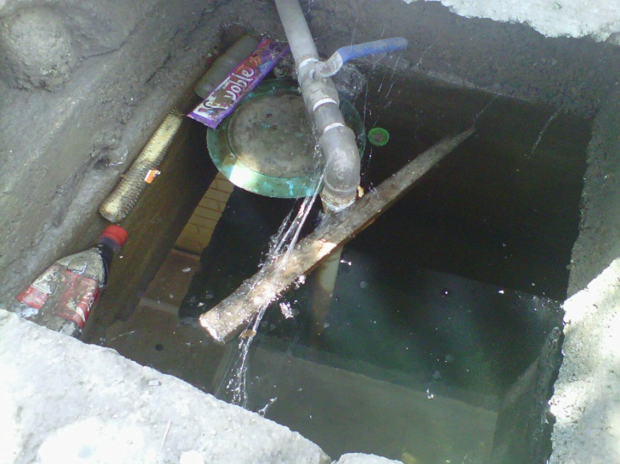
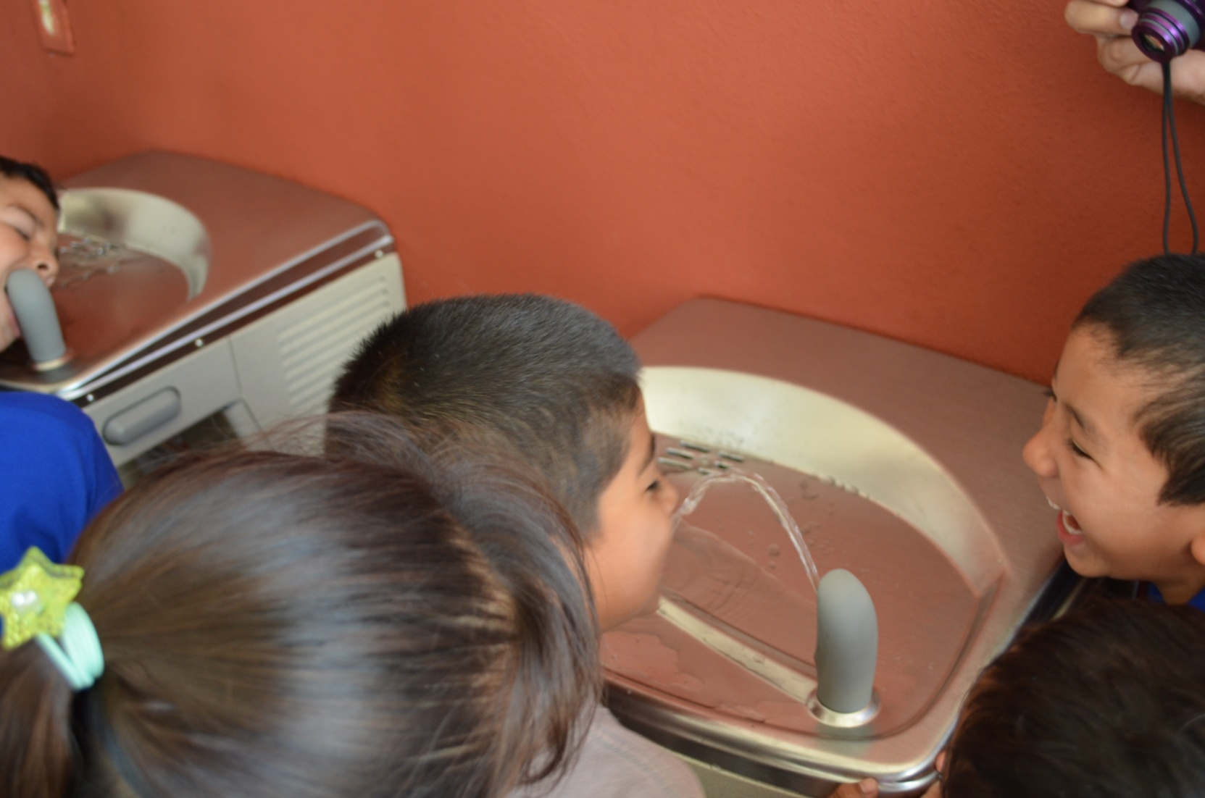
RC Santiago de la Monclova - District 4110
Global Grant Proposal
Global Grant Proposal Project
“Purified Water at your School”
Gastrointestinal
Diseases
Obesity
Diabetes
Thirst
14 schools
9,800 children
14 Water Defenders
Groups
$56,000.00 USD

Slide 2
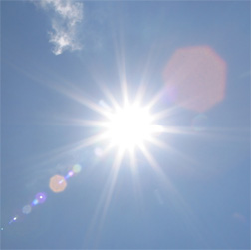
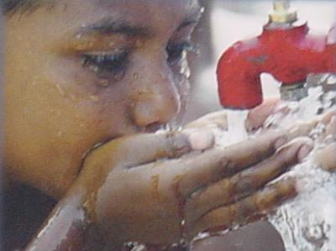
RC Santiago de la Monclova - District 4110
Global Grant Proposal
RC Santiago de la Monclova - District 4110
Matching Grant Proposal
Project “Purified Water at your School”
Project Objective: To install a water purification system in elementary schools in the city poor neighborhoods .
Problem addressed by this project:
No purified water at the schools. No budget for this.
150 sunny days with 104+ temps and 110+ heat index
High incidence of gastrointestinal diseases.
More Soft drinks less water.
Poor achievement due to the heat and thirst.

Slide 3
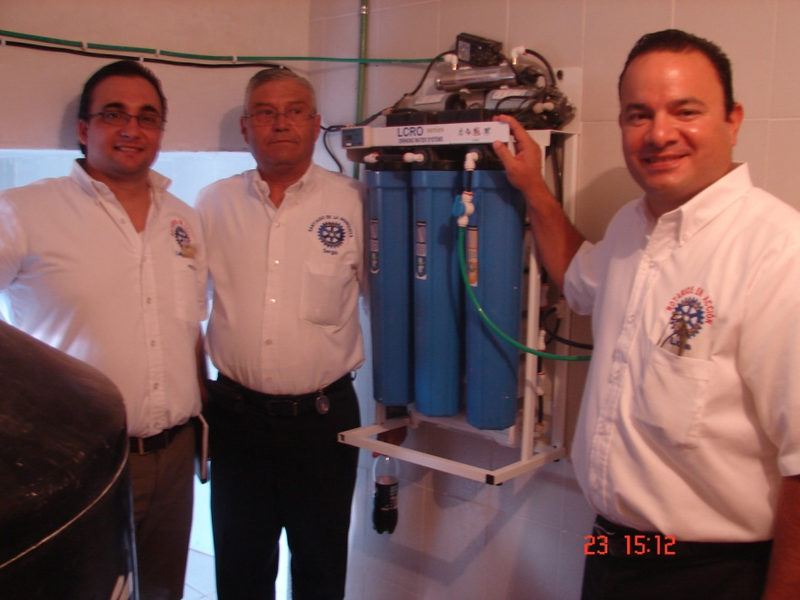
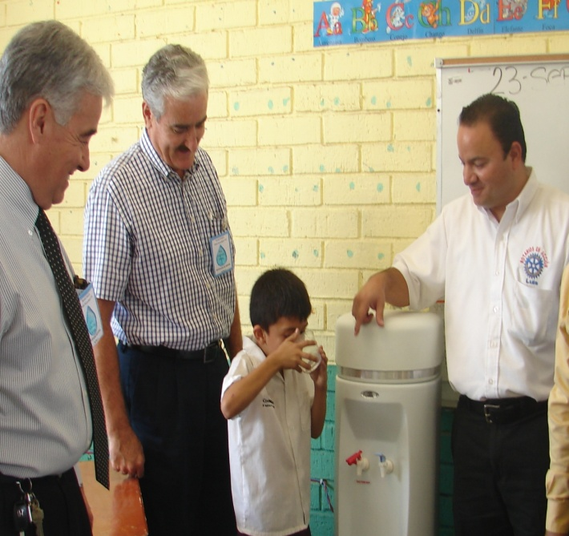
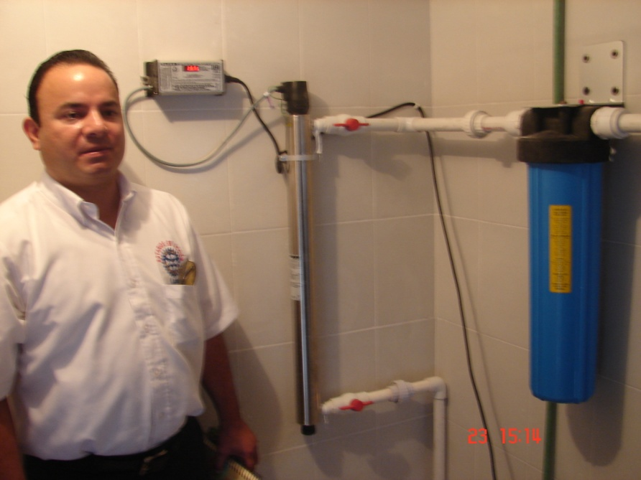
RC Santiago de la Monclova - District 4110
Global Grant Proposal
RC Santiago de la Monclova - District 4110
Matching Grant Proposal
Project “Purified Water at your School”
The water purification system includes:
Sediment Filters
Carbon Filters
Reverse Osmosis
Ultraviolet Lamp
Storage Tank
Pumps
Pipes
Water Coolers

Slide 4
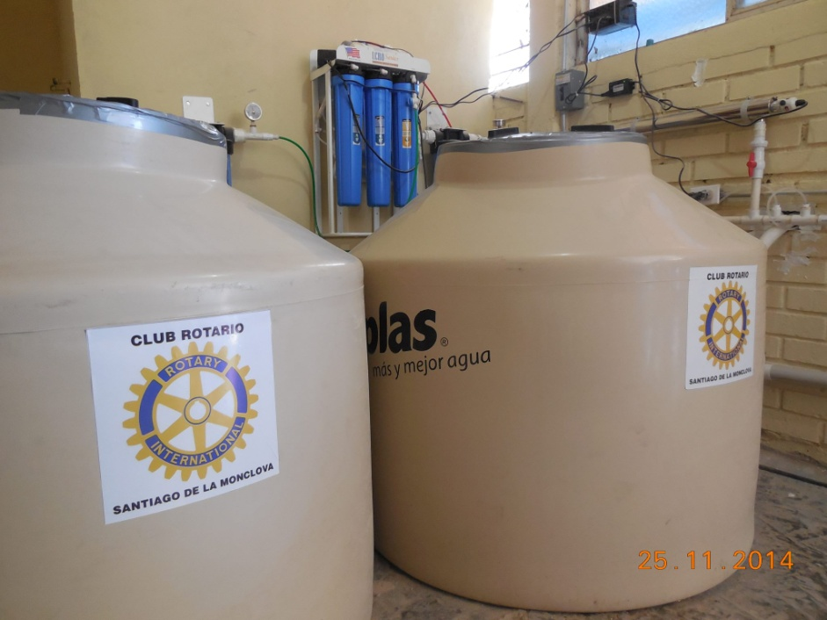
RC Santiago de la Monclova - District 4110
Global Grant Proposal
RC Santiago de la Monclova - District 4110
Matching Grant Proposal
RC Santiago de la Monclova - District 4110
Matching Grant Proposal
Project “Purified Water at your School”
Project characteristics:
Each school will receive a water purification system completely installed, tested and working.
Each system will supply purified water for an average of 700 users, including children, teachers and manual workers.
An average of $4,000 USD are needed for each school.

Slide 5
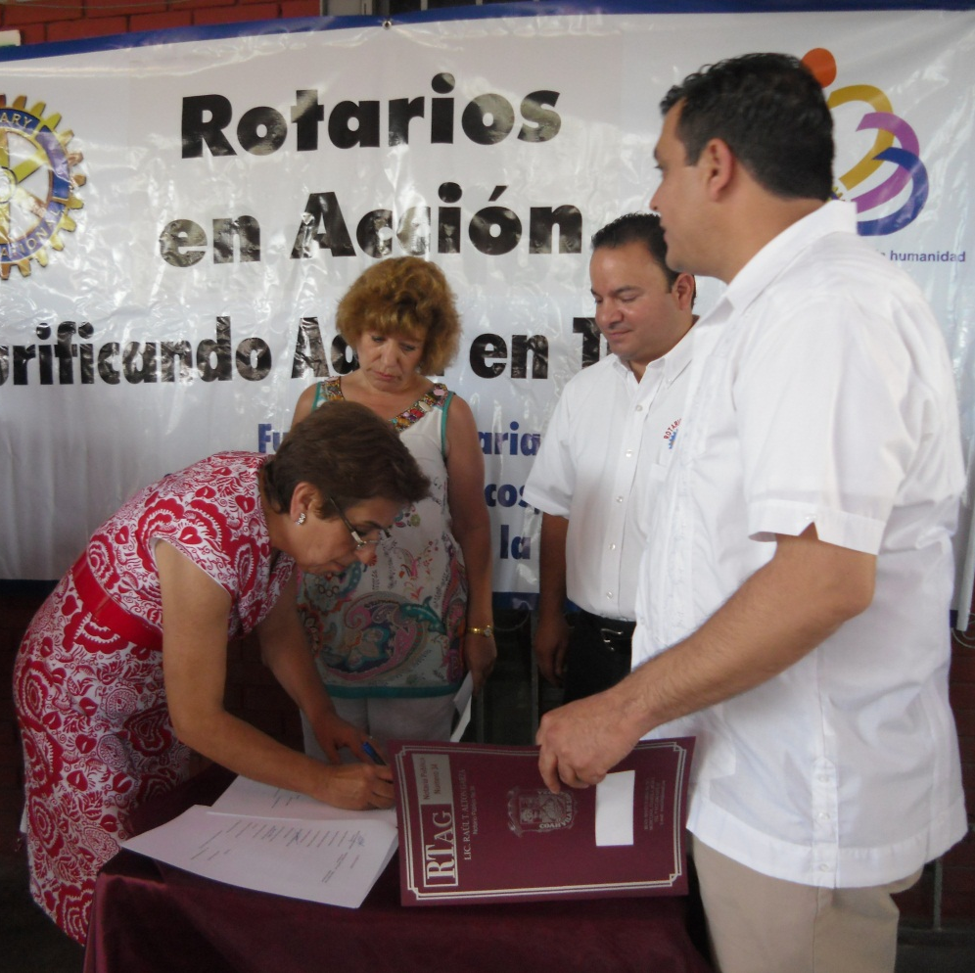
RC Santiago de la Monclova - District 4110
Global Grant Proposal
RC Santiago de la Monclova - District 4110
Matching Grant Proposal
RC Santiago de la Monclova - District 4110
Matching Grant Proposal
Project “Purified Water at your School”
Project Operation:
Each benefited school will, maintain, operate and secure the equipment purchased.
The water purification systems supplier will train school maintenance personnel.
The Rotary Club will create a environmental students group and give water eficency talks to the students, teachers and parents of each school.

Slide 6
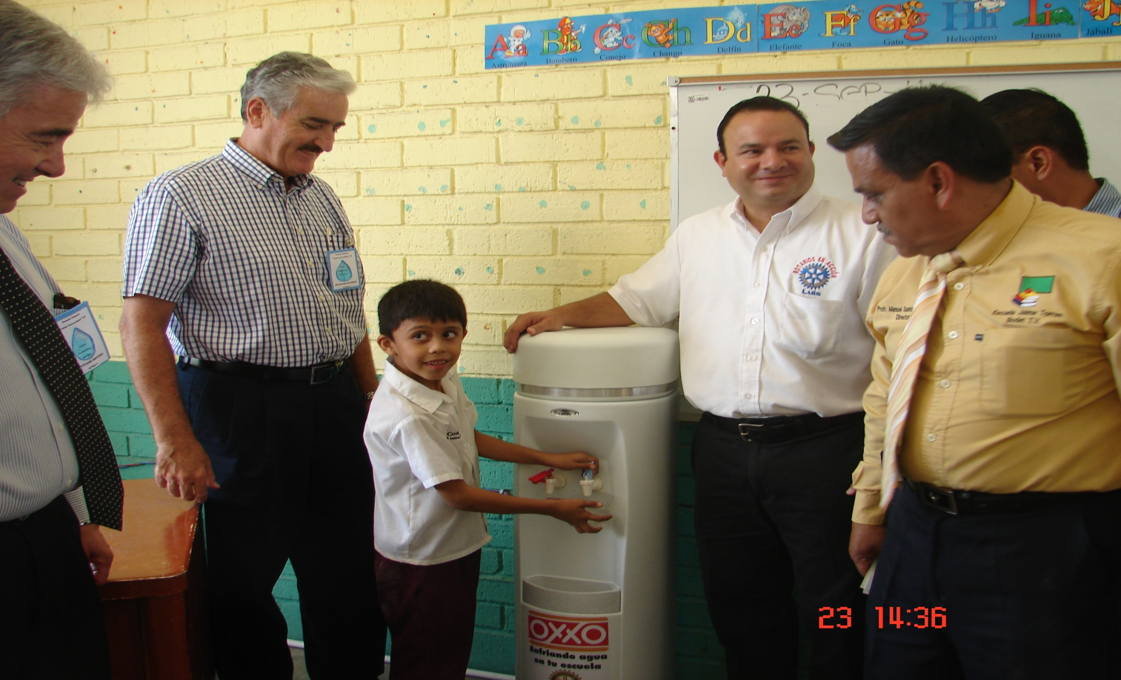
RC Santiago de la Monclova - District 4110
Global Grant Proposal
RC Santiago de la Monclova - District 4110
Matching Grant Proposal
RC Santiago de la Monclova - District 4110
Matching Grant Proposal
Project “Purified Water at your School”
Project History:
Three Matching Grants achieved.
Two Global Grant achieved
Already 32 public schools from poor neighborhoods with more than 23,000 students drinking purified water daily.

Slide 7
RC Santiago de la Monclova - District 4110
Global Grant Proposal
RC Santiago de la Monclova - District 4110
Matching Grant Proposal
RC Santiago de la Monclova - District 4110
Matching Grant Proposal
Project “Purified Water at your School”
Project Goals:
56,000 USD Global Grant
14 Public Schools from poor neighborhoods
9,800 more students drinking purified water daily.

Slide 8
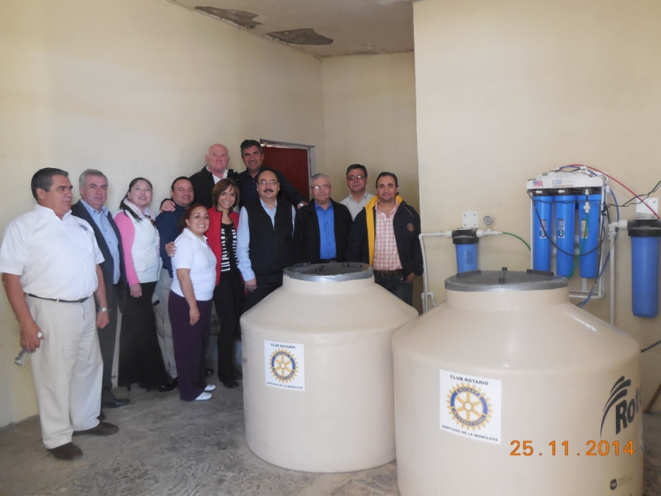





RC Santiago de la Monclova - District 4110
Global Grant Proposal
RC Santiago de la Monclova - District 4110
Matching Grant Proposal
RC Santiago de la Monclova - District 4110
Matching Grant Proposal
Project “Purified Water at your School”
Other Sponsors:

Slide 9
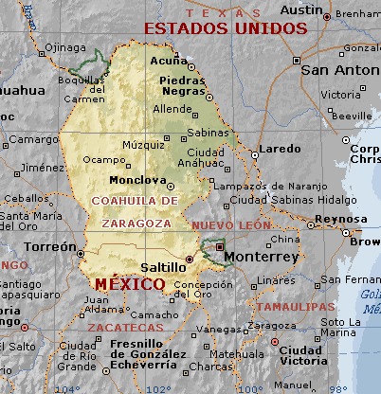
RC Santiago de la Monclova - District 4110
Global Grant Proposal
RC Santiago de la Monclova - District 4110
Matching Grant Proposal
RC Santiago de la Monclova - District 4110
Matching Grant Proposal
Project “Purified Water at your School”
Project Contacts:
Jose Lubano – President
Email: Techidraulics@Hotmail.com
Tel: 011528661359399
Ferbando Ruiz- Rotary Foundation
Email: frm_67@hotmail.com
Tel: 011528661166553
Luis Velazquez – Project contact
Email: luis.velazquezgnz@gmail.com
Tel: 011528661358705

Slide 10
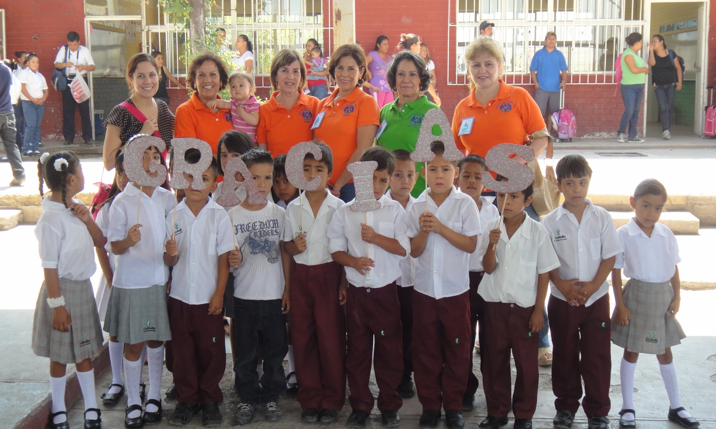
RC Santiago de la Monclova - District 4110
Global Grant Proposal
RC Santiago de la Monclova - District 4110
Matching Grant Proposal
RC Santiago de la Monclova - District 4110
Matching Grant Proposal
Thanks for your interest in our Project
“Purified Water at your School”
RC Santiago de la Monclova

