Slide 1
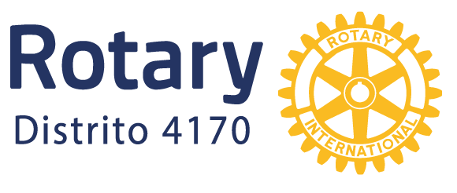


UNIDOS
PARA HACER
EL BIEN

Slide 2
Community Needs
This project replicates the successful experience of the ALEM/Rotary mobile wheelchair repair shop in District 4185.
This project offers high-quality wheelchair and orthotic repair at very low cost to thousands of low-income people with disabilities.
It also provides vocational training and employment for people with disabilities, and challenges the general public's assumptions about the ability of people with disabilities.
The project will empower people with disabilities, their families, and their networks with financial co-participation, paying for labor for the repairs, which generates income for the team of technicians with disabilities, and Rotary Clubs and individual donors support with the repairs.

Slide 3
Global Grants - Area of Focus
Area. Economic development of communities
Strengthen the capacity of civic leaders, local organizations, and community networks to support the economic development of impoverished communities and people living in vulnerable situations.
Create productive employment opportunities and improve access to sustainable sources of income.
There will be 33 "enchulame la silla" (Pick Me Up the Chair) sessions for technical training. 30 chairs will be fixed each day, resulting in 990 chairs being repaired. People with disabilities will receive training in marketing, human relations, and accounting.

Slide 4
Sustainability
This project will provide technical, administrative, and business training, as well as employment for people with disabilities through wheelchair repair, benefiting a minimum of 2,000 people with disabilities and their families annually.
Additionally, it will provide basic training in wheelchair maintenance for at least 200 people. People with disabilities have the highest unemployment rate in the country.
According to the National Council for the Evaluation of Social Development Policy (CONEVAL), in 2020, 49.5% of people with disabilities lived below the poverty line.*
The project allows us to offer employment to people with disabilities and, at the same time, offer wheelchair repair at a very low cost.
It is also important to mention that the project not only offers employment to the technicians who work directly on the project, but also to thousands of people who are unable to perform their income-generating activities due to lack of mobility.

Slide 5
Budget
Concept | Category | Cost in USD
Tools and equipment for wheelchair repair | Equipment | 6,700.00
fasteners: nuts, bolts, washers and rivets | Supplies | 850.00
General supplies: sandpaper, fiberglass, loosening agent, paint, tape, etc | Supplies | 1,500.00
Spare parts for wheelchair repair | Supplies | 26,500.00
Marketing and sales training | Training | 1,700.00
Effective communication and human relations workshop | Training | 1,700.00
Planning, administration, and basic accounting workshop | Training | 1,700.00
Technical training: tools, welding, and wheelchair repair processes | Training | 3,350.00
Project management | Training | 3,350.00
Total budget |  | 47,350.00

Slide 6
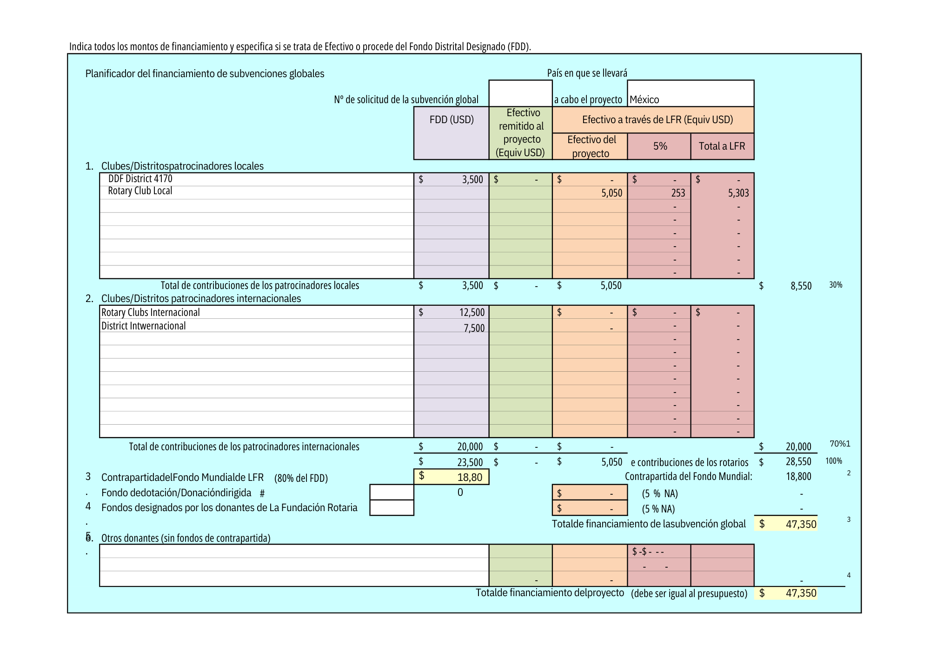
Funding

Slide 8
