Slide 1



“Blue hearth” project

Slide 2
OBJETIVE
Streghten the adaptation and stimulation to overcome the sensorial obstacles facing the autism and neurodivergent patients on the Puruándiro area by the implementation of a Sensorial stimulation hall on the CRIP (an ongoing rehabilitation center with enough space)
This center room would allow us to bring personalized therapies for around 240 patients per month enhacing them to adapt to their families, schools and social development also allowing the parents to save time and money for their healthy purpouses.
This project involves the Prevention and treatment of illness Rotary focus area.

Slide 3
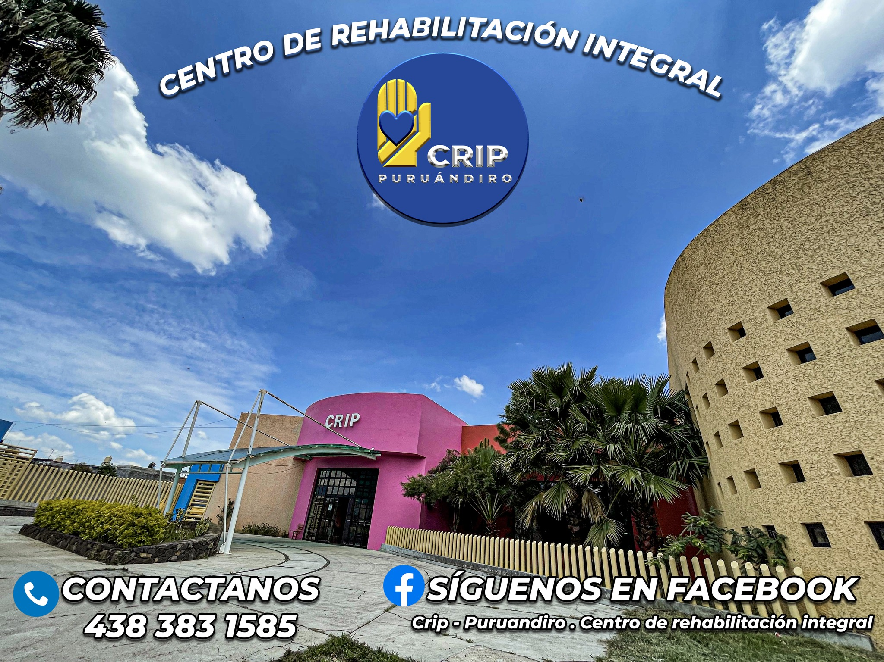
What have in advance?
A work of many years …
Rehabilitation Center of Puruándiro
“CRIP” and a former club member who is facing this situation with his own kid and have the expertise and contacts to make of this a great project.

Slide 4
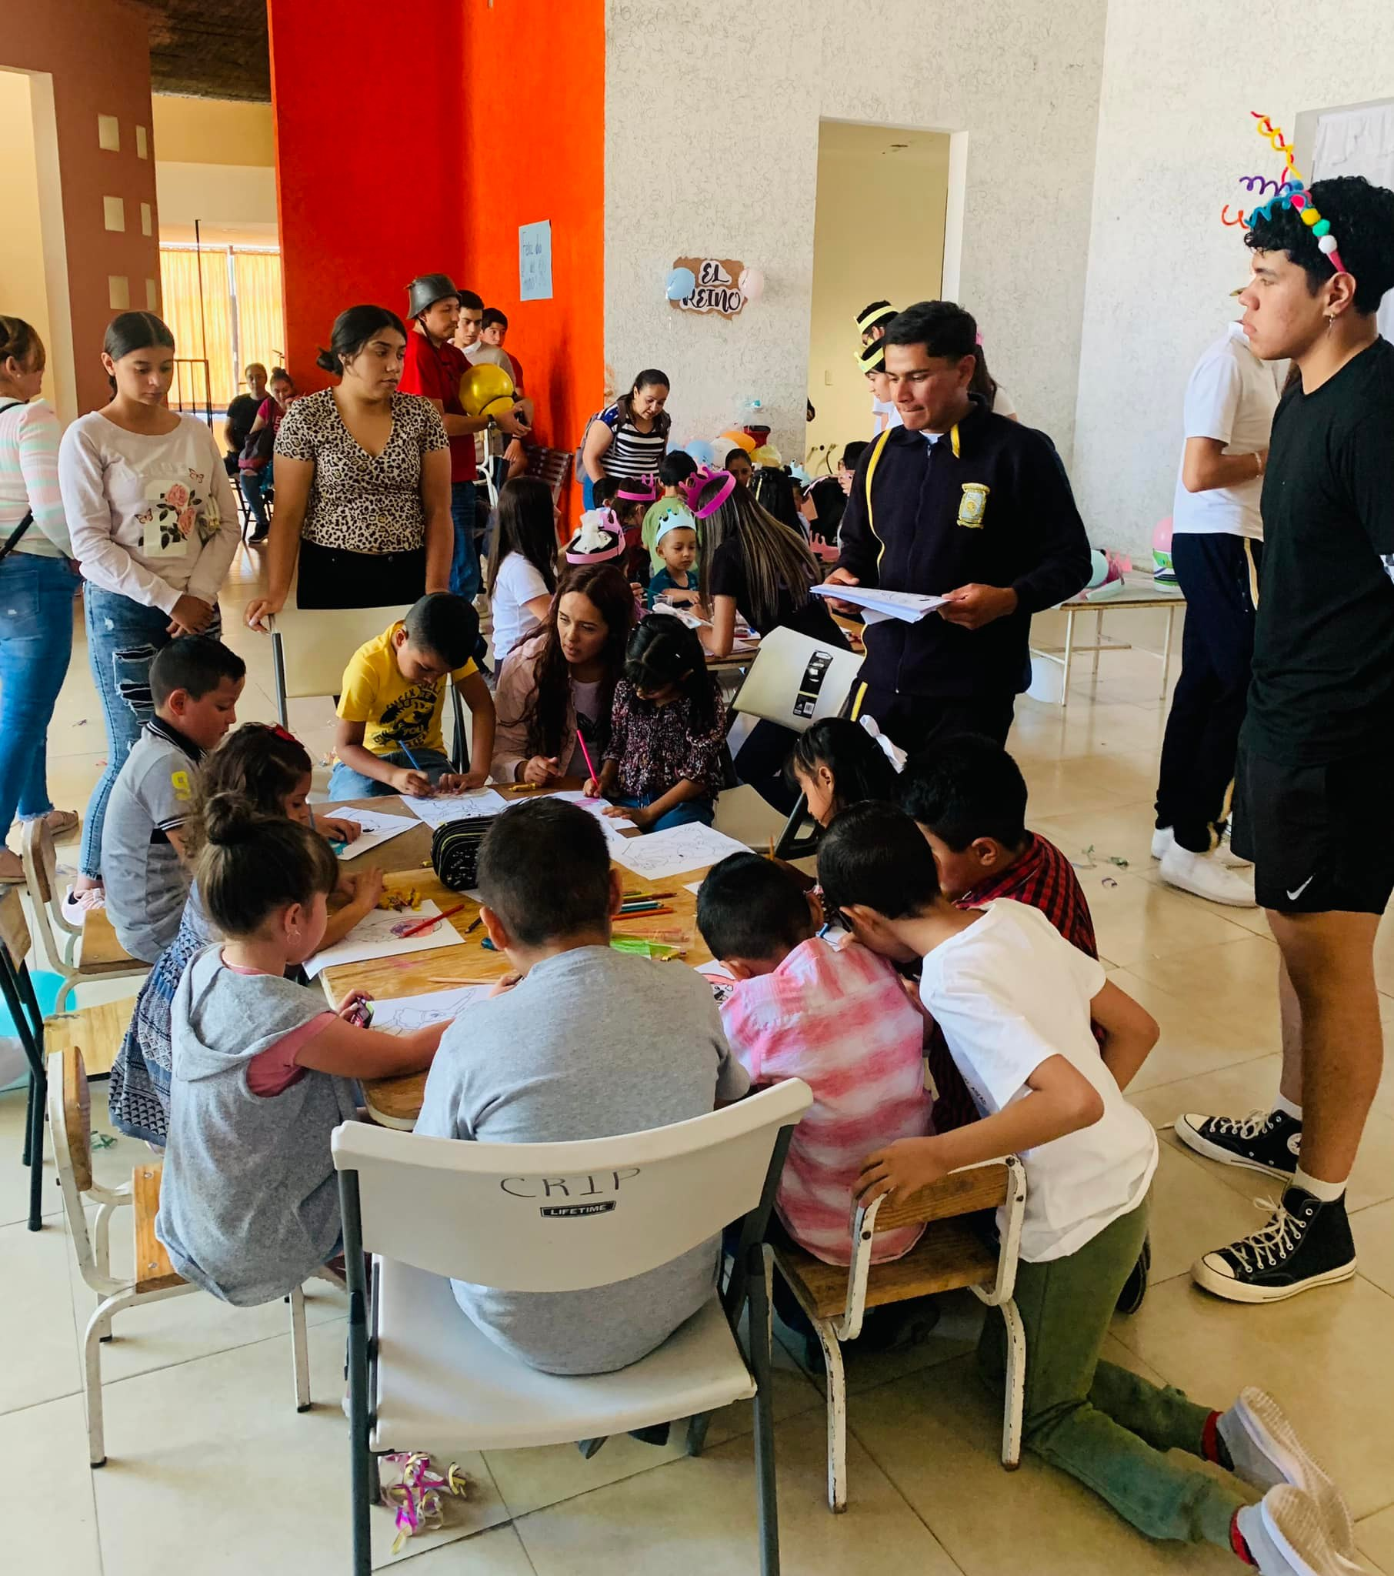
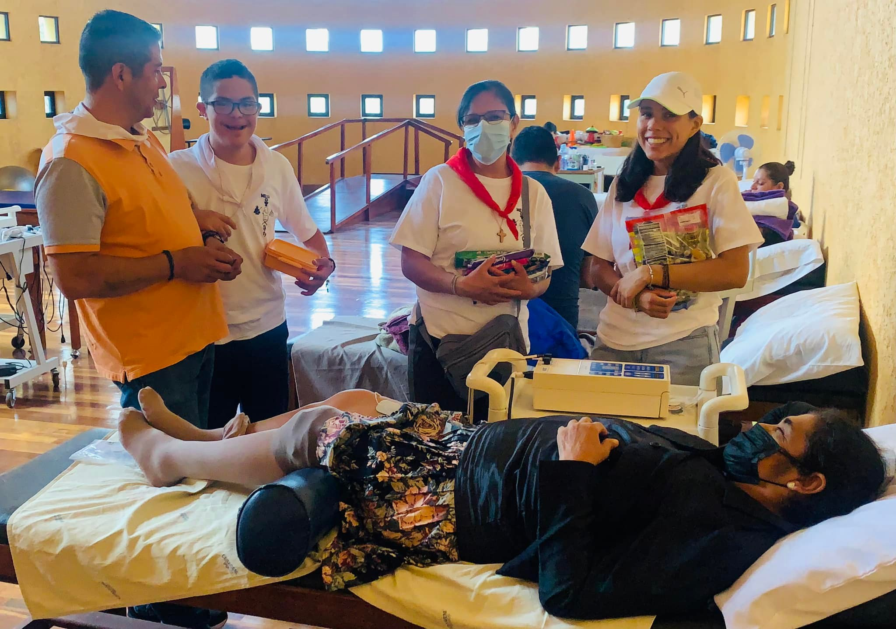
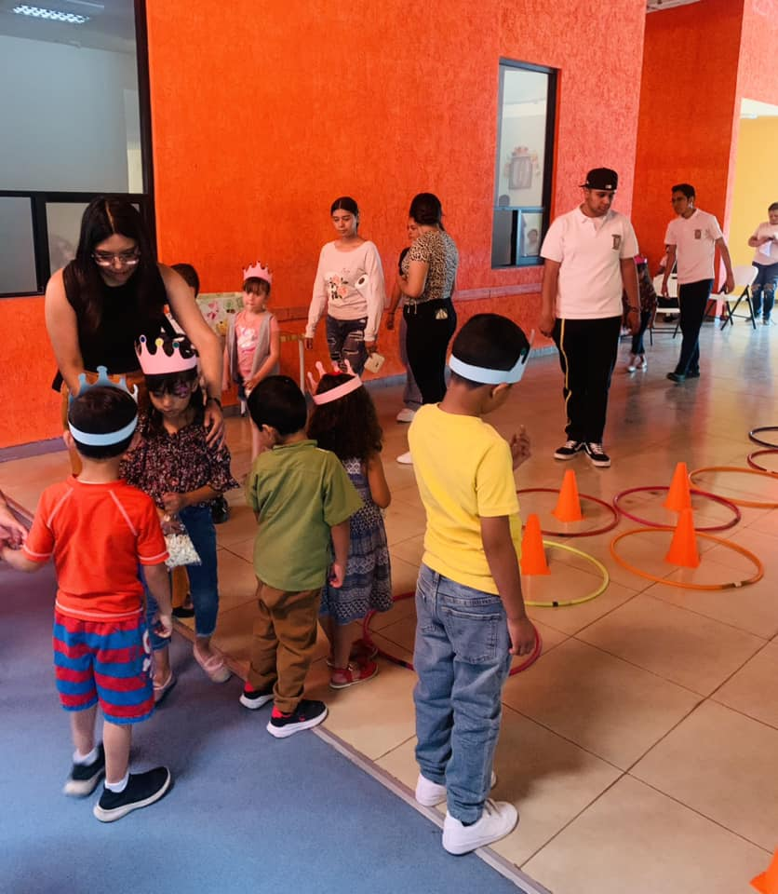
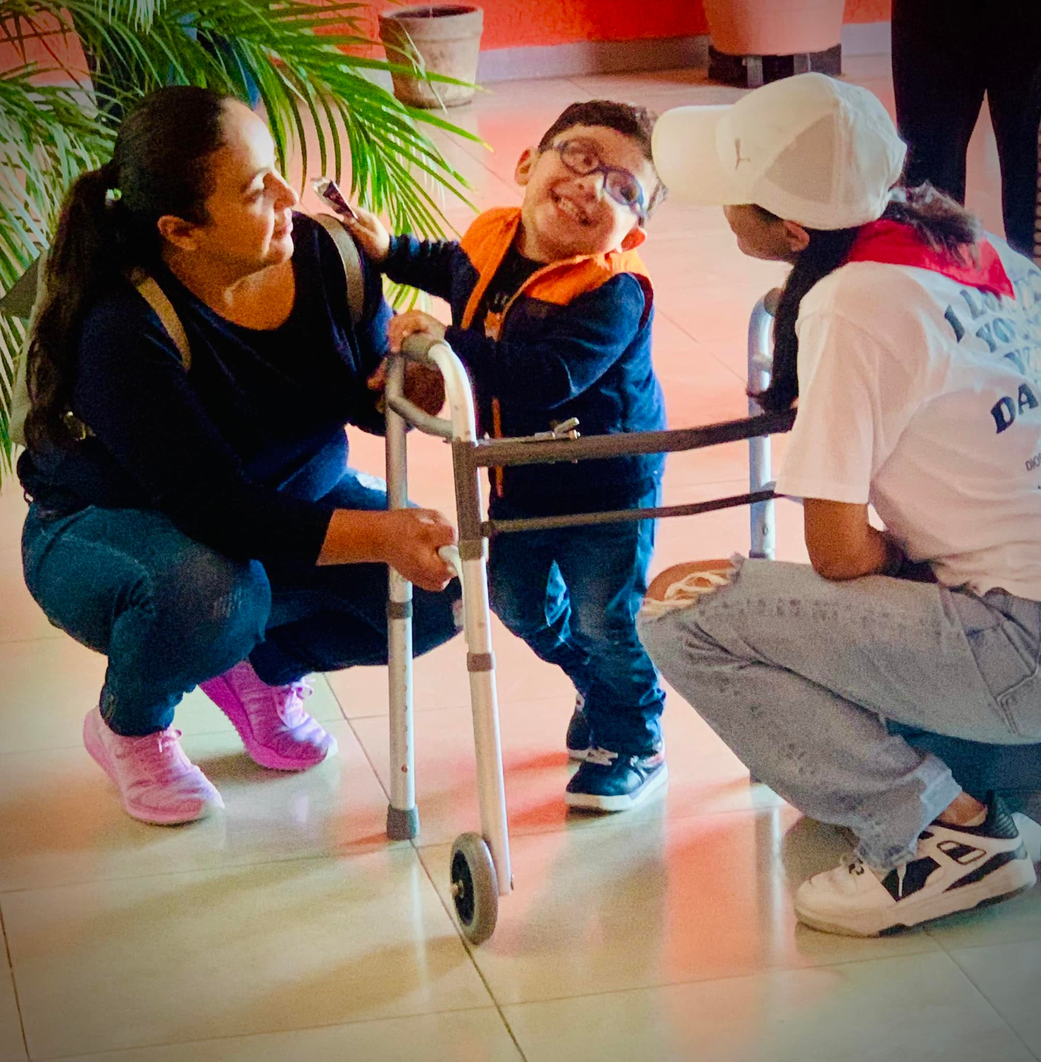
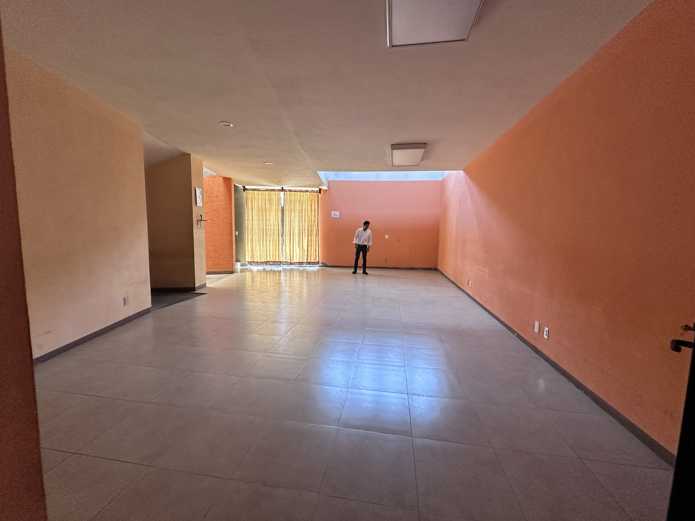
A great place but just nearly 25% of used space potential

Slide 5
Actual care therapies
This are some of the ongoing attention services in the CRIP
Cognitive stymulation
Emotional inteligence / emotional control
Social skills
Learning problems
Phisical Rehabilitation/treatment (injuries, eldery & born disabilities)
Identity, security and selfsteam
Speaking Language therapy

Slide 6

Autism related panorama
Acording to one of the UNAM studies(The most recognized university in México) one in every 115 people belong to the autism spectrum. Puruandiro and its surrounding areas have at least 235,000 inhabitans giving us around 2,043 people with autism, many of them haven’t been diagnosted yet. https://www.dgcs.unam.mx/boletin/bdboletin/2020_291.html
Those that knows and requiere to have the attention need to travel distances between 50 to 200 miles and it takes from 4 to 10 hours a round trip just in case they travel in ther own vehicle if not increases by double by using public transportation.
Another problem they are facing is that the nearest centers usually are being fully booked up so they need to wait even for a month or more to be attended.
Session cost in the actual centers are about $1,000 pesos and sometimes more than once is required in a week.

Slide 7
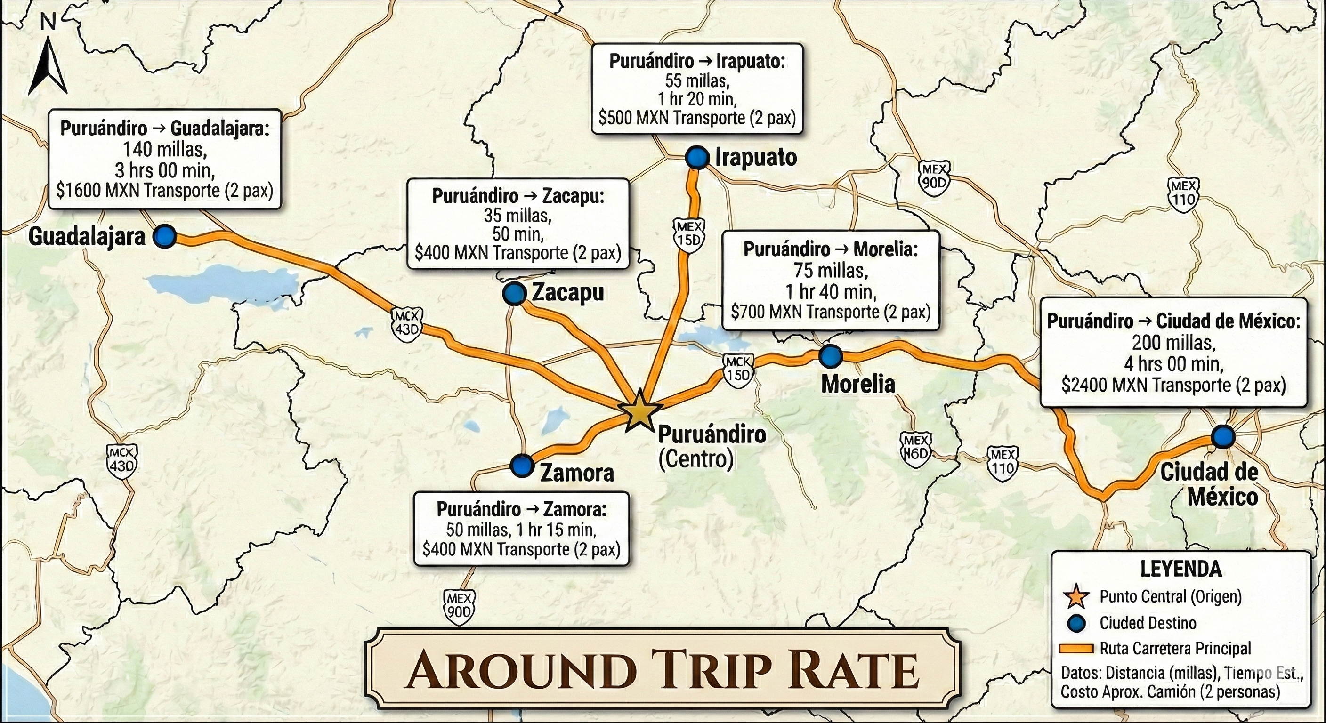
Map of location and near centers

Slide 8
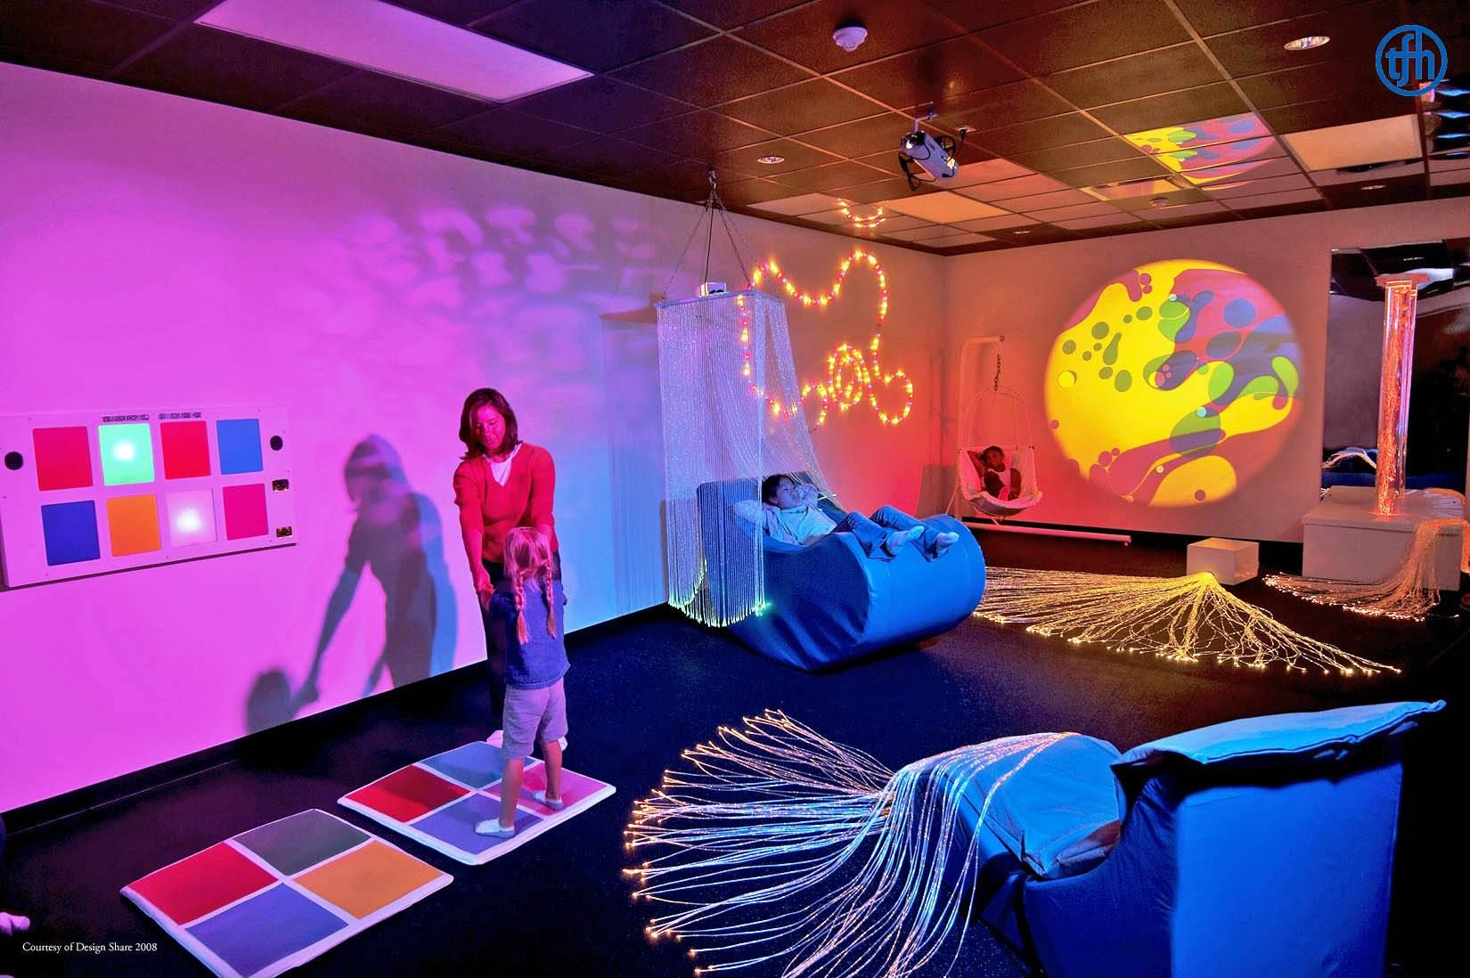
The Project
The project involves the equipment and operatioal hall and the set up of a sensorial stymulous devices and certification curses for the tecnical personel that is going to give this therapies at the Crip center of Puruandiro to be designed to attend minors and teenagers on the autism spectrum, TDAH and other related issues like modulation and strugles with self control and self regulation.
Set up hall attention area (vinylic floor, cushioned walls, ceiling fabrics, intelligent lights, sounds and effects controlled by voice, video proyector for ceiling adaptive atmosphere.
Set of playgroud kits according to the activities to work.
Certification courses for the persons who’s giving this treatments.
Set up of the areas for parents waiting room, caregiver office, security areas devices (security AC outlets, handrails), AC units, dehumificator unit etc.

Slide 9
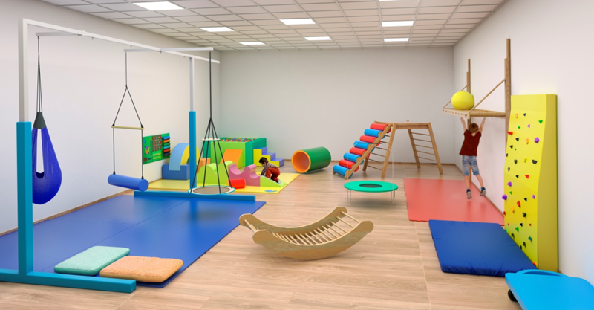
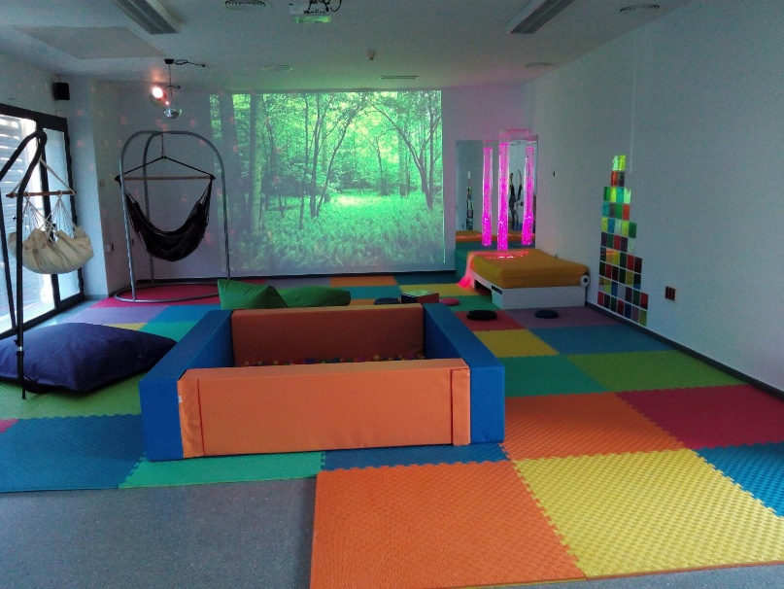
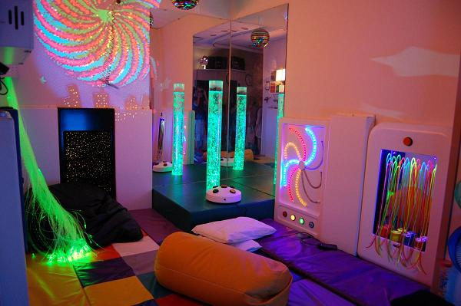
Specialized sensorial equipment
This kind of sensorial equipment are designed to stimultate every sense on kids and could even make them improve from a level 3 to a level 1 of autism when therapies are used from a early stage.
This images describe an example of these set of tools.
Equipment of terapeutic swings, tyrolese, hanging leter, trampoline, and climbing wall.
Setting up of visual, tactile, auditive and propioceptive areas inside the playgroud with multi sensorial matterials, tactive panels, acrylic mirrors, fiber optics sets and sensorial tables.
Setting up of a relaxation area involving balls pool, heavy blanquets, cushioned pillows, and self regulation area.

Slide 10
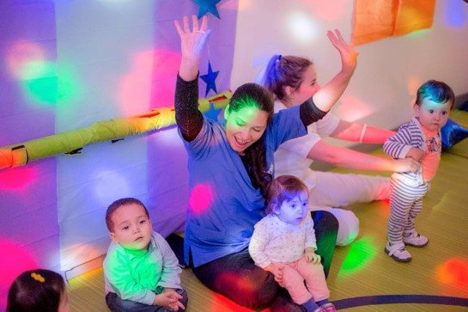
Enrollment certified personel
Enrollment of two ocupational persons an infant psicologist, administrative personal for caretaker and physiotherapist.
Integral Sensorial Certification under the SPM, Dunn, EOIS and Ayres SI scope.

Slide 11

Playground working areas
Vestibular.
Propioceptive.
Tactil and visual.
Auditive and musical.
Balance and motricity.
Relaxation and contention.
Cognitivity and social.

Slide 12
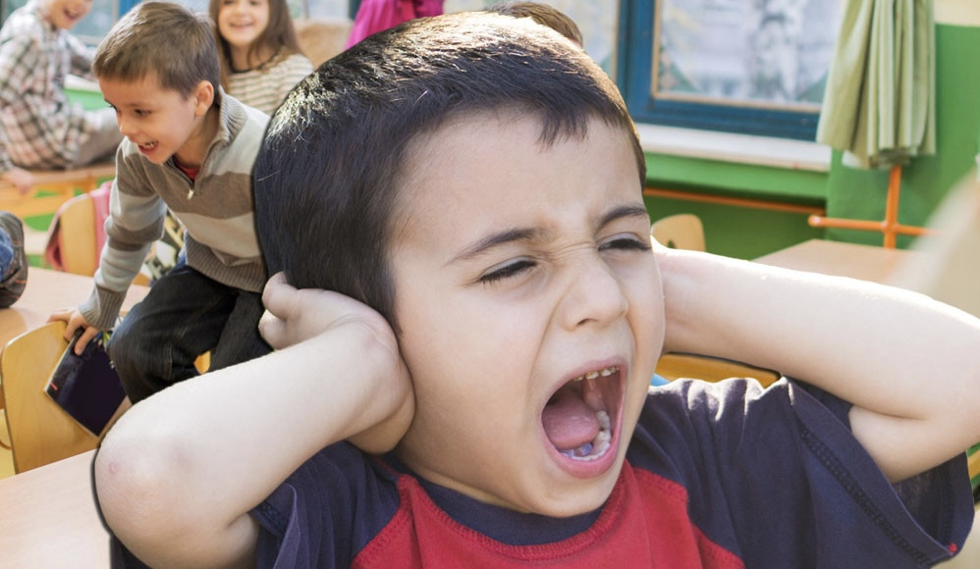
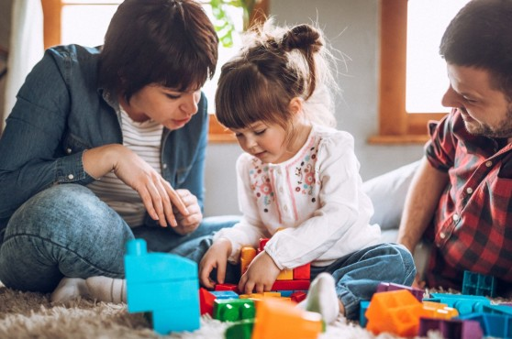
Beneficiaries and Social impact
An aproximate of 80 kids by week, 320 per month by the therapies and 1280 people (their families, classmates, etc)

Slide 13
Sustainability
After the second year according to the attention capacity of 7 patients per day on 7 active hours by two simultaneous areas (or psycologist attention) considering just 5 days per week (could be even 6 days if nessesary) the finantial panorama would be enought ($70,000 MXN a month but we consider just $60,000 MXN for this example) for the expenses every year and if the capacity is reached we could add rooms, therapiest, to improve the patient attention amount.
If things go acording to plan the first income by the patiets could be used to buy more equipment, have more courses for the care givers, etc.
 | Amount | monthly | Expenses | Gross INCOME
Session cost | 250 | $60,000
Per year |  |  |  | 720,000
Therapeutes per year |  | $14,000 | 336,000
Psicologyst and administrative |  | $15,000 | 180,000
Janitors |  | $6,000 | 72,000
General miselaneous expenses |  | $5,583 | 70,000
Total expenses $658,000
After expenses we have $62,000 MXN

Slide 14
Phisical adecuation
 |  | Total
Room set up | Painting, acoustic isolation, vinilic floor, lights, electrical | $65,000
Climatization | Two AC | $30,000
Office furniture and PC | Desk, chairs, benches, office cabinet, waiting room furniture (sofas, central table, TV, water dispenser) | $78,360
Therapeutic decoration | Vinils, pictograms, calm colors | $10,000
Automated Lights and effects | Alexa, Automated lights and effects | $9,500
Ceiling vinils and fabrics | To achieve sensorial adaptive visual atmosphere | $14,500
$207,360 MXN

Slide 15
Sensorial room areas
Set areas | Description | Total
Vestibular | terapeutic swings, tyrolese, hanging leter, trampoline, and climbing wall, musical cushios, iris huracan panel | $130,456
Propioceptive | Rollers, tunnels, spring board, sensorial weights, weight excercise leggins | $25,000
Visual and tactil | Multi sensorial matterials, tactive panels, acrylic mirrors, fiber optics sets and tables, Bubbles tube, fiber optics rain, infinite geometric panels, Flouresent lights set | $206,774
Auditive and musical | Speakers, musical instrumets, and scent difusor, magic cube, | $75,876
Balance and motion | Therapy Swing, Equilibrium Sensorial bag, climbing wall, tactil panel | $53,696
Relaxation and behavioral contention | balls pool, heavy blanquets, cushioned pillows, and self regulation area. | $14,500
$506,406 MXN

Slide 16
Human resources
Personnel | Description | Total
Therapeutic | Ocupational and Sensorial therapeutes (2) x 14,000 | $336,000
Infant psycologist | Part time $ 9,000 | $108,000
Administrative | Part time $ 6,000 | $72,000
Janitor | $ 6,000 | $72,000
Certification | SPM, Dunn, EOIS, Ayres scope SI x 2 | $56,000
$644,000 MXN

Slide 17
Administrative and operational
Personnel | Description | total
Therapeutic material | Molding clay, sheets, globes, liquid kits | $18,000
Clinical paper work | Sheets and patient files, certificates sheets | $6,000
Janitor and mantenaince | Cleaning and laundry items, preventive maintenaince | $12,000
Electrical, water bills | AC, lights and equipment | $7,000
Internet and software | Wifi, Spotify subscription, Computer | $17 ,000
Ads and propaganda | Posters, Social network ads and school visits. | $10,000
$70,000 MXN

Slide 18
Totals
 |  | Amout
Adecuation |  | $207,360
Equipment |  | $506,406
Human resourses |  | $644,000
Operational |  | $70,000
Initial investment $1,427,766
*$82,913.24 USD
* Considering a Echange rate of 17.22

Slide 19
Thank you!!
We apreciate your willing to support projects in our beloved district and thank you for being kind, without you we would’t be able to do nothing.
Your help would be a great change to really improve our kids and families! blessings from our club members.
Any Questions?? ☺

