Slide 1


Slide 2



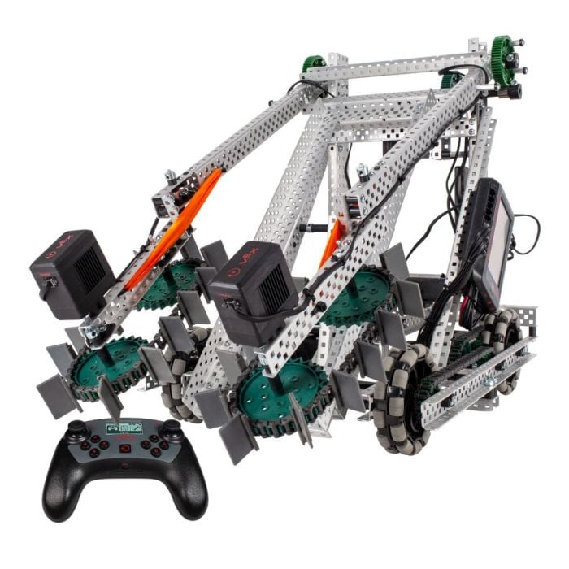
Robotics Workshops for Digital Inclusion: Tumbulushal, Tabasco, México
Rotary Club Tabasco
Distrito 4195

Slide 3

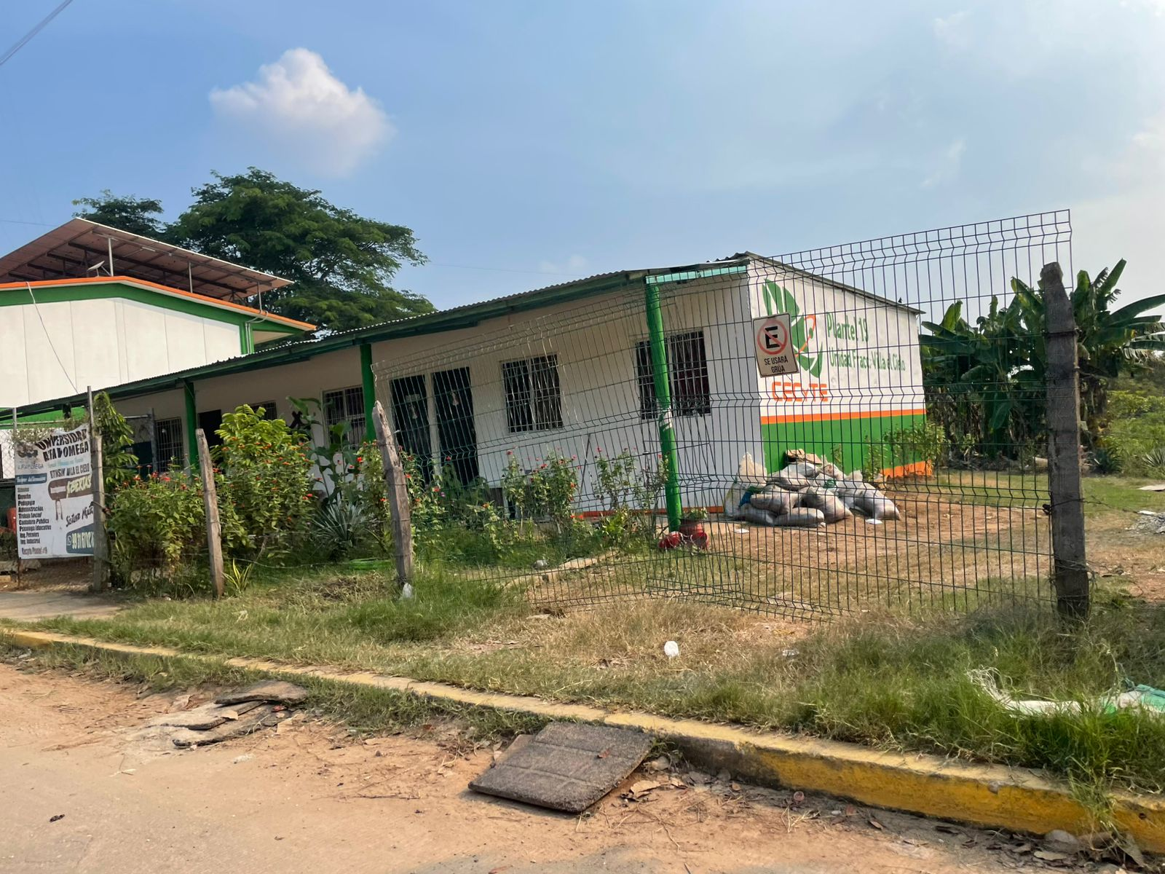
ROTARY CLUB TABASCO
“Robotics Workshops for Digital Inclusion: Tumbulushal, Tabasco, México."
In Tabasco, there are no initiatives that actively seek to make robotics accesible to rural communities.
Limited access to basic resources for students and their families.
High dropout rates in Elementary & Middle School.

Slide 4

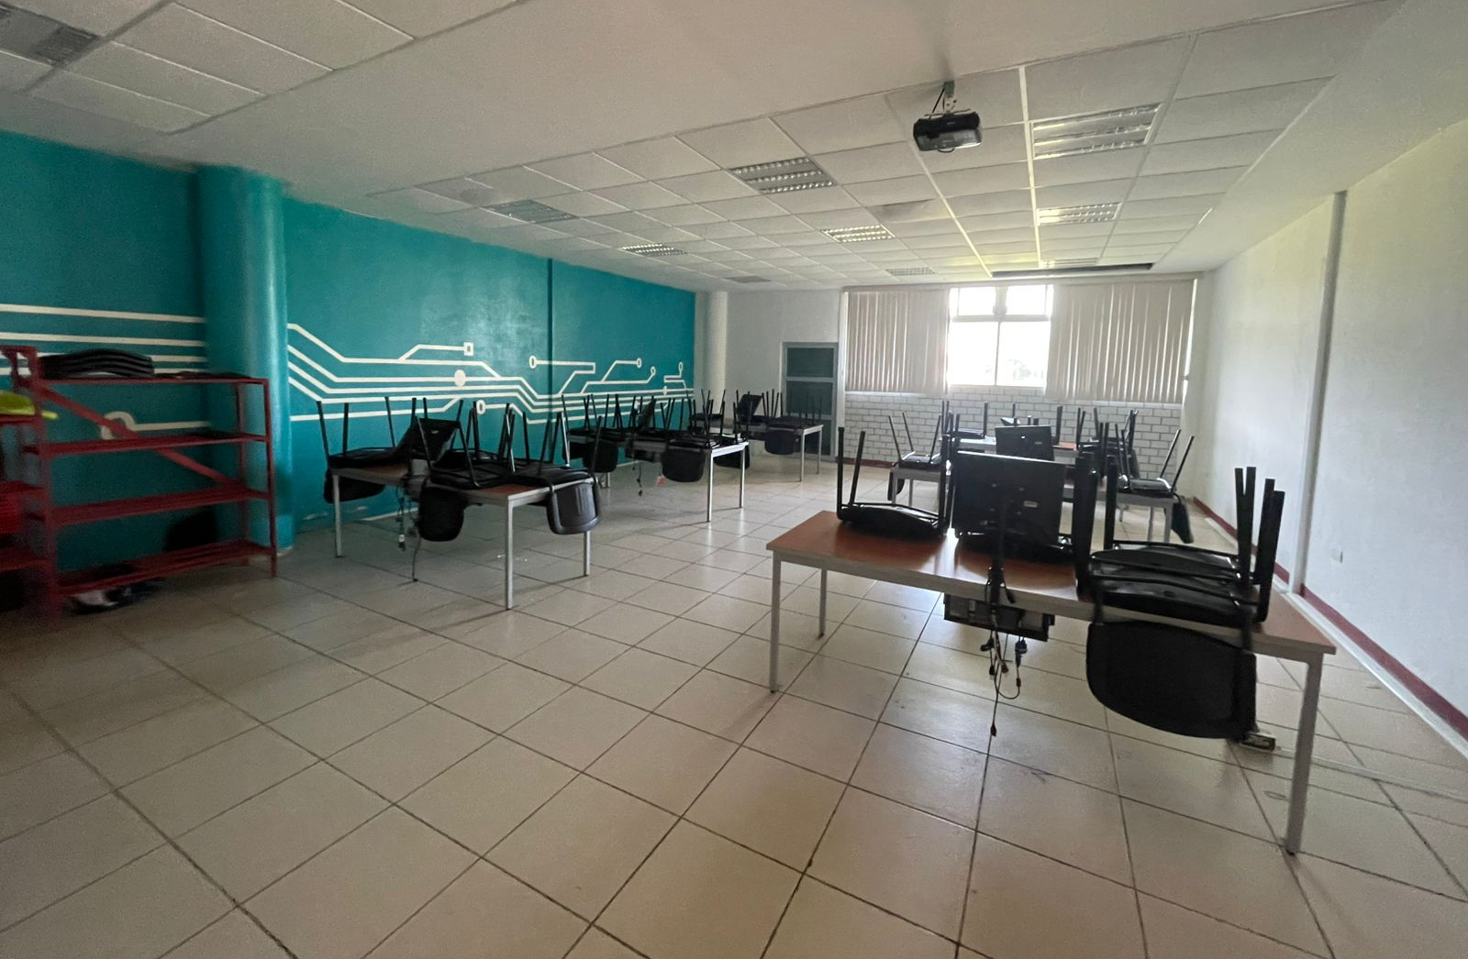
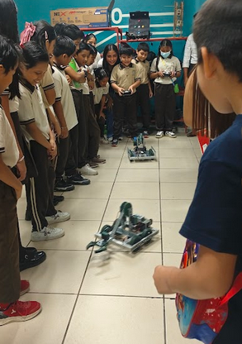
STEAM Training to Strengthen the Educational Community
We seek to mitigate these problems by establishing a Robotics workshops for Elementary & Middle School students in Tumbulushal.
Teaching robotics to children with the goal of motivating them to continue their studies, on STEAM-related careers.​
We want to establish a multi-level, robotics educational program that will benefit the community of Tumbulushal, invloving schools and the university in the area.

Slide 5

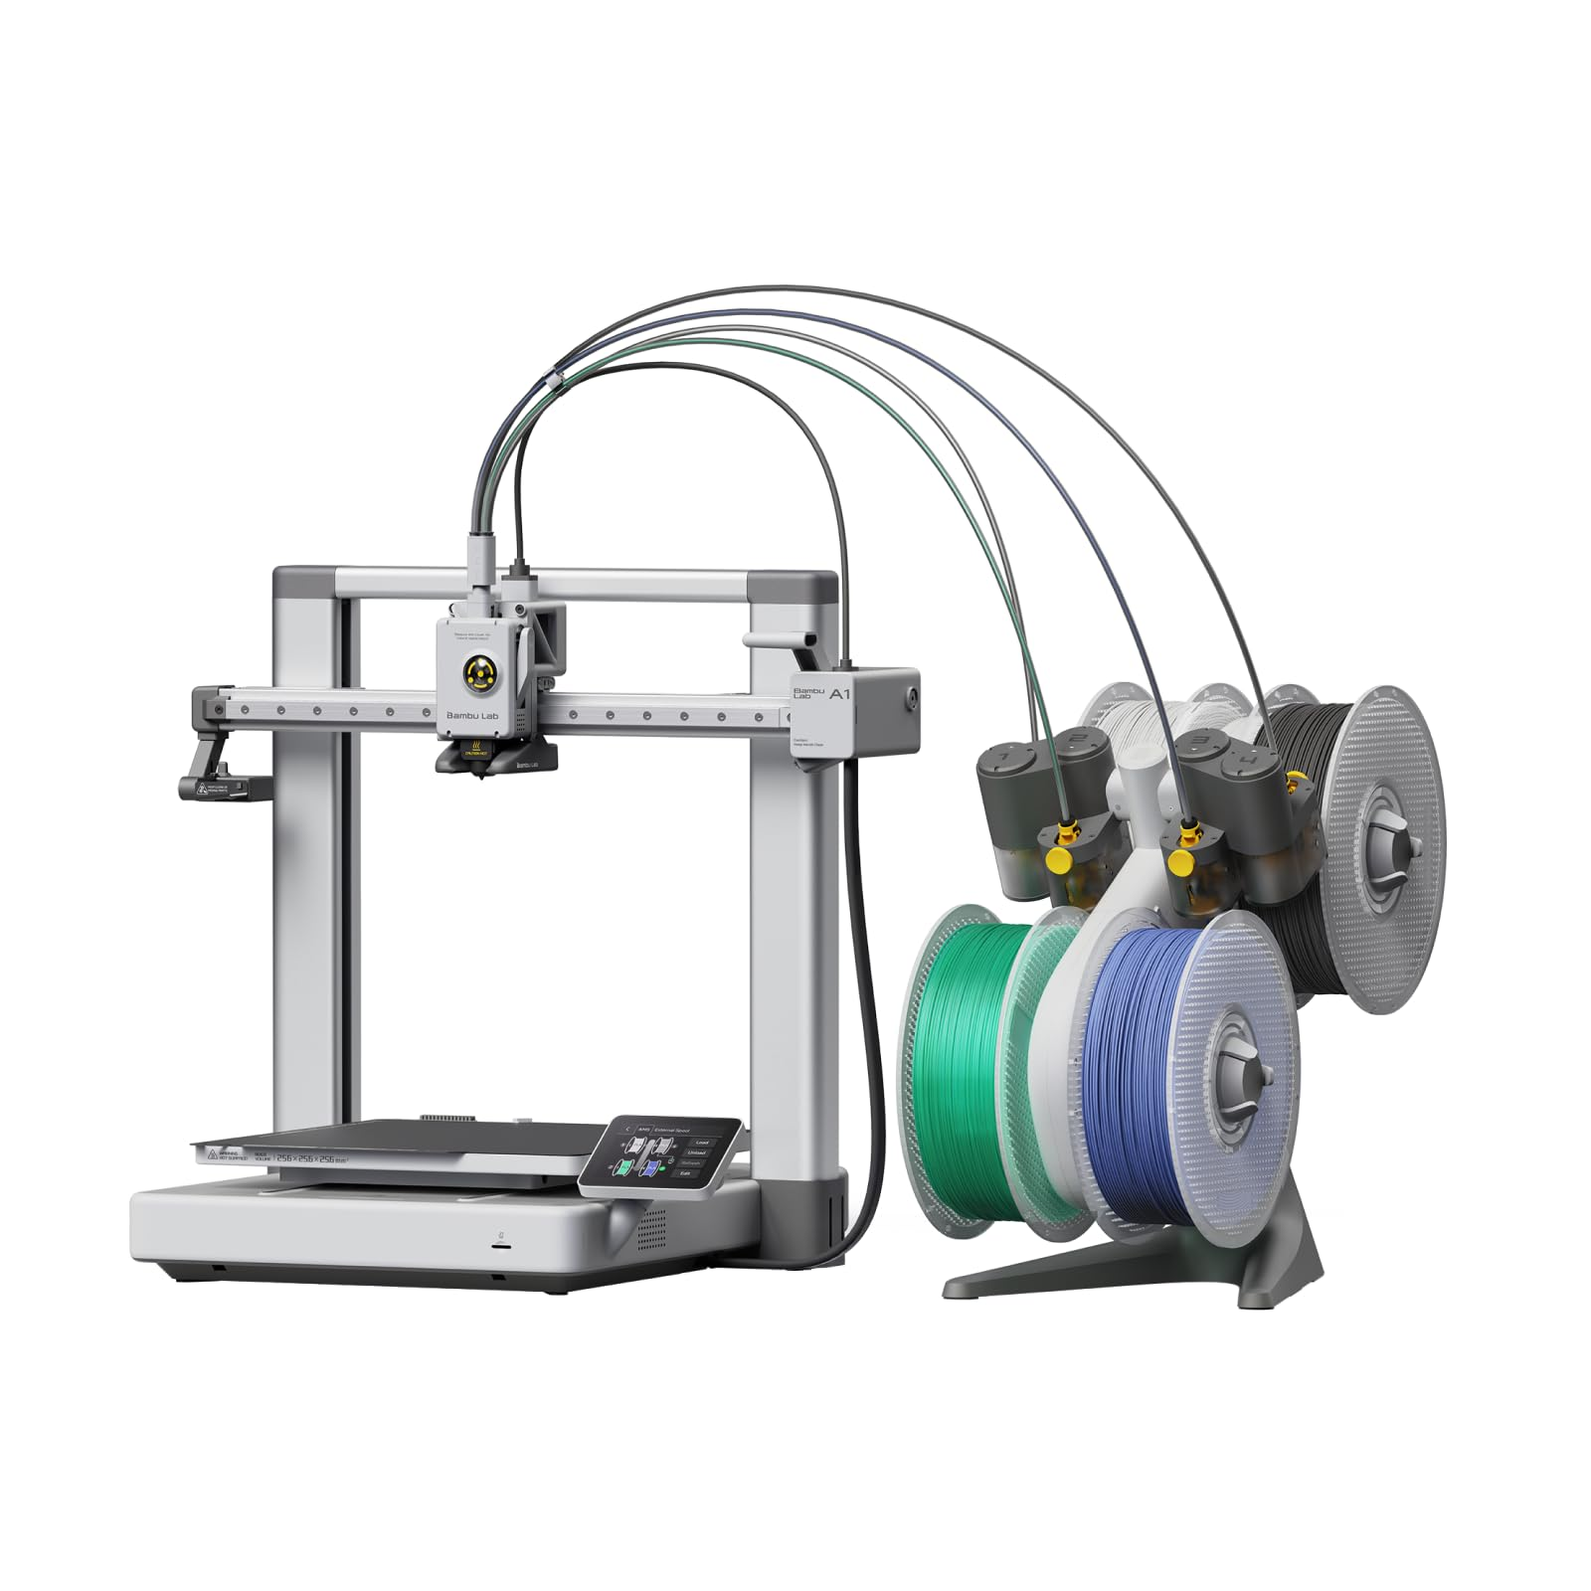
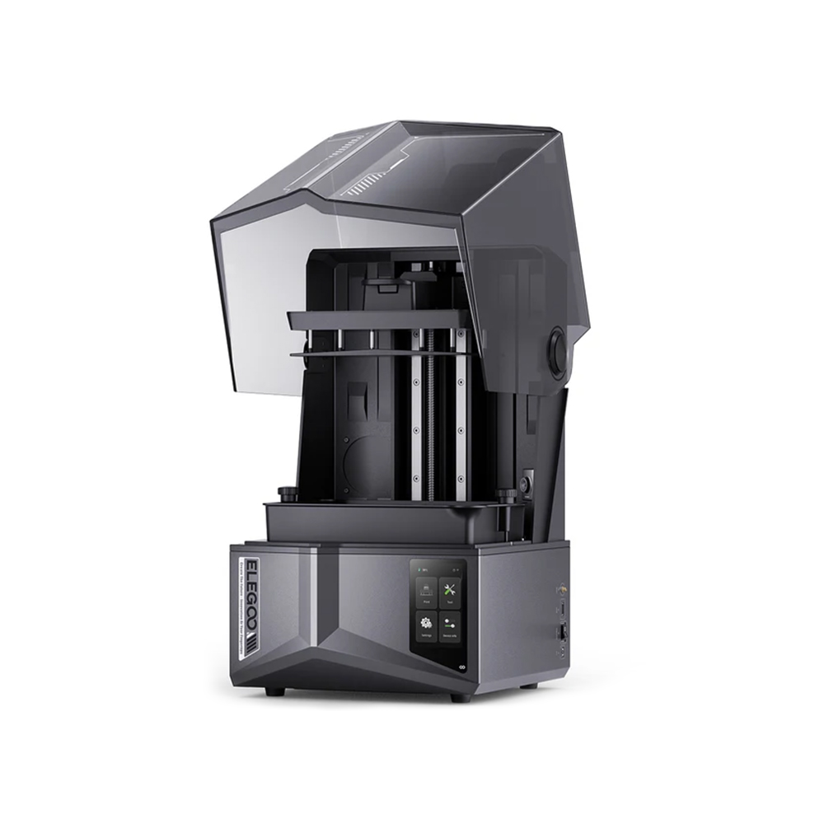
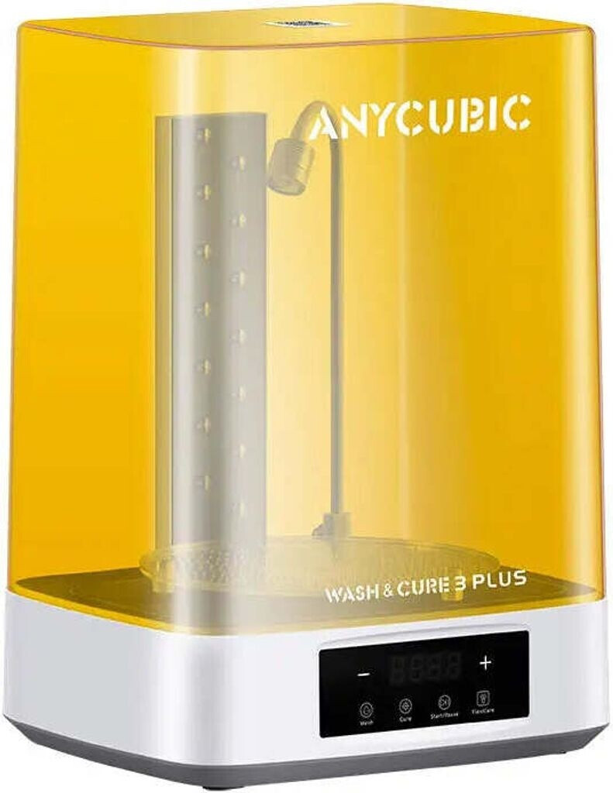
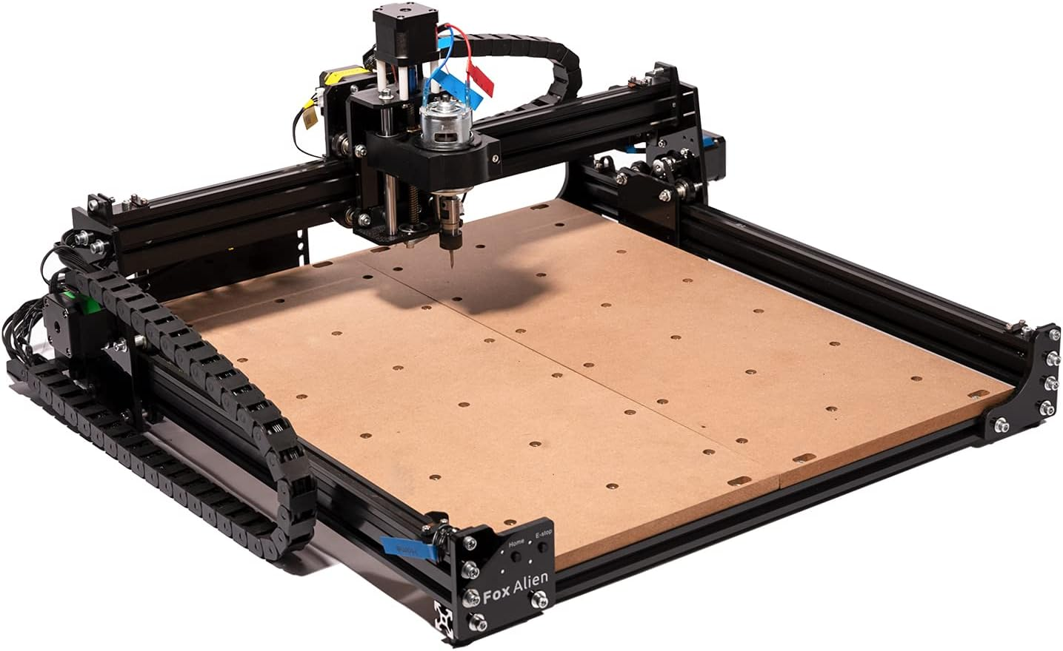
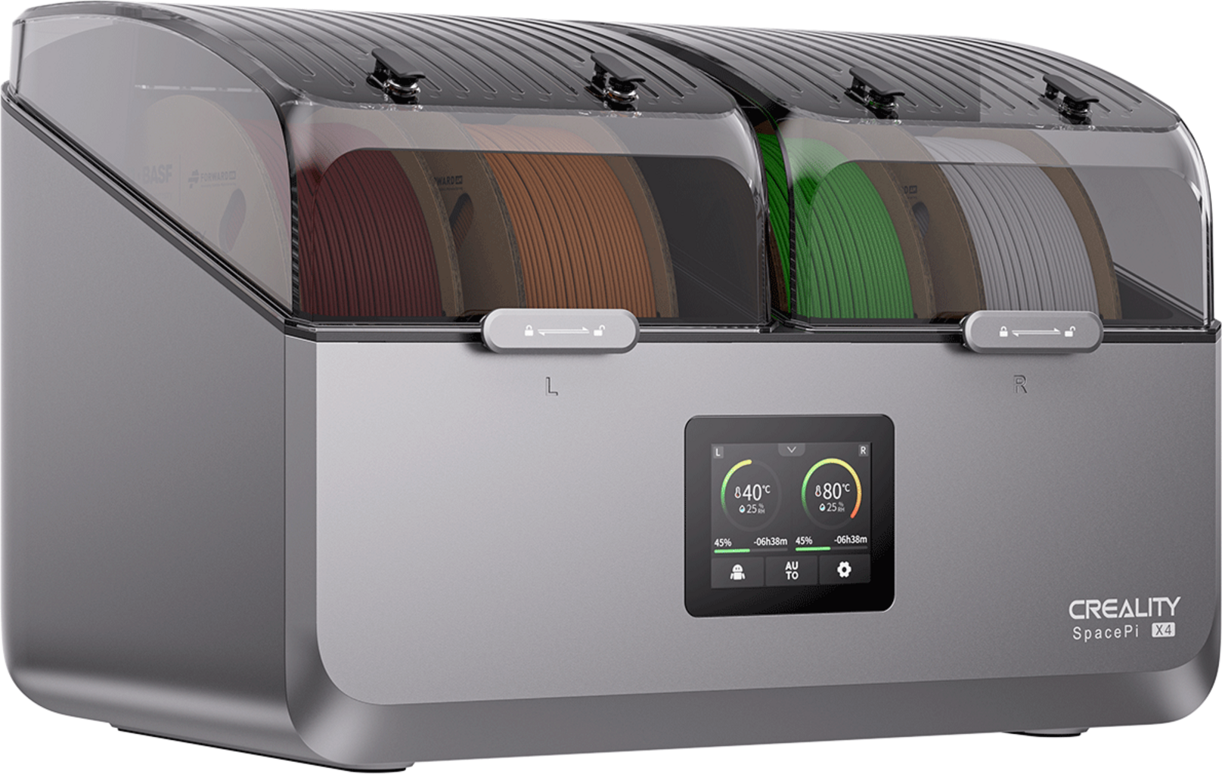
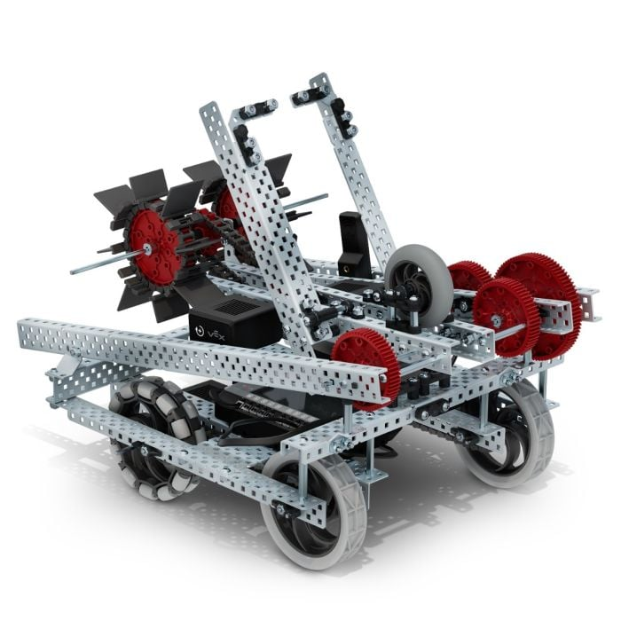
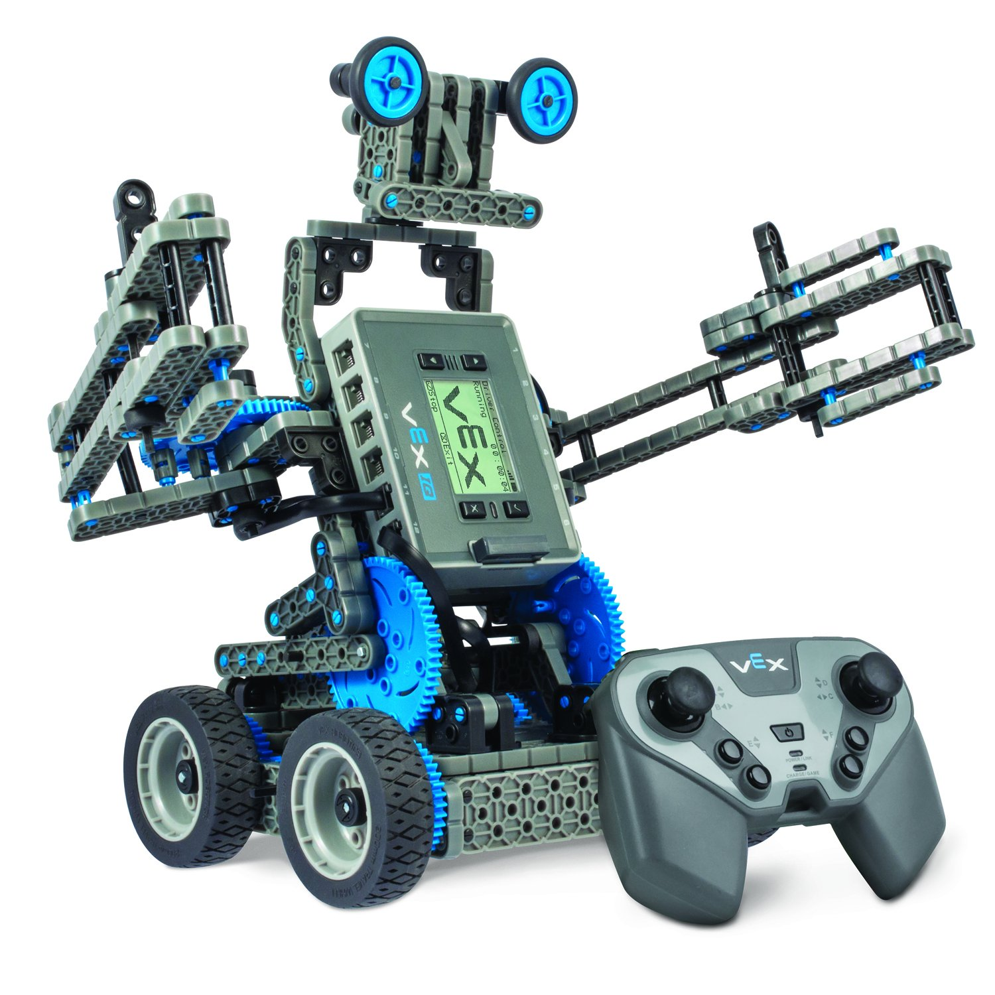
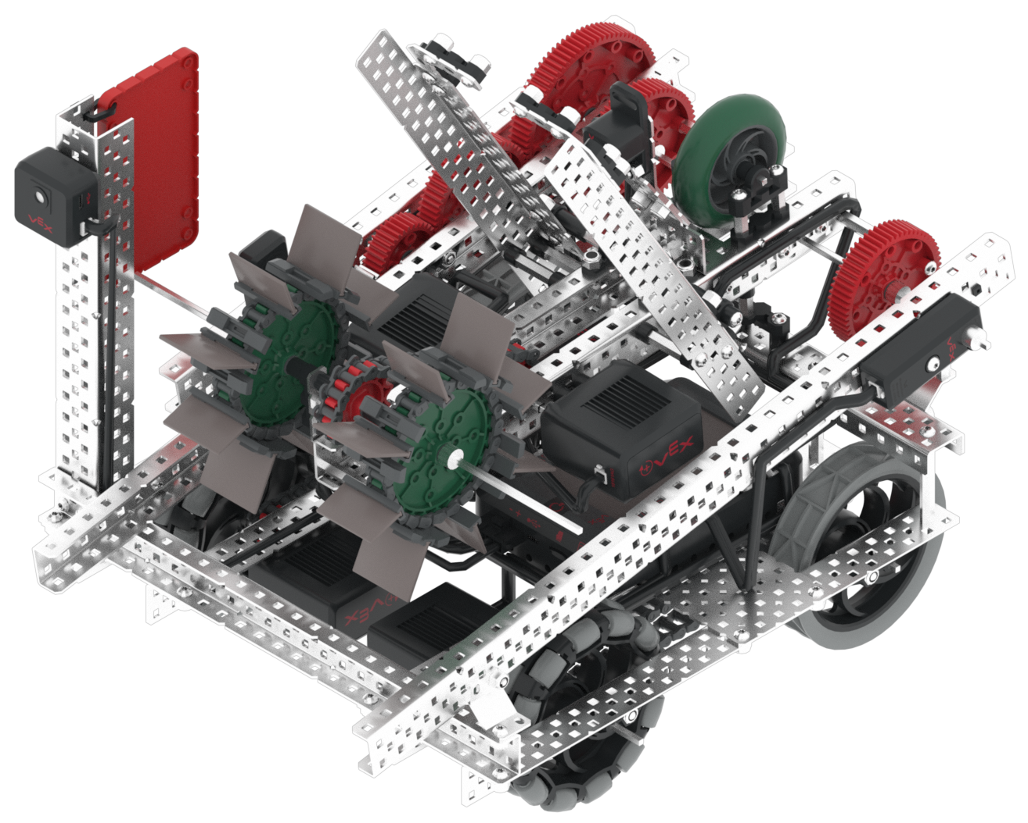

ROTARY CLUB TABASCO
"Robotics Workshops for Digital Inclusion: Tumbulushal, Tabasco, México."
Required equipment & training:
Filament storage & part curing
Circuit Etching
3D Printing
VEX EDR and IQ robotics equipment
3D modelling

Slide 6
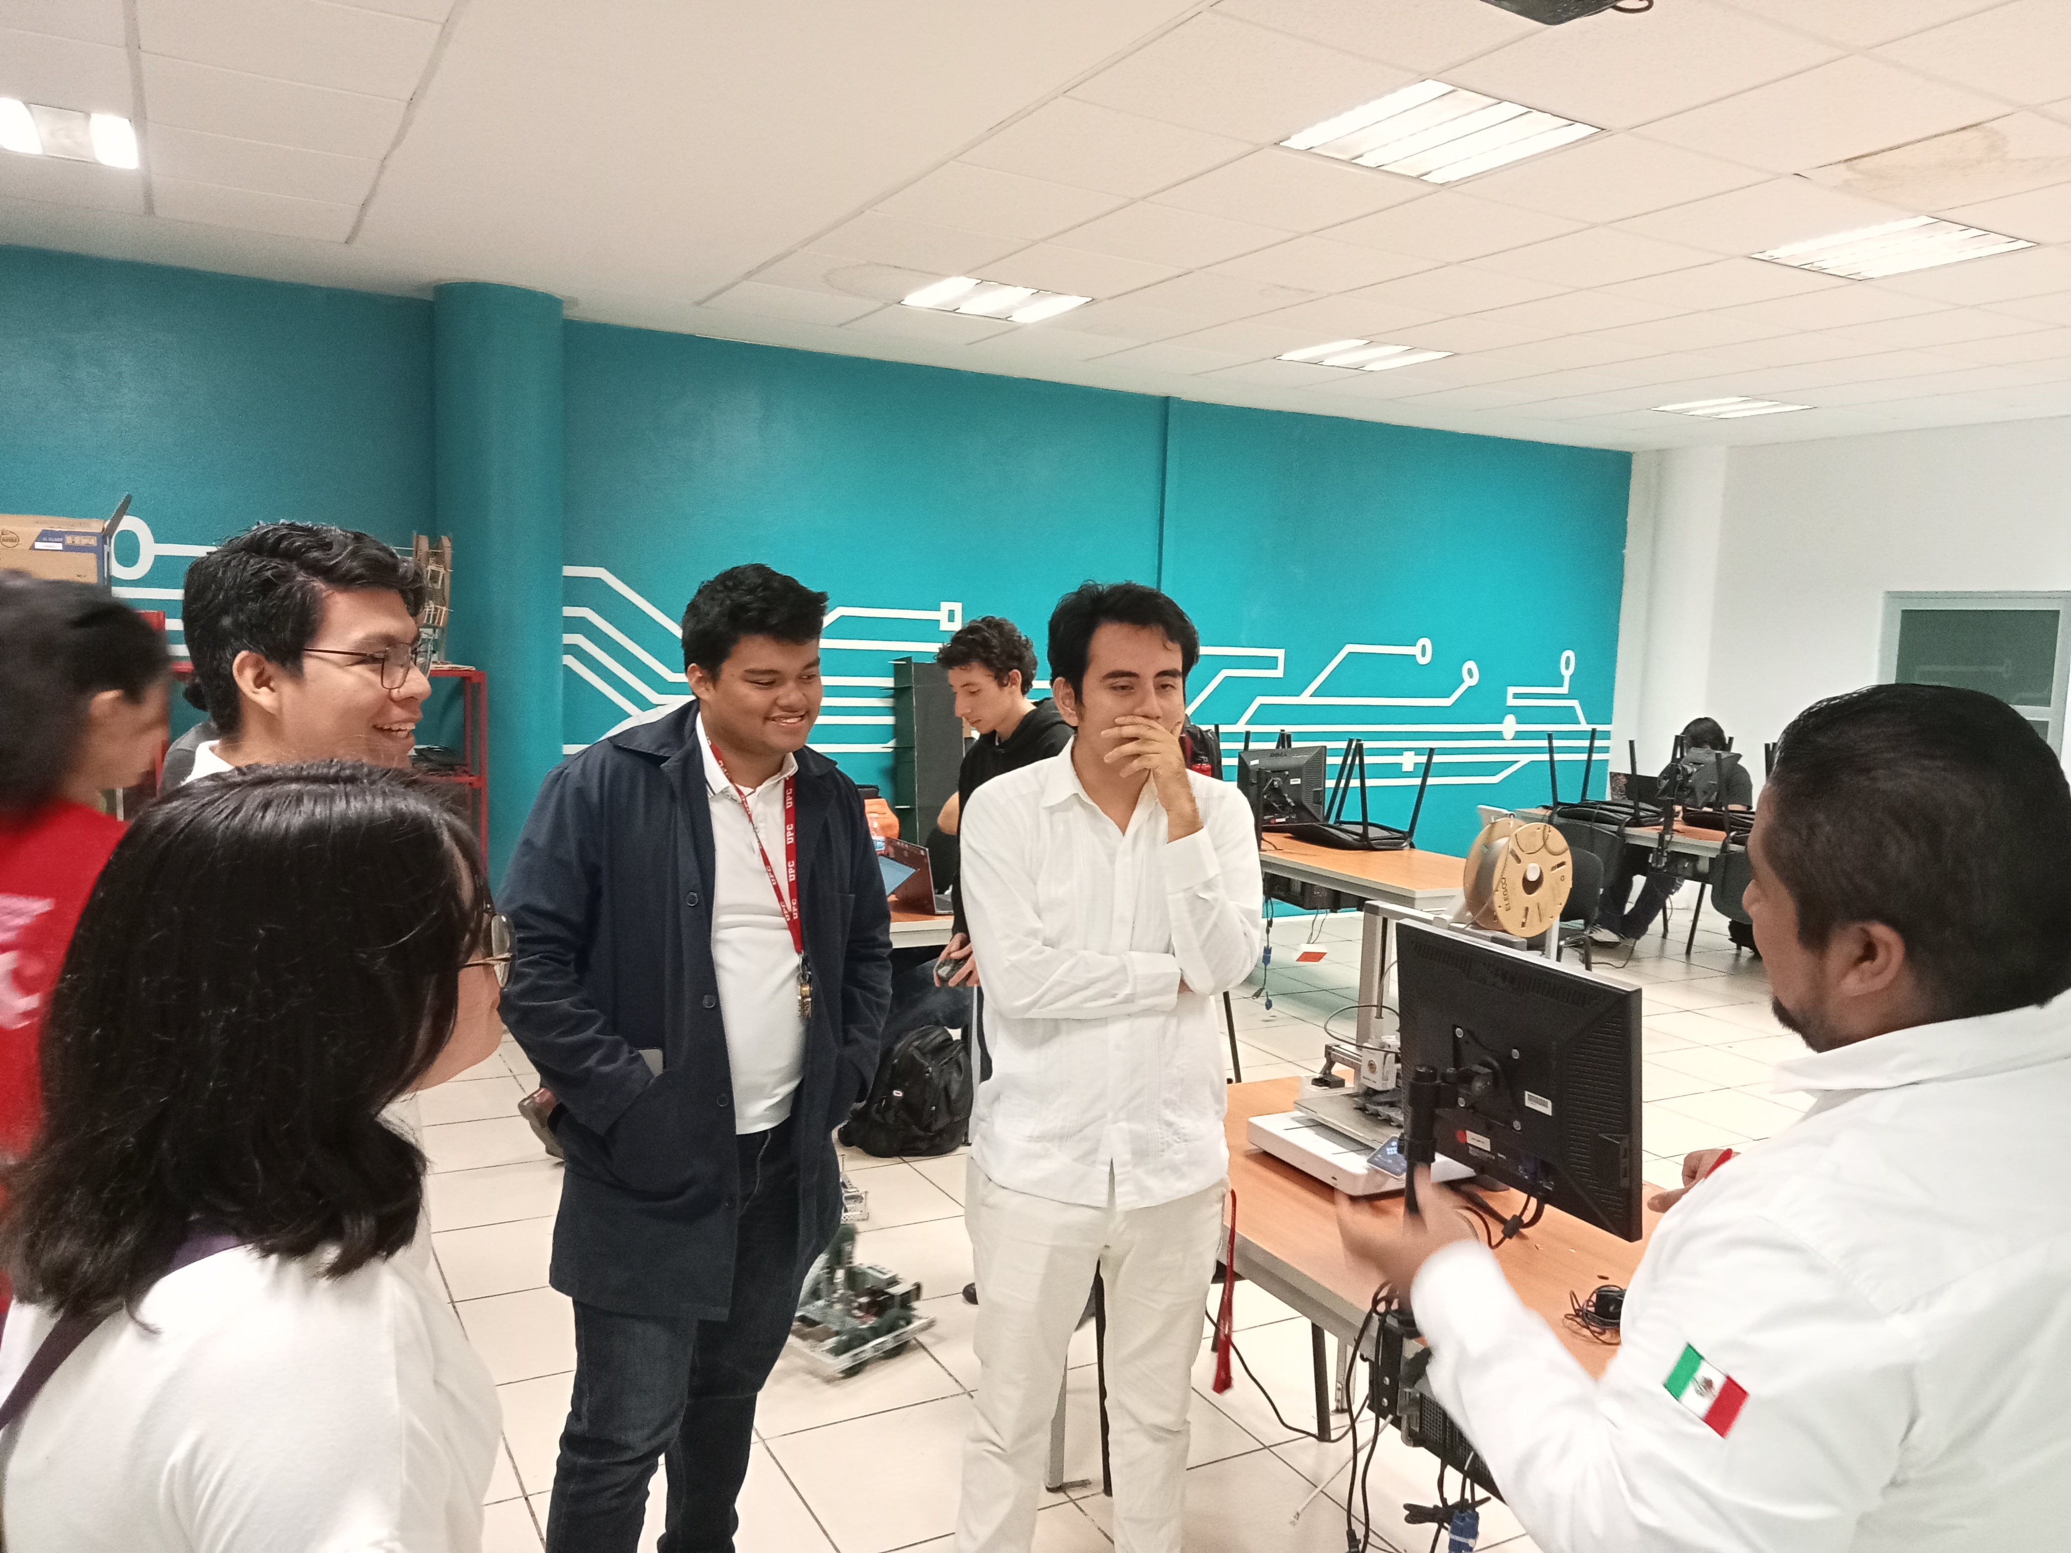
SUSTAINABILITY
Training: A group of university level students & their teachers will be trained in equipment operation & children teaching methods.
Maintenance and Operation: Specialized training drives operational efficiency and long-term knowledge retention, reducing maintenance costs.

Slide 7



SUSTAINABILITY
Main Collaborators with MOU

Slide 8
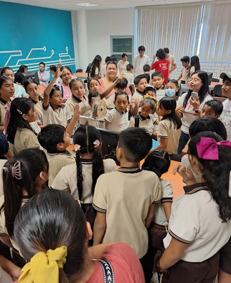
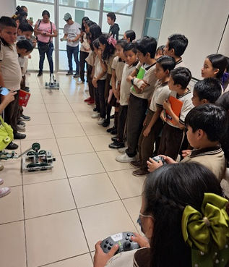
SUSTAINABILITY
Short-Term Results: Establish robotics workshops for 100 elementary school students.
Long-Term Results: Consolidate the robotics workshops for 200 children in the community and neighboring areas.
Once Rotary support ends: UPC will assume technical and operational oversight of the program.

Slide 9

BUGDET
Category | Description | Amount. MXN | Percentage
Equipment | Aqcusition of requiered equipment | $ 400,000.00 | 66.67%
Professional Training | Trainig for participating students & teachers | $ 50,000.00 | 8.33%
Community Training | Trainig for students of target schools | $ 50,000.00 | 8.33%
Consumables |  | $ 100,000.00 | 16.67%
TOTAL |  | $ 600,000.00 | 100%

Slide 10
FUNDING

Slide 11

"Robotics Workshops for Digital Inclusion: Tumbulushal, Tabasco, México."
ROTARY CLUB TABASCO
We request:
Solicitamos:
$8,000 USD FDD

Slide 12

CONTACT INFO
Contact 1: Ana Edith Palomino Vergara
E-mail: aepalomino@yahoo.com
Tel. / Whatsapp: +52 993 393 7571
Cargo: Presidenta Club Rotario Tabasco Villahermosa
Contact 2: Karla Alvarez Toledo
E-mail: kalvarez@prodigy.net.mx
Teléfono / Whatsapp: +52 553 045 3045
Cargo: Rotary Foundation Club Rotario Tabasco Villahermosa
Contact 3: Alejandro Camacho Morales
E-mail: acm.upc@outlook.com
Teléfono / Whatsapp: +52 551 909 0637
Cargo: Director de Mecatrónica, UPC
Contact 4: Miguel Alejandro Sánchez Jiménez
E-mail: mi.saj0002@gmail.com
Teléfono / Whatsapp: +52 993 162 7536
Cargo: Profesor de Mecatrónica, UPC
Contact 5: Andrés Gerardo Barahona Bautista
E-mail: angerbarahona@gmail.com
Teléfono / Whatsapp: +52 993 196 1937
Cargo: Profesor de Mecatrónica, UPC

