Slide 1

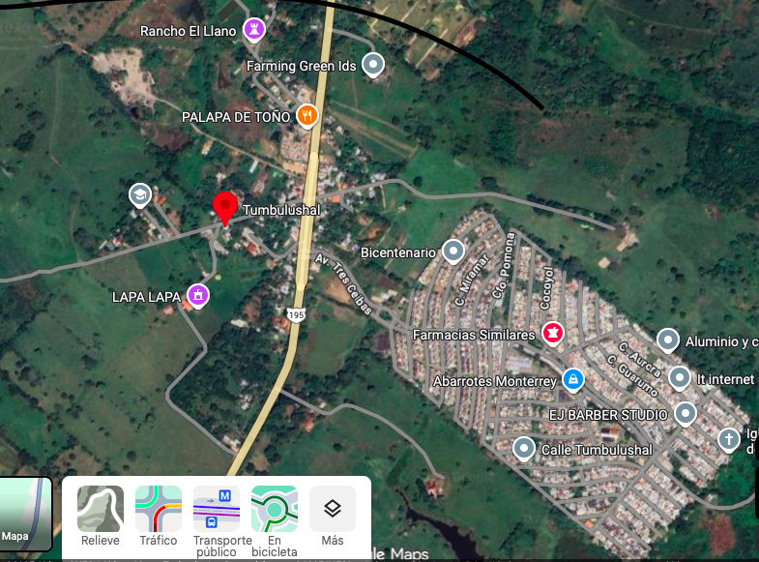

Tumbulushal, Tabasco, México."
https://www.google.com/maps/place/Tumbulushal/@17.8202276,-92.9332121,16.36z/data=!4m6!3m5!1s0x85edc5004c5ad9dd:0xb253a4409903ad1b!8m2!3d17.8208354!4d-92.9314818!16s%2Fg%2F11vm1ms2cj?entry=ttu&g_ep=EgoyMDI1MTIwMi4wIKXMDSoASAFQAw%3D%3D

Slide 2
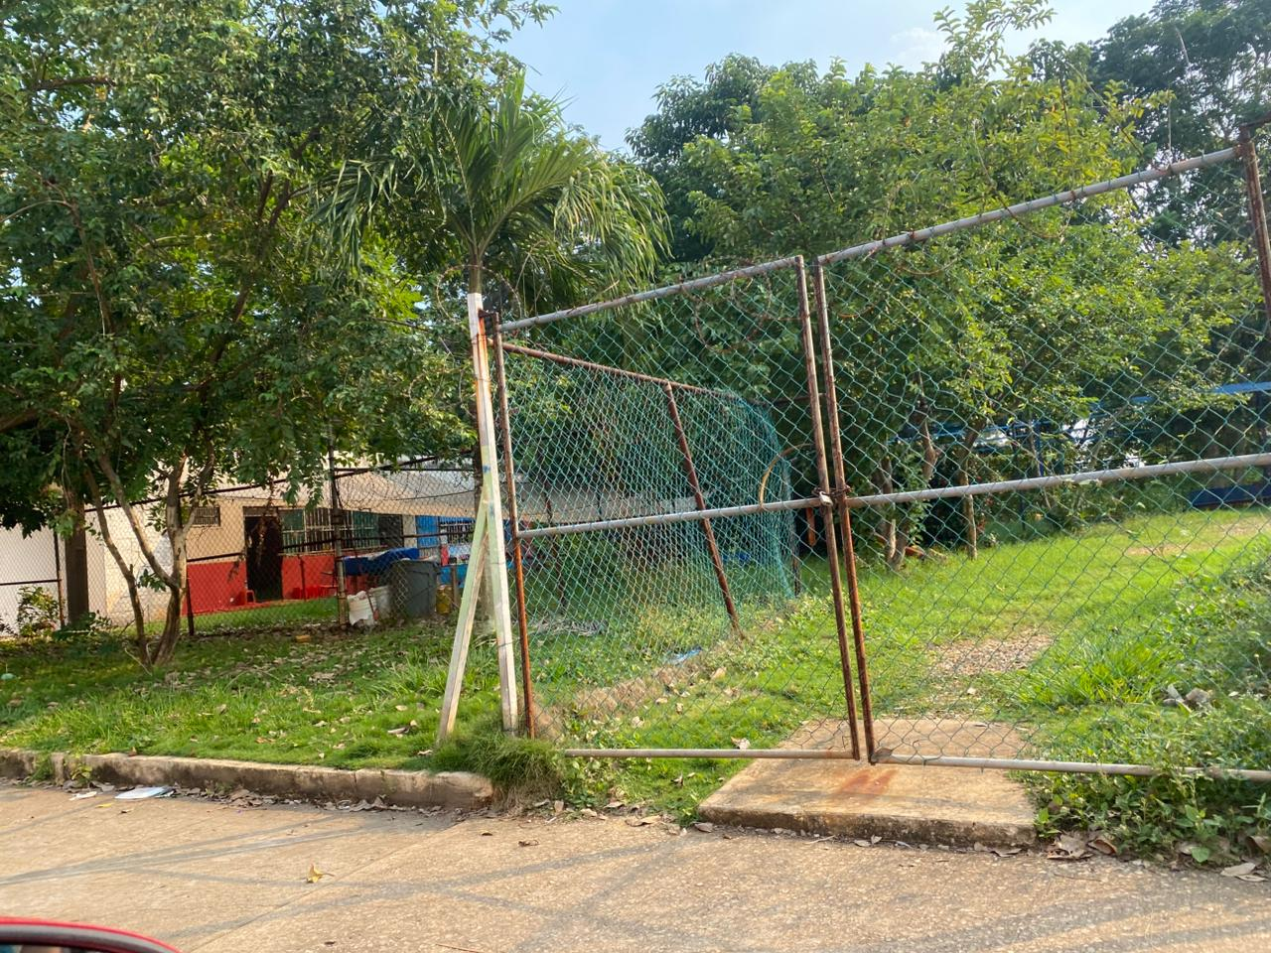
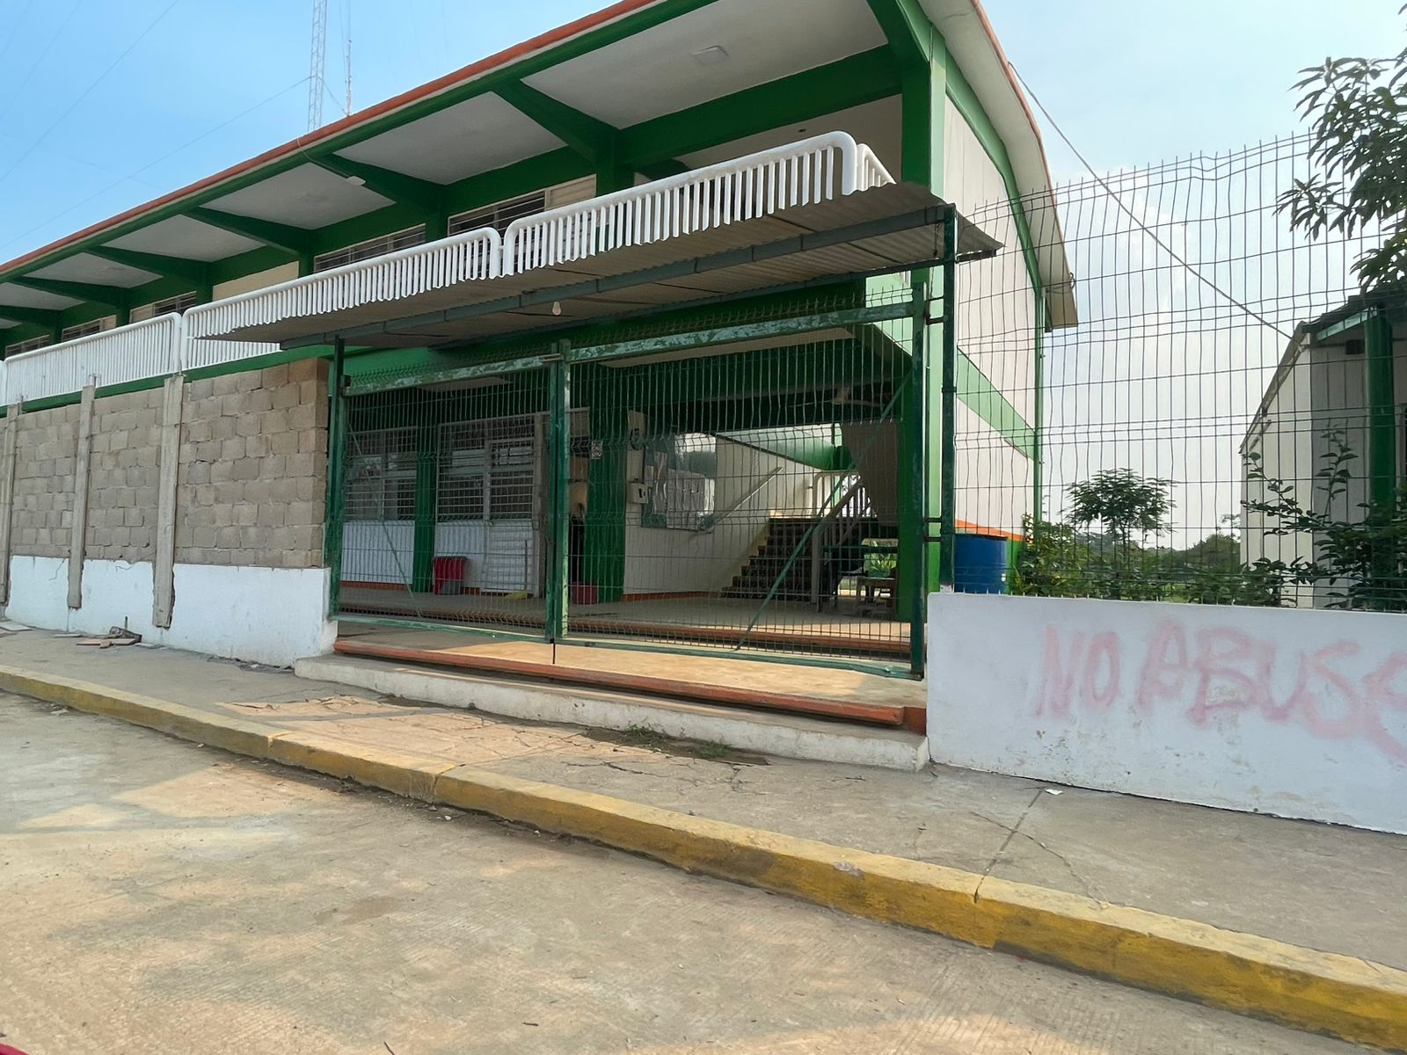
Tumbulushal, Tabasco, México."

Slide 3
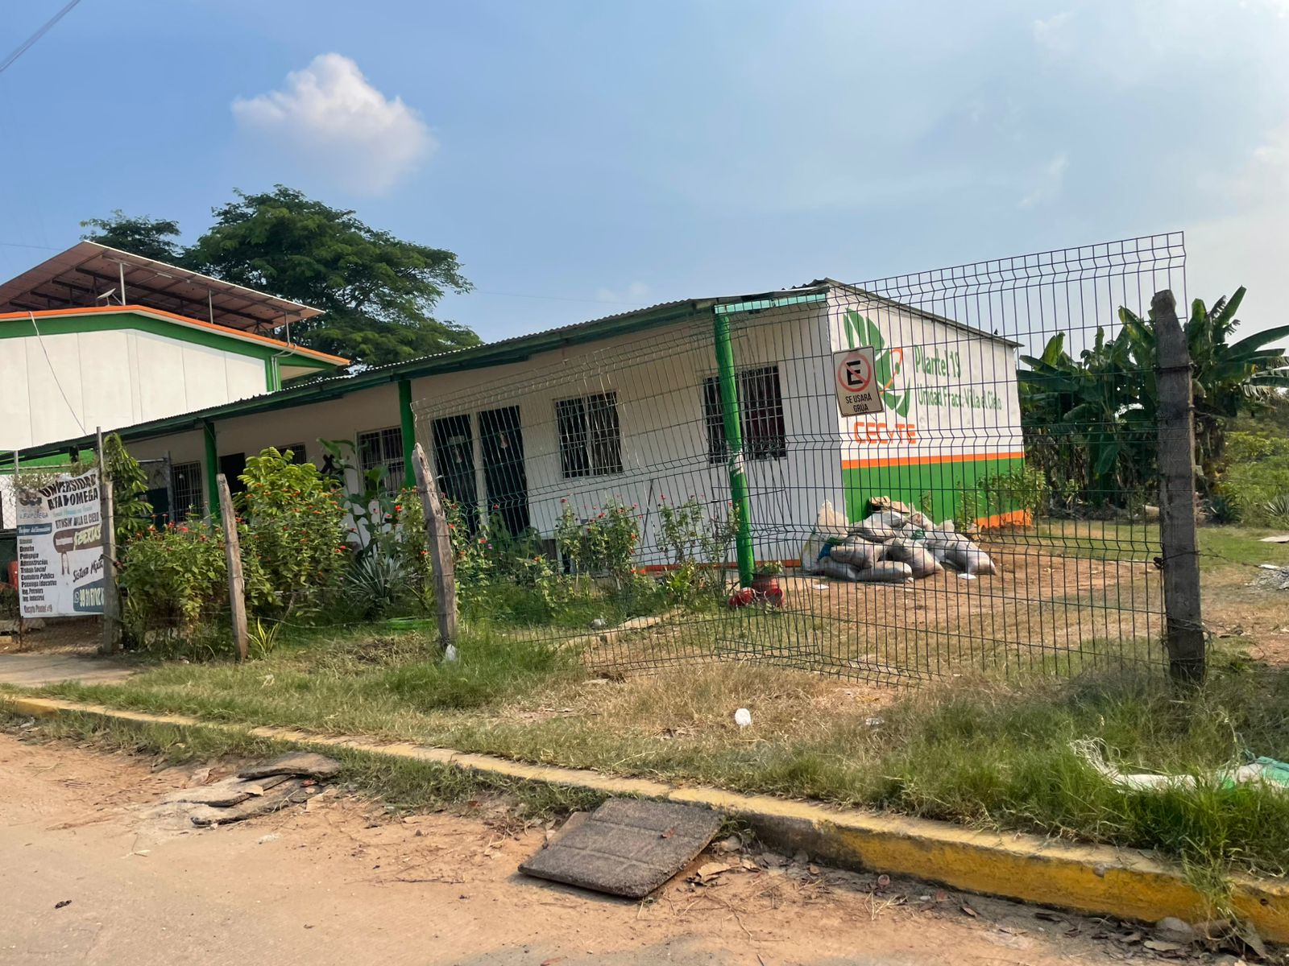
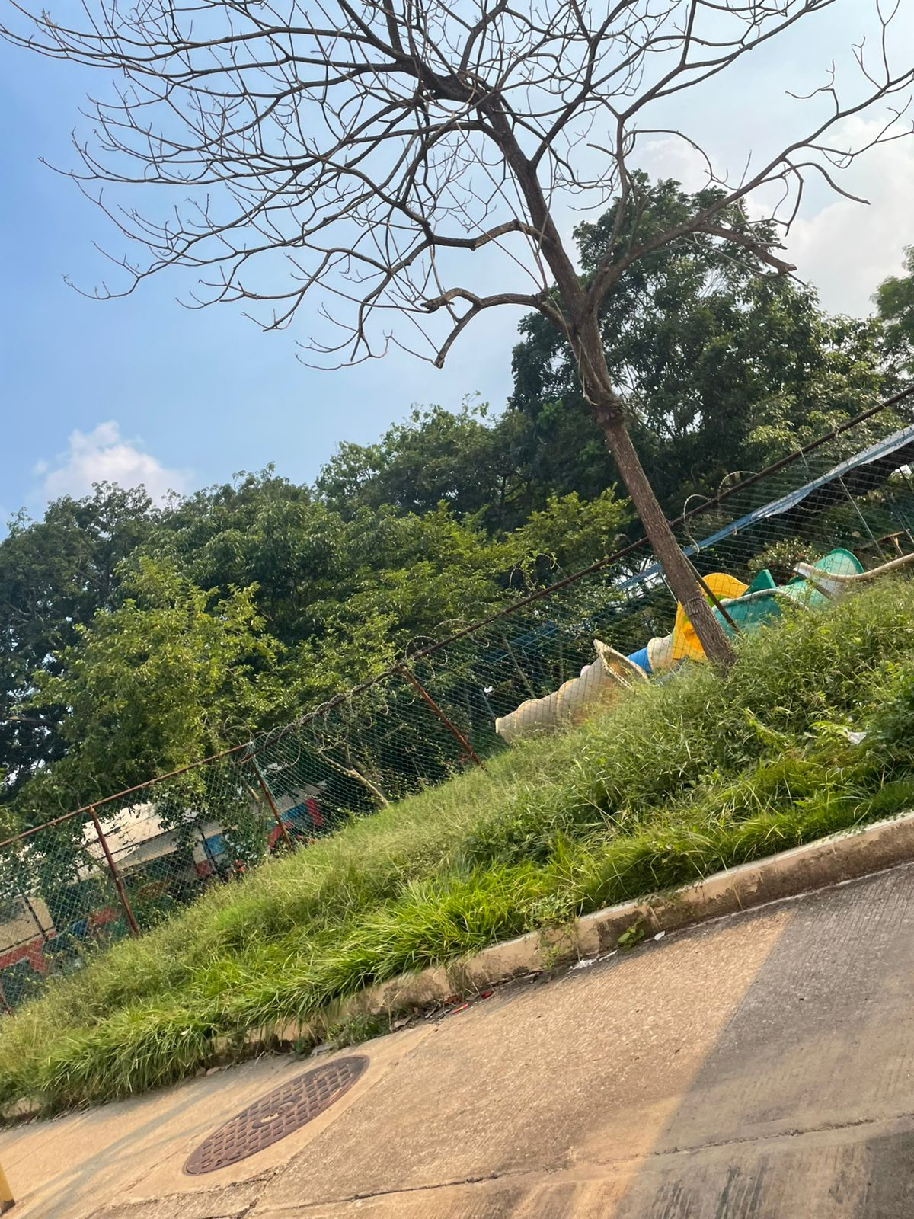
Tumbulushal, Tabasco, México."

Slide 4

