Slide 1


Slide 2


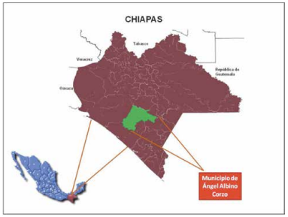

General Information
ROTARY CLUB OF ORIENTE DE TUXTLA 24186, DISTRICT 4195, CHIAPAS, MEXICO. "TRAINING AND EQUIPMENT PROGRAM FOR THE ANGEL ALBINO CORZO COMMUNITY BASIC HOSPITAL"
We are the Rotary Club of East Tuxtla 24186 and we have worked since 2019 with the Basic Community Hospital in Angel Albino Corzo, on different projects that have benefited thousands of people in countless communities.

Slide 3
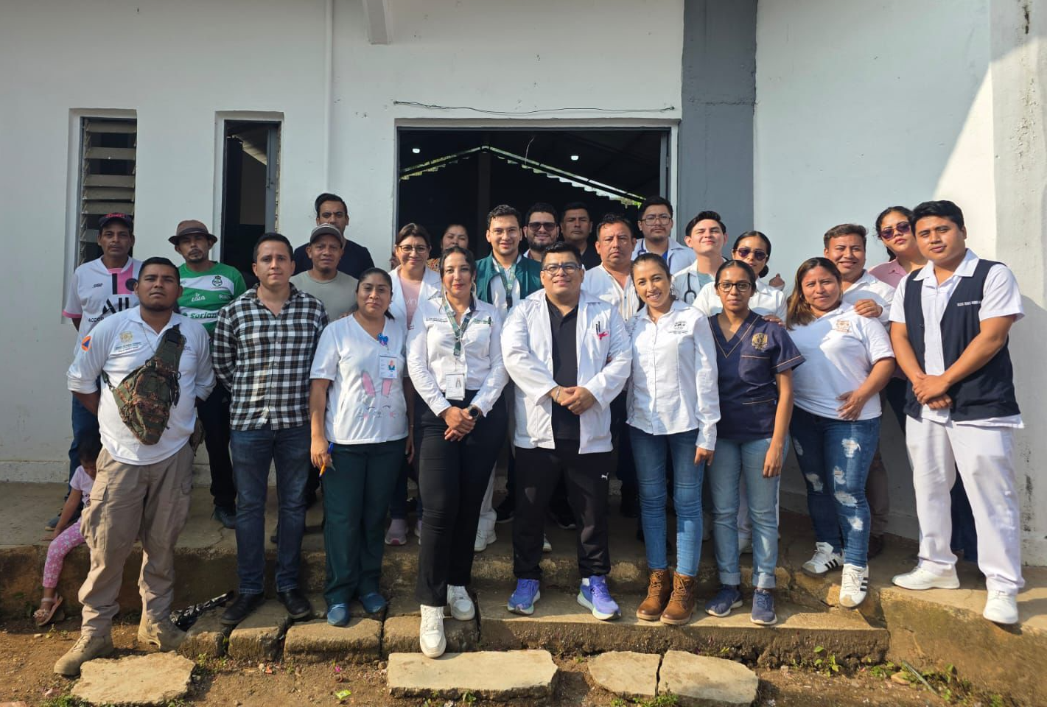
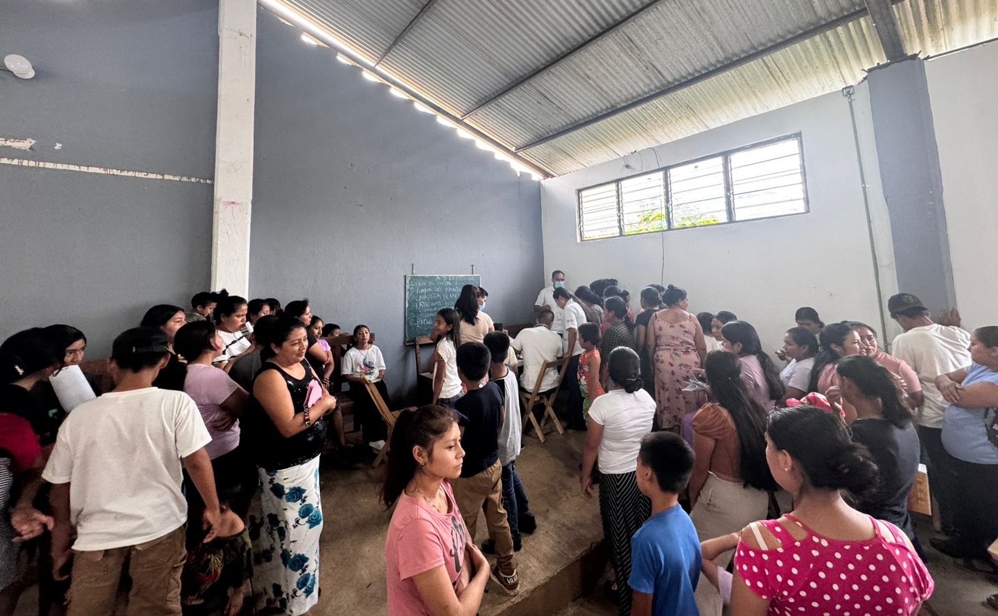
The Basic Community Hospital serves more than 108,000 patients annually in 7 municipalities of the Sierra and Frailesca regions.
The project aims to strengthen maternal and child health care and disease prevention through a training program and essential equipment for critical areas.
Currently, it operates with numerous limitations: much equipment is broken or nonexistent.
The project's objective is to train hospital staff and equip critical areas (maternity, pediatrics, emergency, and operating room) with appropriate technology to save lives
This training and equipment will improve maternal and child health care and prevent diseases, as well as strengthen emergency response capacity and reduce maternal and neonatal mortality in the region.

Slide 4
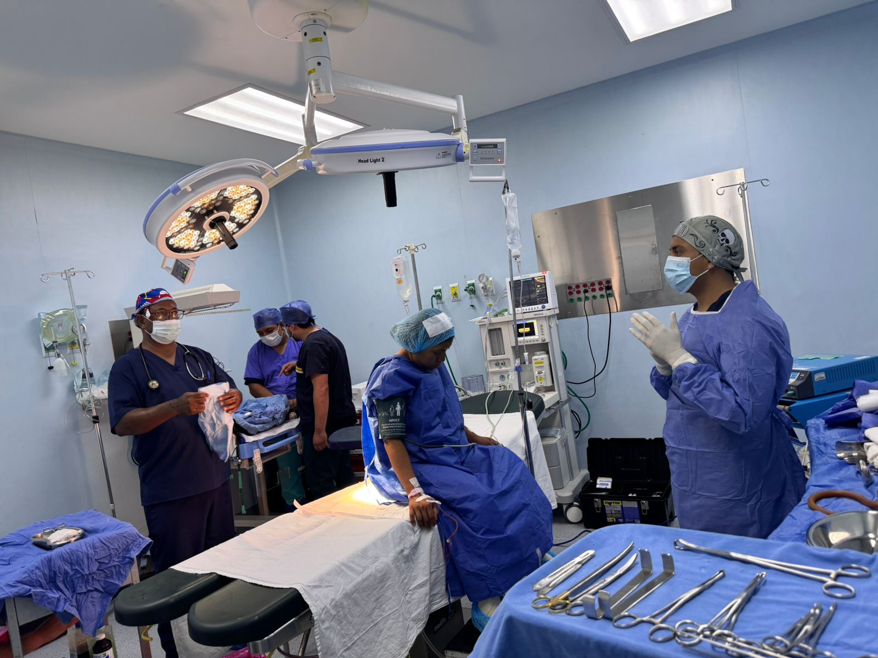
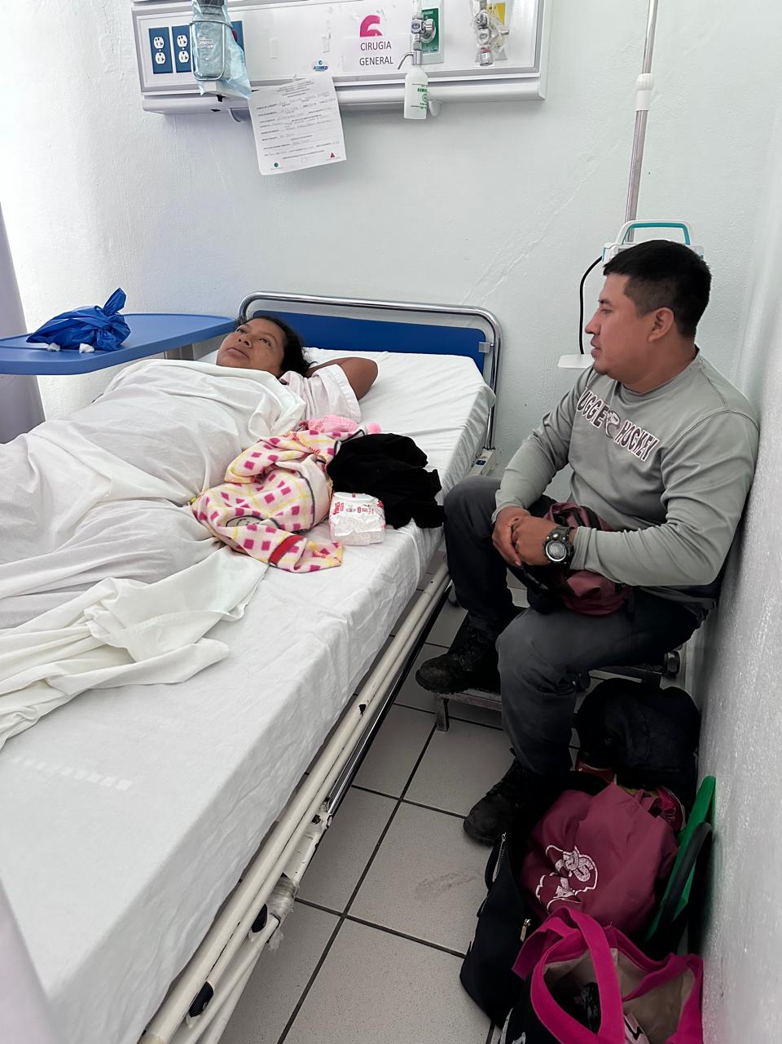
Expected Results and Measurement:
Direct Beneficiaries: Patients per year. +108,000
Safer and more effective care in childbirth, surgery, and emergencies.
Reduction of maternal and infant mortality in Chiapas and a replicable model in other community hospitals
Problem:
Social backwardness and extreme poverty in Chiapas.
High maternal and neonatal mortality (25-26 deaths in the first half of 2024).

Slide 5
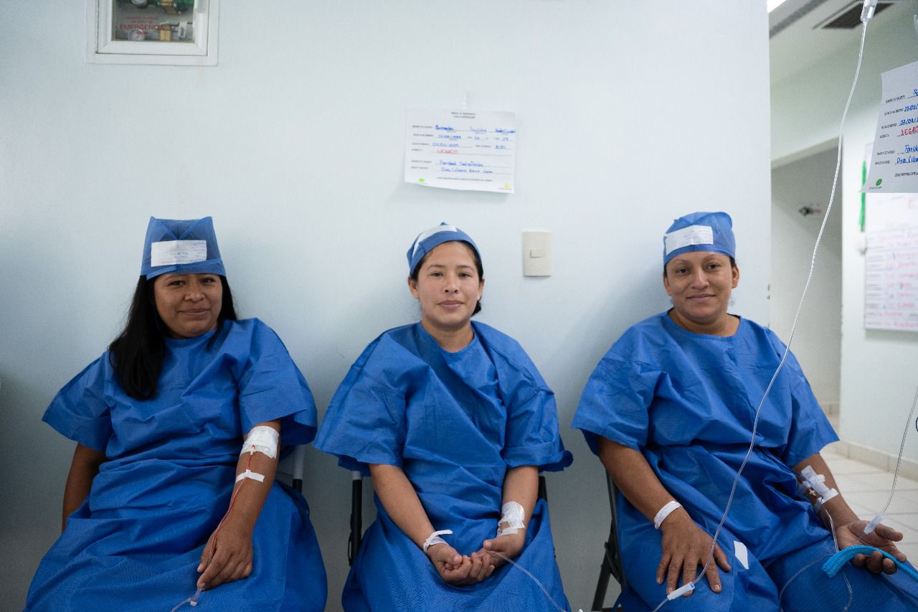
SUSTAINBILITY
Training: Specific training will be provided by the supplier for the proper use and maintenance of the equipment. Courses for midwives are also being implemented; currently, they are being taught how to administer rapid HIV tests and ensure timely detection for those they serve. Various preventive health campaigns are also being conducted for the entire community.
Main Collaborators:
Dr. César Uberto Molina Orozco - Director HBC
Dr. Dania Molina Palacios - Deputy Director HBC
Dr. María Azucena Espinosa Olivas - Pediatrician HBC
Partners in Health
Red Salud
Maintenance and Operation: Low-cost medical services will allow the acquired equipment to be kept in optimal condition.

Slide 6
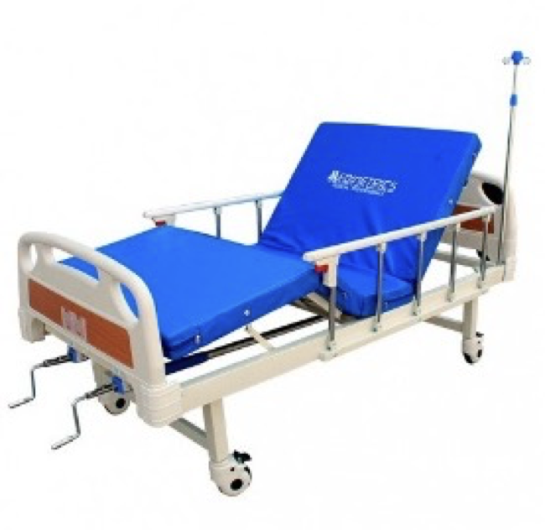
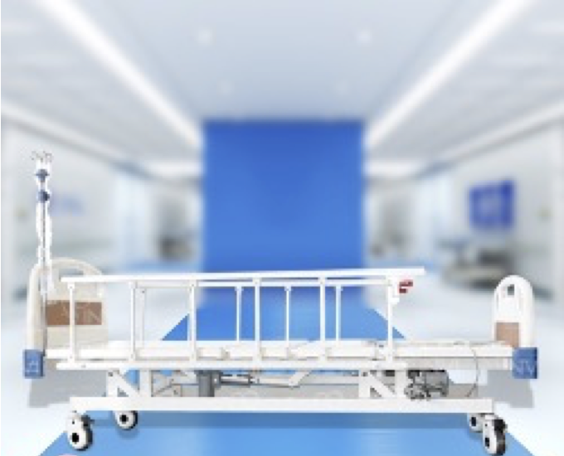
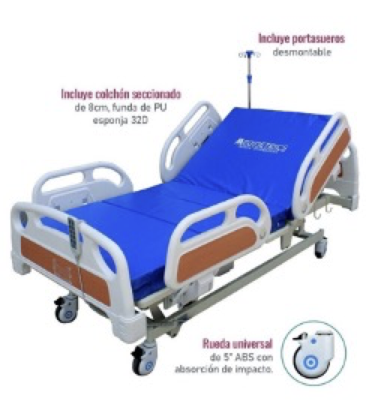
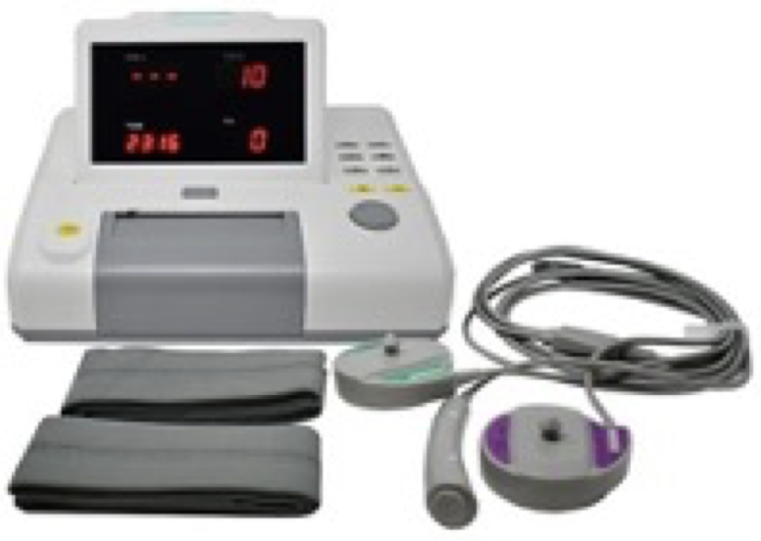
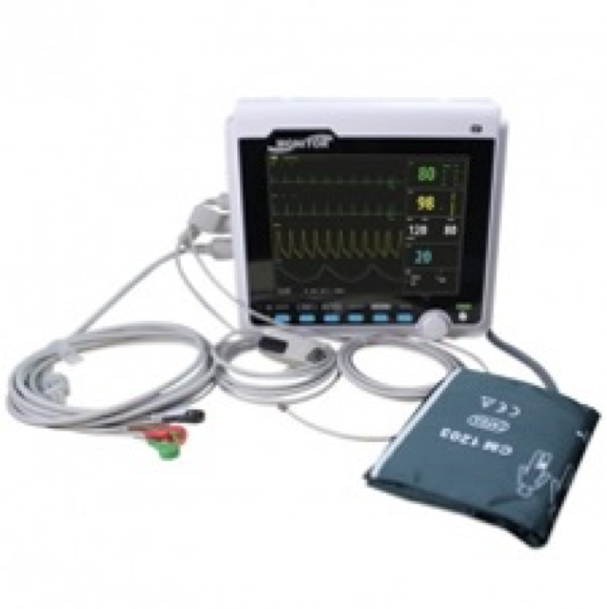
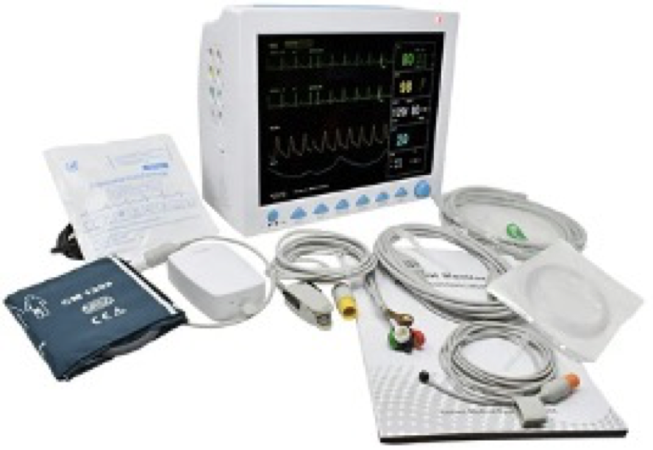
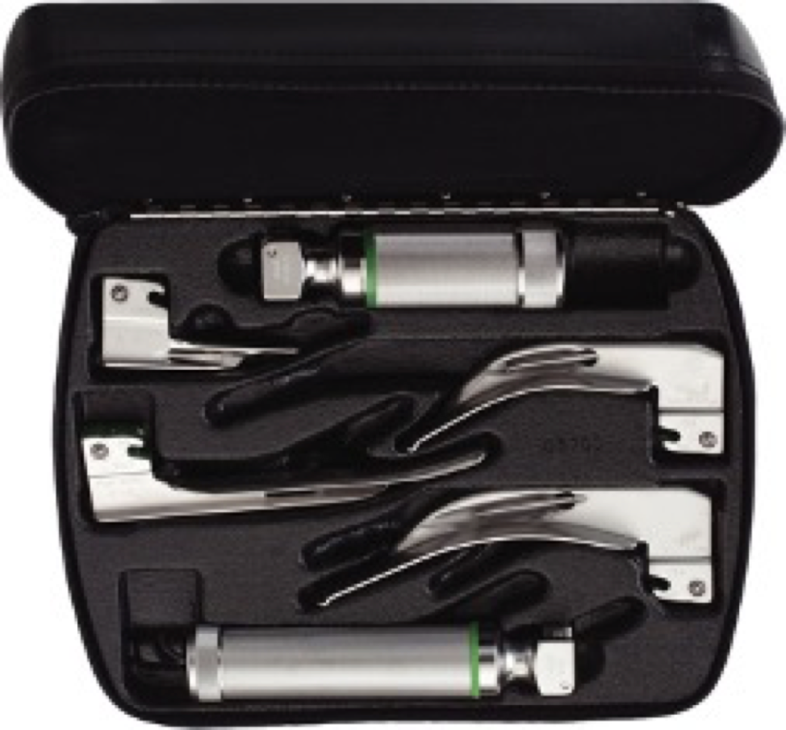
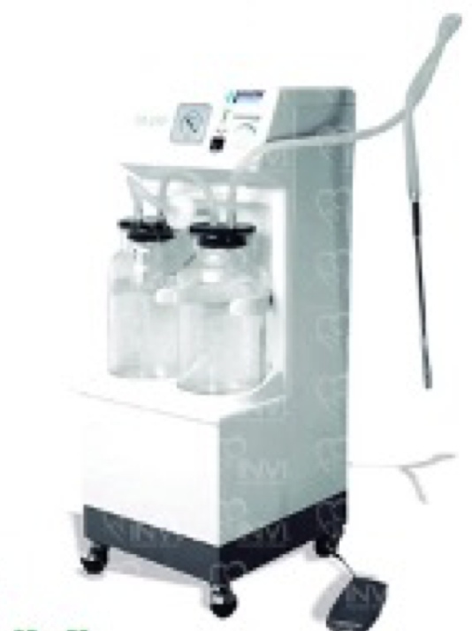
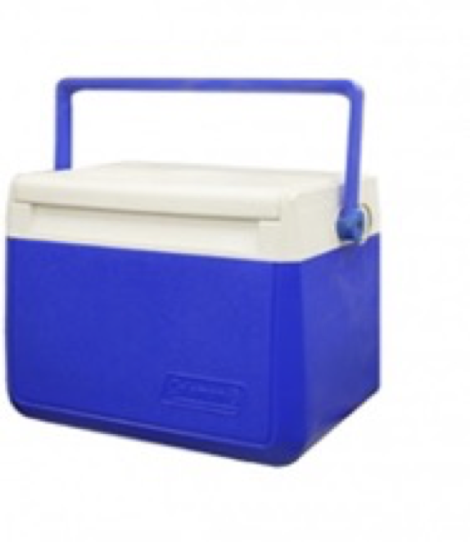
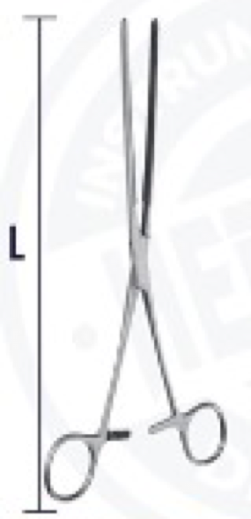
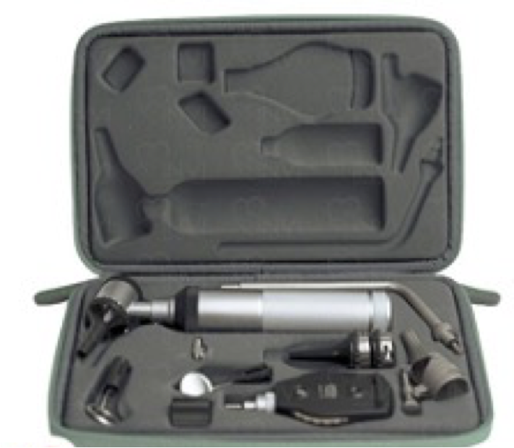
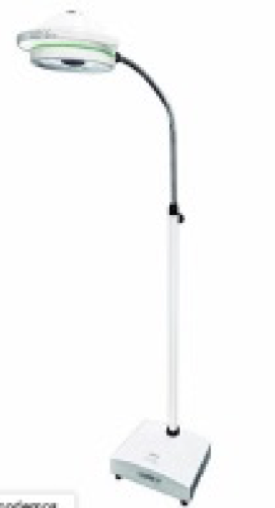
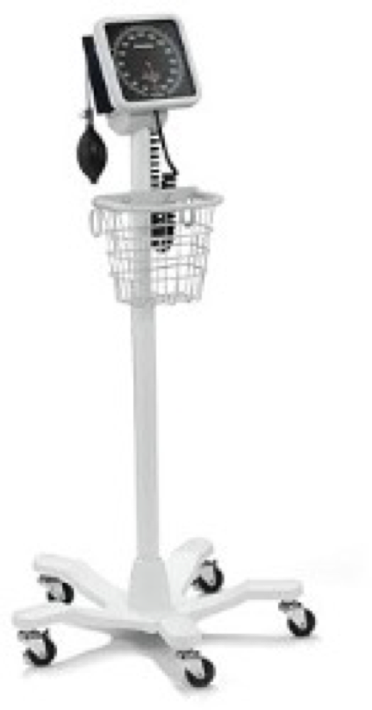
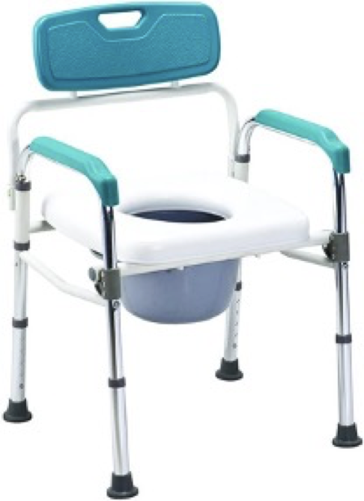
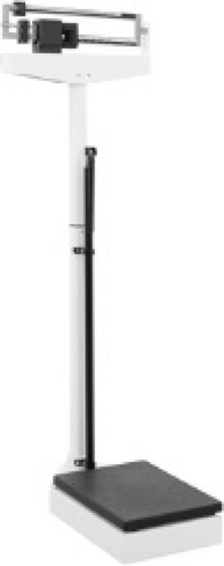
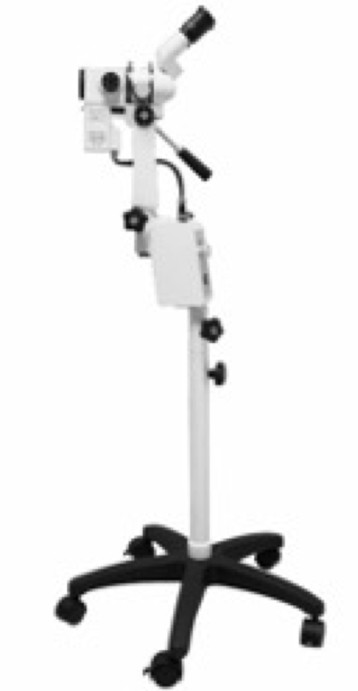
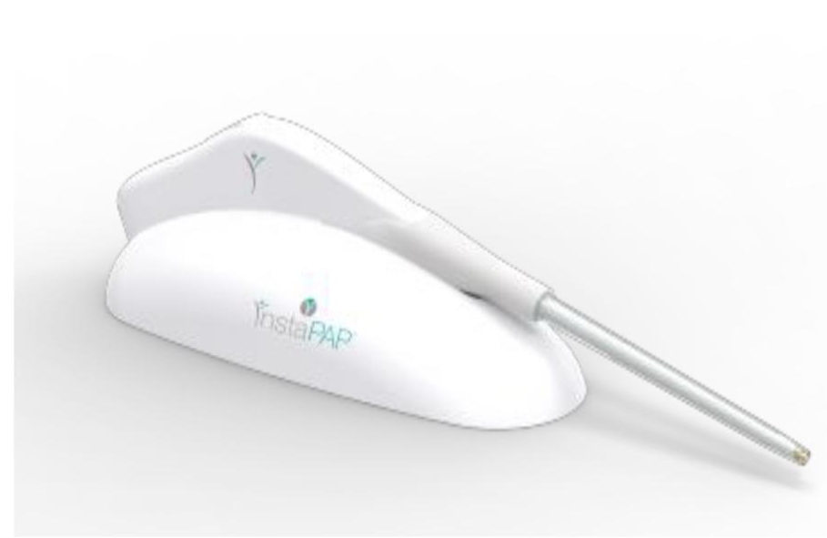
The project addresses the lack of basic medical equipment. With the new devices, critical cases will be treated more safely and efficiently.
Requested equipment:
Fetal monitor (1)
Adult vital signs monitor (2)
Pediatric vital signs monitor (1)
Laryngoscopy set (2)
Manual hospital bed with accessories (3)
Electric hospital bed (includes mattress) (1)
5-function electric hospital bed (1)
Surgical electric aspirator (2)
9L Coleman vaccine cooler (3)
Doyen intestinal forceps curved (4) and straight (4) 23 cm
Diagnostic set (2)
LED examination lamp (1)
Manual sphygmomanometer (2)
Mobicare chair/stool (2)
Clinical scale with stadiometer (3)
Colposcope (1)
HeraFem® device (1)

Slide 7
BUDGET AND FINANCING

Slide 8
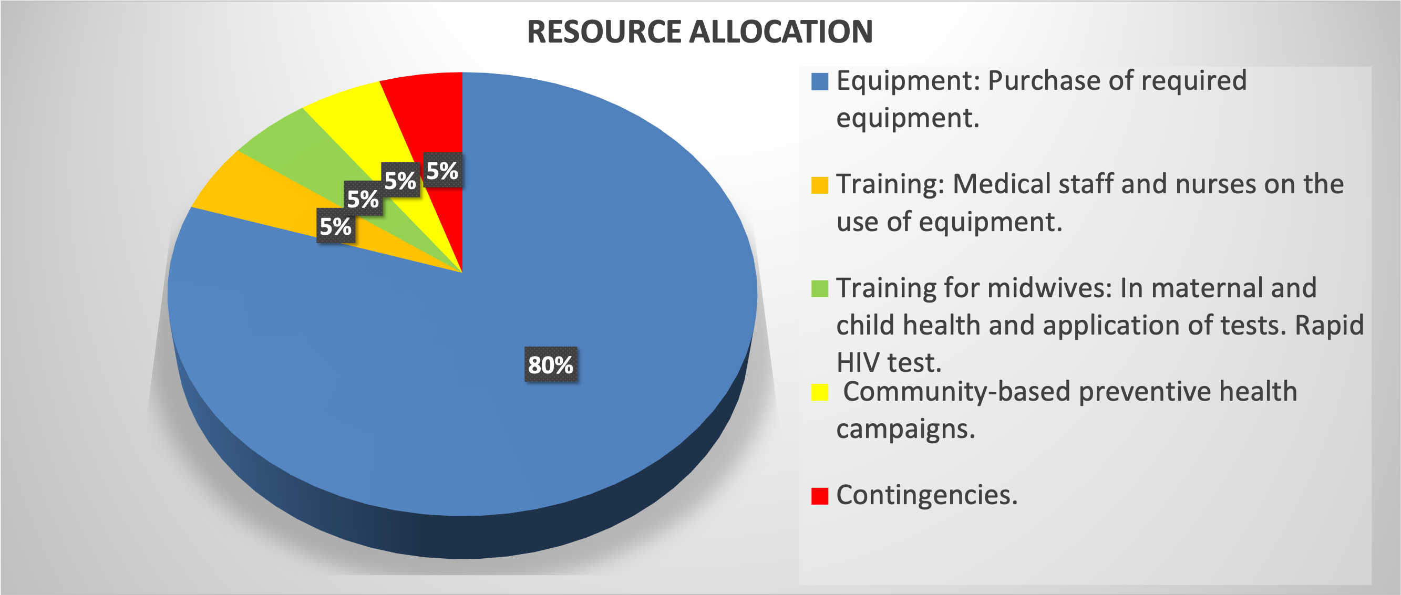
v
BUDGET AND FINANCING

Slide 9

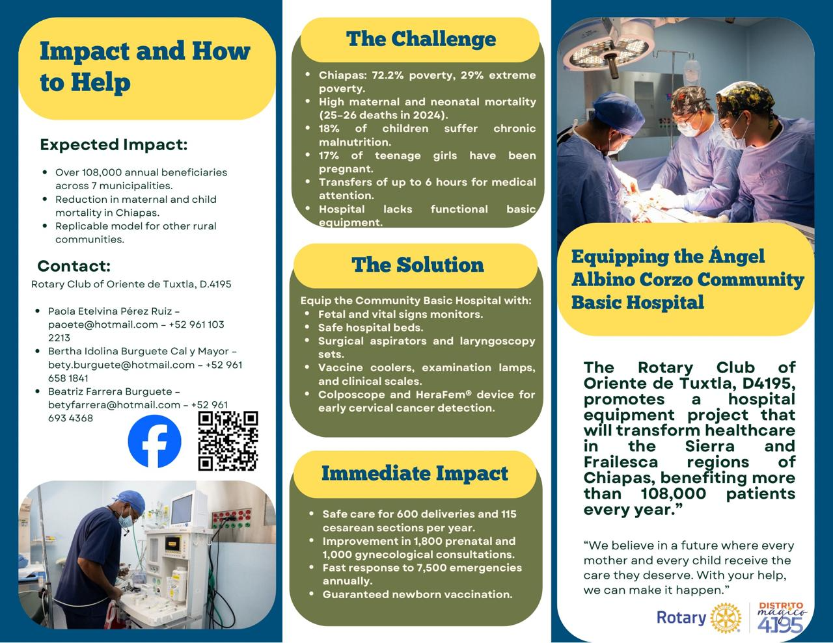

CONTACTS
"The Rotary Club East Tuxtla No. 24186 and the community of Ángel Albino Corzo thank you for your support in transforming lives, united to do good."
THANK YOU

