Slide 1
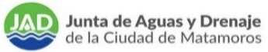
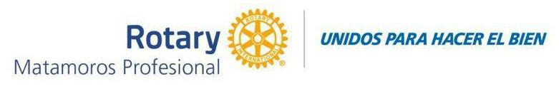
REHABILITATION OF CAST IRON DRINKING WATER PIPELINES TO PVC
FRANCISCO T. CANALES STREET AND LAURO VILLAR AVENUE, COLONIA MODELO

Slide 2
REHABILITATION OF CAST IRON DRINKING WATER PIPELINES TO PVC
FRANCISCO T. CANALES STREET AND LAURO VILLAR AVENUE, MODELO NEIGHBORHOOD
The drinking water distribution network of the City of H. Matamoros dates back to the 1950s. It originated at Water Treatment Plant No. 1 and extended to its service area.
It was originally constructed with cast iron pipes, and due to the high calcium and magnesium content in the water, scale buildup has reduced the hydraulic cross-sectional area of these pipes to nearly zero. Furthermore, there are constant leaks in these pipes, preventing users from receiving adequate service.
The low pressure at which the cast-iron network operates prevents users from enjoying a service that is currently available in these areas. Despite efforts made over time to renovate the water infrastructure, distribution networks originally installed with cast-iron pipes still remain in place today and must be replaced.

Slide 3
REHABILITATION OF CAST IRON DRINKING WATER NETWORKS TO PVC
FRANCISCO T. CANALES STREET AND LAURO VILLAR AVENUE, MODELO NEIGHBORHOOD
        Based on the foregoing, rehabilitation is required for the existing 4-inch-diameter cast iron (Fo. Fo.) pipelines on FRANCISCO T. CANALES / JUAREZ STREET AND AV. LAURO VILLAR and AV. LAURO VILLAR / FRANCISCO T. CANALES and ROBERTO F. GARCIA, COL. MODELO, with 4-inch-diameter PVC RD 21 pipe, to ensure the supply of this vital resource.
        Since the existing pipes have reached the end of their useful life and have caused low pressure in the system, as well as constant leaks, this has resulted in service interruptions for residents due to repairs and high operating costs.

Slide 4
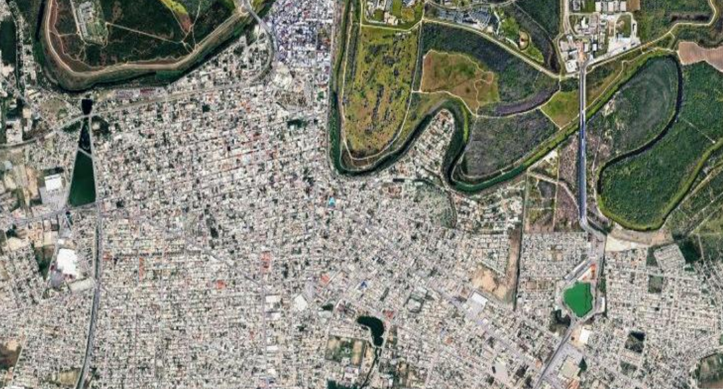

REPLACEMENT OF CAST IRON DRINKING WATER PIPES WITH PVC PIPES
FRANCISCO T. CANALES STREET AND LAURO VILLAR AVENUE, COL. MODELO
PROJECT LOCATION WITHIN THE CITY
USA
BROWNSVILLE, TX.
USA
BROWNSVILLE, TX.
JARDÍN NEIGHBORHOOD
COLONIA CENTRO
RIO BRAVO
H. MATAMOROS, TAM. MEXICO
COLONIA MODELO
4

Slide 5
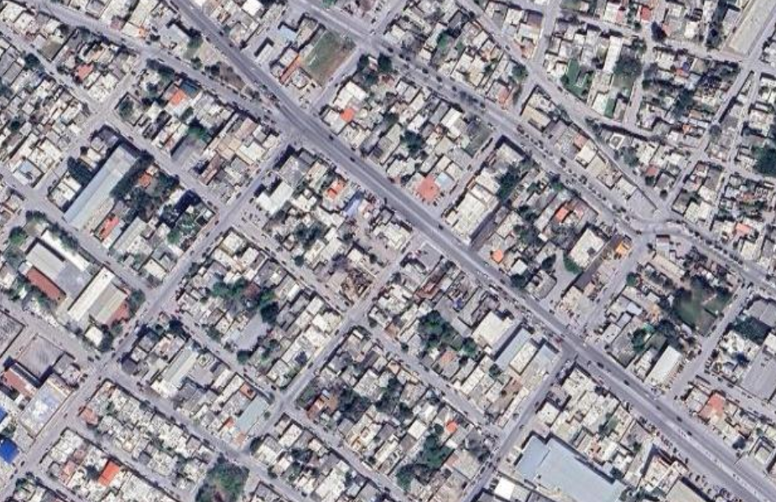
REPLACEMENT OF CAST IRON DRINKING WATER PIPES WITH PVC PIPES
FRANCISCO T. CANALES STREET AND LAURO VILLAR AVENUE, MODELO NEIGHBORHOOD
COLONIA MODELO
LAURO VILLAR AVENUE
ROBERTO F. GARCÍA STREET
LEANDRO VALLE STREET
FRANCISCO T. CANALES STREET
JUÁREZ STREET
SYMBOLS
LOCATION OF THE PROJECT FOR THE REHABILITATION OF THE 4-INCH DIAMETER DRINKING WATER NETWORK FROM Fo. Fo. TO PVC RD 21
OCAMPO STREET
5

Slide 6
REHABILITATION OF DRINKING WATER NETWORKS FROM CAST IRON TO PVC
FRANCISCO T. CANALES STREET AND LAURO VILLAR AVENUE, MODELO NEIGHBORHOOD
Location: Francisco T. Canales Street and Lauro Villar Avenue, Colonia Modelo.
Objectives: Rehabilitation of 344 ML of 4"∅ PVC RD 21 pipe, including the replacement of 27 service connections with 4" to 1/2" bronze clamps.
  Required investment: 774,000 pesos / 43,000.00 USD.
Beneficiaries: 550 residents directly.
6

Slide 7
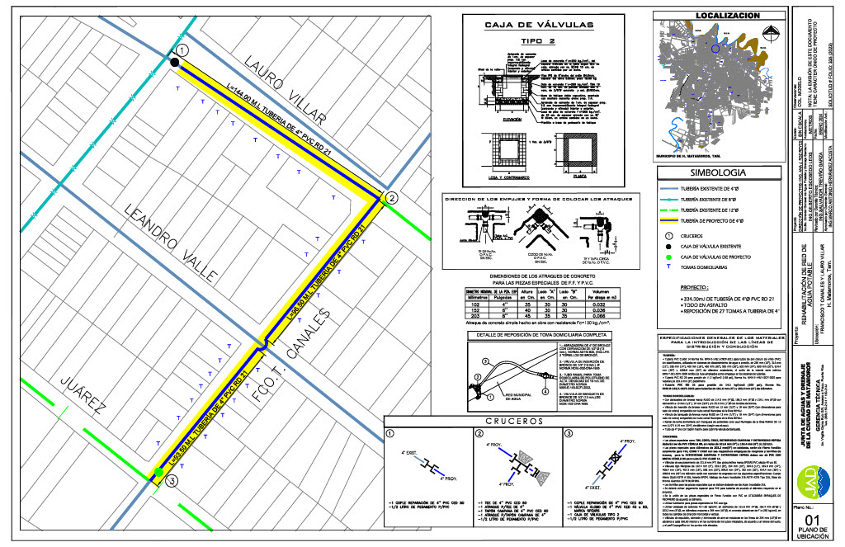
REHABILITATION OF DRINKING WATER PIPELINES FROM CAST IRON TO PVC
FRANCISCO T. CANALES STREET AND LAURO VILLAR AVENUE, MODELO NEIGHBORHOOD
7
7

Slide 8
REHABILITATION OF CAST IRON DRINKING WATER PIPELINES TO PVC
FRANCISCO T. CANALES STREET AND LAURO VILLAR AVENUE, COLONIA MODELO

